Slide 1
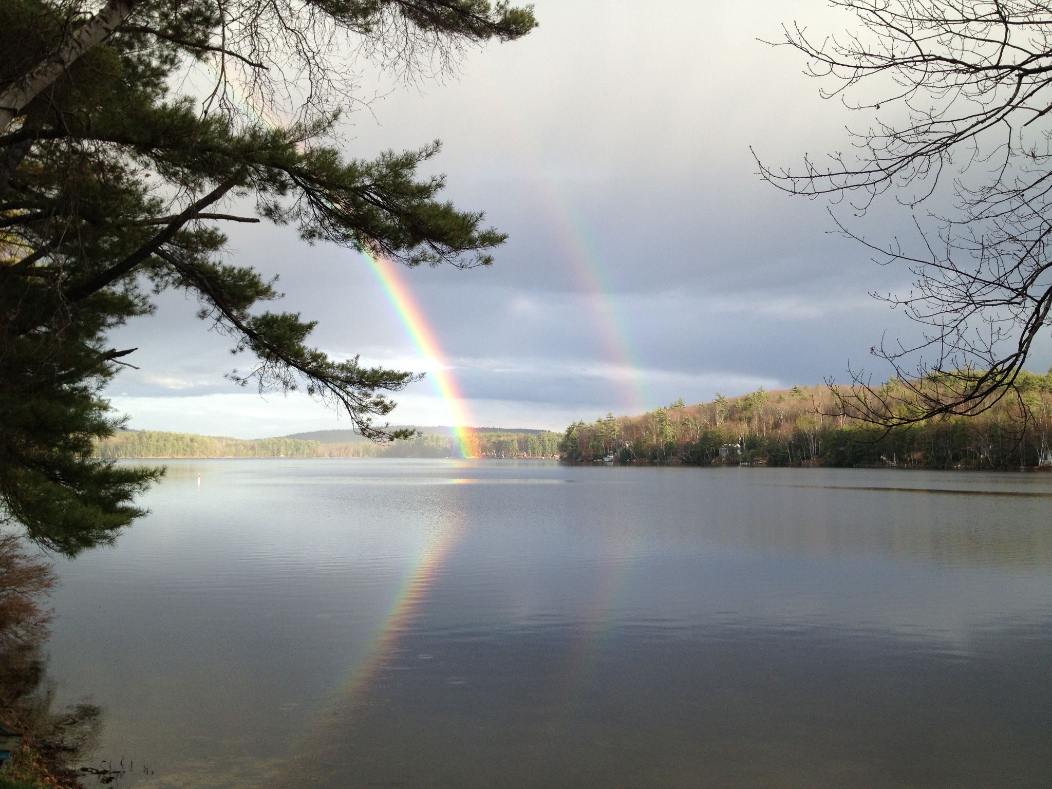
Water Quality Trends
Mirror Lake

Slide 2
