Slide 1
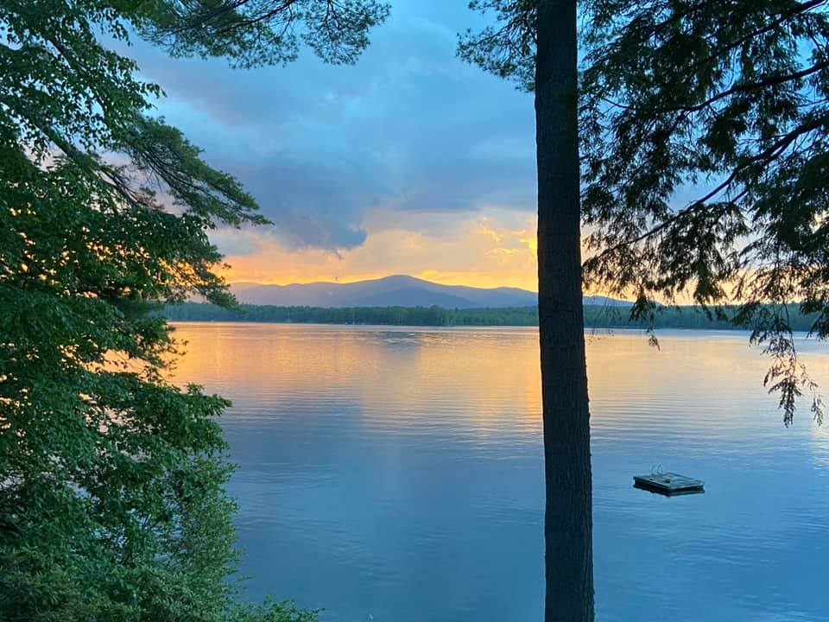
Mirror Lake Protective Association
Annual Meeting: July 23, 2022
Notes:
Welcome and thank people for their support of the MLPA. Special thanks to all who have sent in membership. Membership envelopes are available if you need one. Steve Scapicchio has a record if you need to be reminded whether or not you joined.

Slide 2
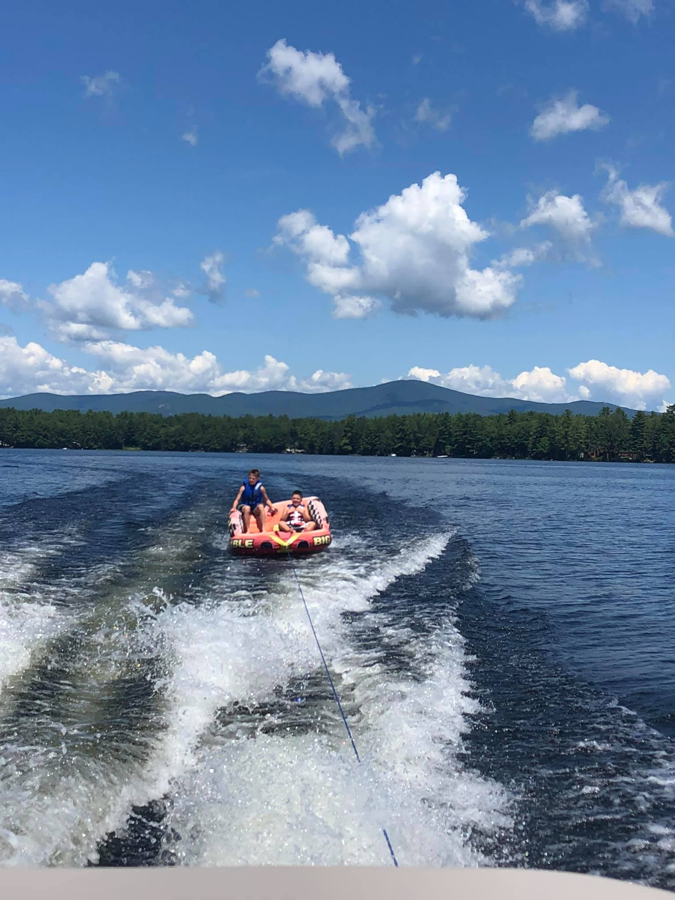
Agenda
Welcome
Approve minutes
Treasurer’s Report
Nominations
Standing Committee Reports
Long Range Planning
Old & New Business
  Resolutions
Adjourn
Notes:
Quick look. Our meeting will end by 10:00am

Slide 3
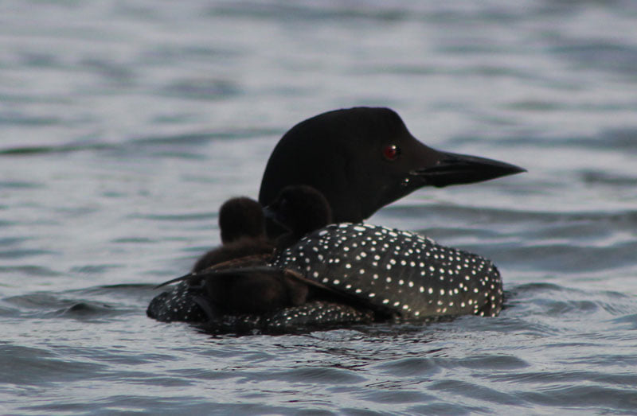
Minutes of the 2020 Annual Meeting
Fran O’Donoghue, Secretary
Notes:
Motion to accept the minutes included in the mailing from last year. These have already been reviewed in detail by three board members
Second
Discussion
Yea/nay/abstain

Slide 4
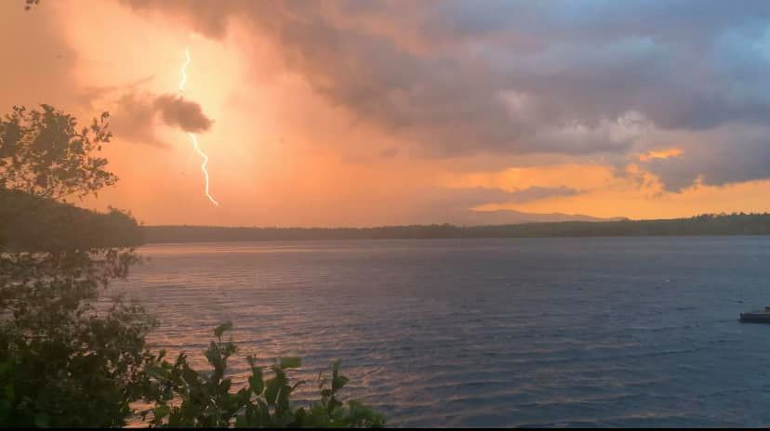
Treasurer’s Report
Robin Muench, Treasurer
Notes:
Robin will review the financial situation

Slide 6

Nominations
Nominating Committee: Gene Kelley, John Dawson
Mirror Lake Protective Association Officers
MLPA Officers serve for one year
President: Kathy Sciarappa Nominated 2022
Vice President: Val Zanchuk Nominated 2022
Treasurer: Robin Muench Nominated 2022
Secretary: Fran O’Donoghue Nominated 2022
Mirror Lake Protective Association Board of Directors
MLPA Board of Directors serve for three years
Larry Gil (term expires 2023)
Dusty Davies (term expires 2023)
Steve Scapicchio (term expires 2022)
Gene Kelley (term expires 2022)
Steve Cloutier (term expires2024)
Ann Torregrossa (term expires 2024)
Notes:
This is the slate of officers and directors. Officers are elected annually; directors serve for three year terms. Both Steve Scapicchio and Gene Kelley would like to retain their positions and are running for office. Are there any nominations from the floor in addition to Steve and Gene?
Move to accept the slate of officers as presented?
Second?
Discussion
Yea/nay/abstain

Slide 7
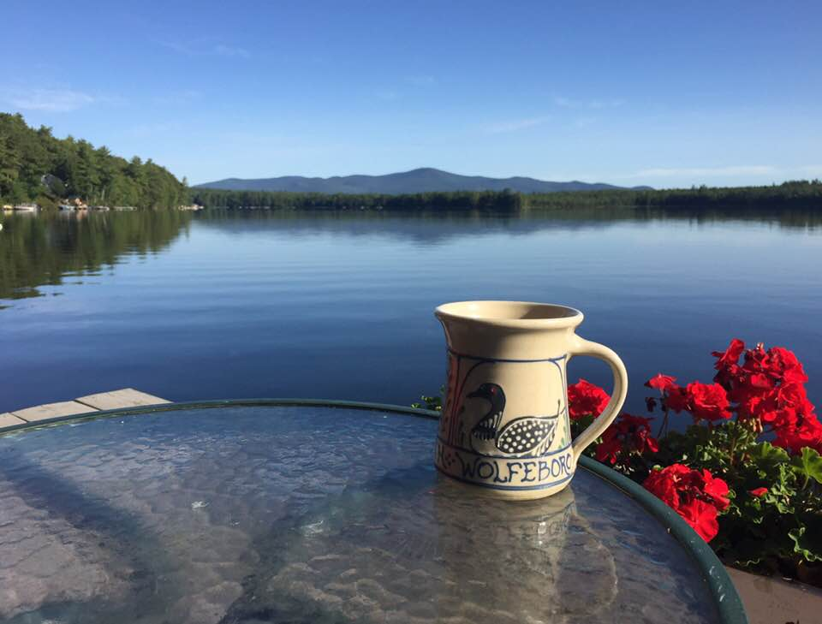
Aquatic Plant Monitoring Program
“Weed Watchers”
2022 Team
  Norma Milne, Chair
  Tiina Urv
  Glenda Philbin
  Alan Hardiman
  Jeanne Freeze
  Claudia and Tom Bissett
New Initiatives
  Weed watchers are now using grabbing tools (funded by MLPA) to assist with removal of debris from the lake.
  We are beginning to photo-document aquatic plant growth by areas covered by the team. It is our intent to create a baseline, by month and area, for future reference.
Notes:
Norma will report

Slide 8
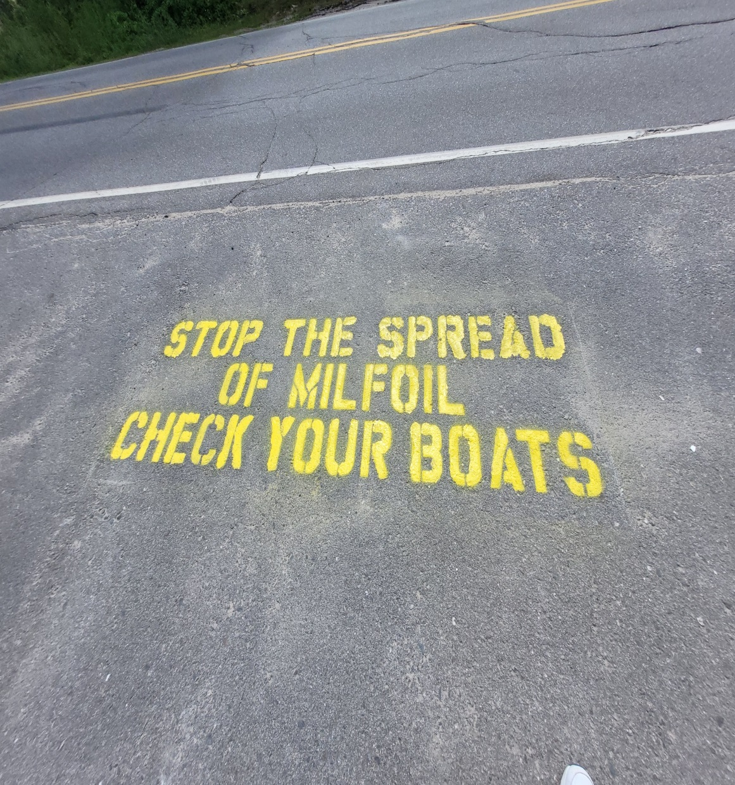
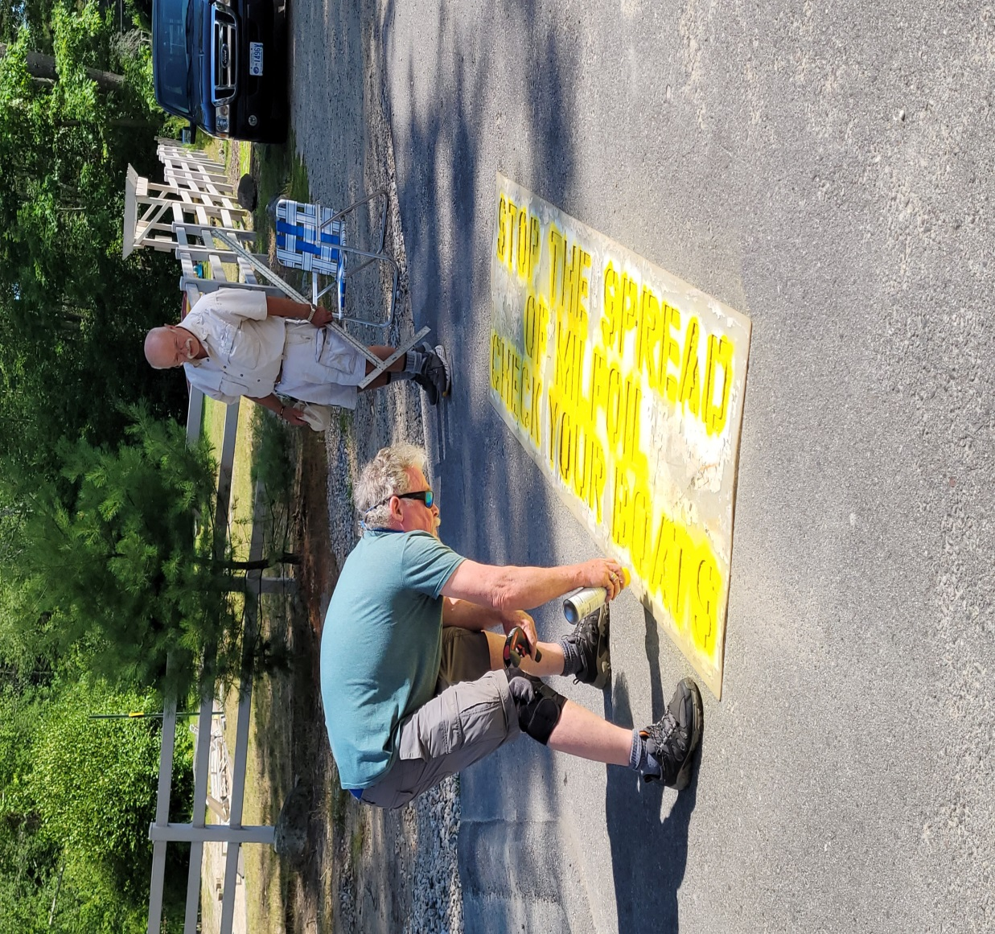
NH Lake Hosts
Notes:
Thank you Al Hardiman (painter!) and Larry Gil for adding one more layer of protection to the boat ramp. This message may also been seen at the Town Docks boat ramps and we thank the Wolfeboro Highway Department (Jim) for the use of their stencil.

Slide 9
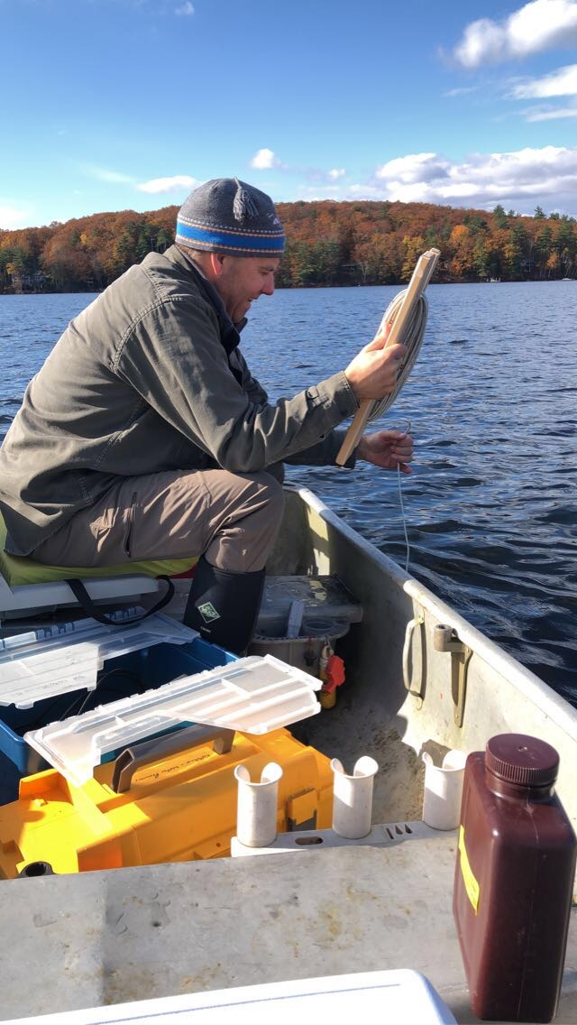
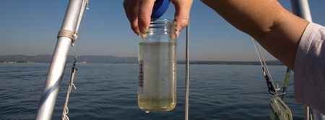
Water Quality
Highlights: UNH & NHDES Reports
Notes:
Don Kretchmer has continued year-round water testing but we now have a reliable team of our own residents comprised of
Larry Gil
Steve Scapicchio
Tom Bissett
Al Hardiman
Steve Cloutier
Fran O’Donoghue
Val Zanchuk

Slide 10
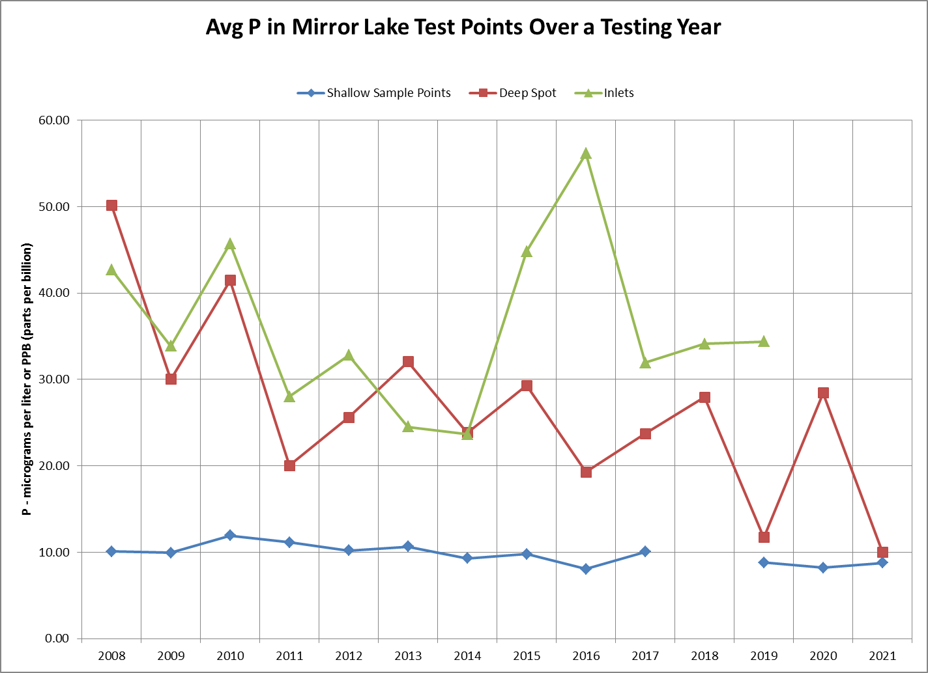

Slide 14
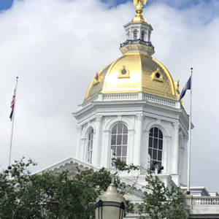
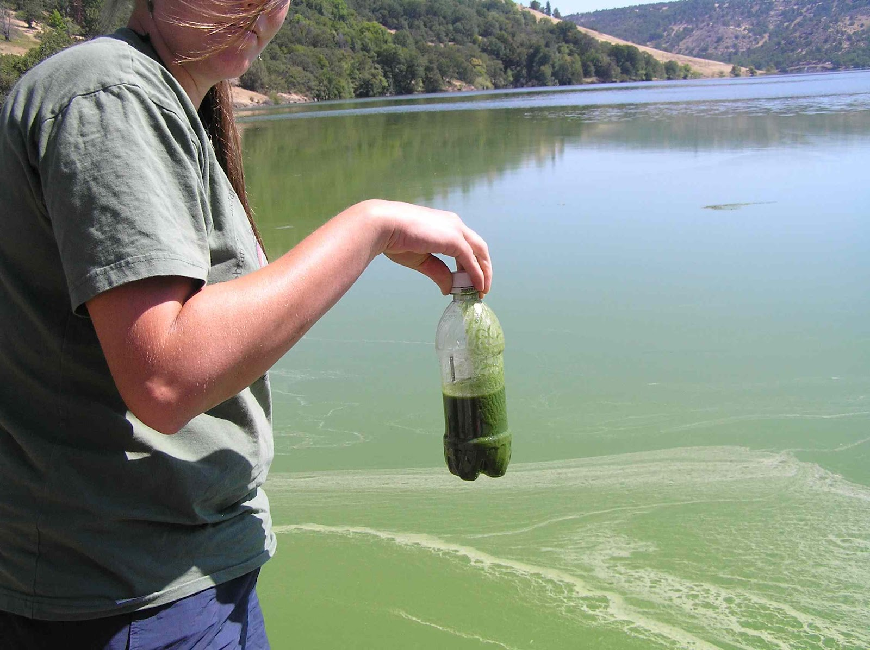
NH Cyanobacteria Legislation
Notes:
1/7/22 A letter of support was sent for HB 1066 with the original purpose of establishing a commission to investigate and analyze the environmental and human and animal health impacts relating to cyanobacteria blooms in New Hampshire water bodies. It would be the first time that experts from the NH Department of Environmental Services (NHDES), the NH Department of Health and Human Services (NHHS), environmental conservation groups, veterinarians, universities, and policy makers would come together to address cyanobacteria in NH and recommend ways to mitigate its threat. The bill was amended to add $30,000 for the purpose of NHDES preparimg a plan to address cyanobacteria. 7/1/22 Passed and signed by the governor.
2/8/22 A second letter of support for HB 1071 was sent from MLPA to the House Resources, Recreation and Development Committee regarding the need for protection from unnecessary wakes created by wave surfing vehicles by requiring a distance of 250 ft. from shore rather than the current 150 ft. This bill was voted “inexpedient to legislate.”

Slide 15
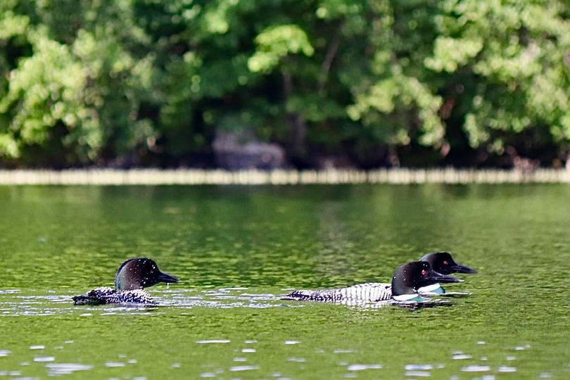
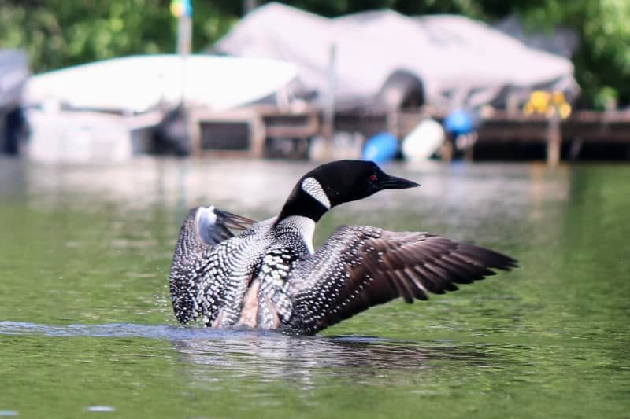
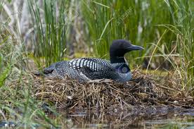
Loon Update
Beth Urda
Notes:
Beth will report. The renegade loon(s) interfered with the nesting couple; eggs were abandoned and deemed not viable; NH Loon Preservation Committee removed the eggs for study

Slide 16
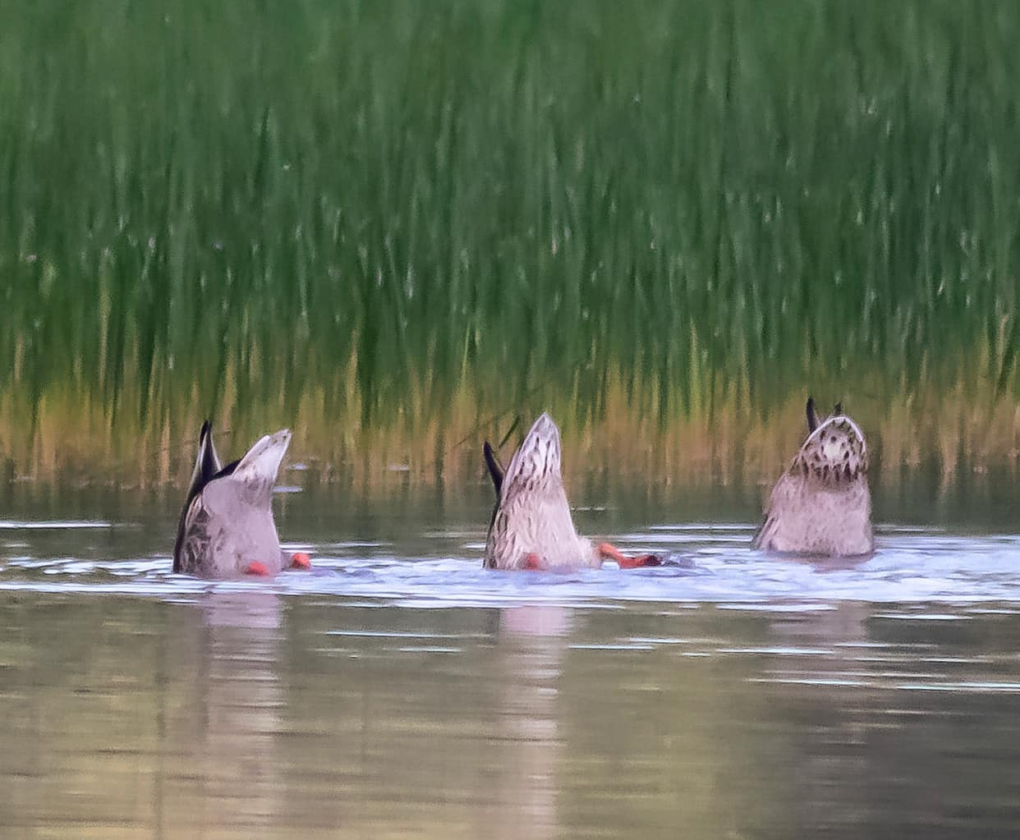
Land Conservation Committee
Ann Torregrossa
Notes:
Major purchase done of land around the one and only outlet to Mirror Lake. Completed by the Tuftonboro Conservation Commission Steve Scapicchio, Chair (Larry Gil Member) Not large in terms of acreage but critical in terms of importance to the ecology of the lake.
Six parcels of land were identified and ranked in the Rick Van de Poll Rapid Ecological Assessment study in terms of conservation importance and impact. One property owner is nearing completion of converting acreage to conservation land; other property owners have been contacted and are at various levels of moving towards land conservation or not.

Slide 17
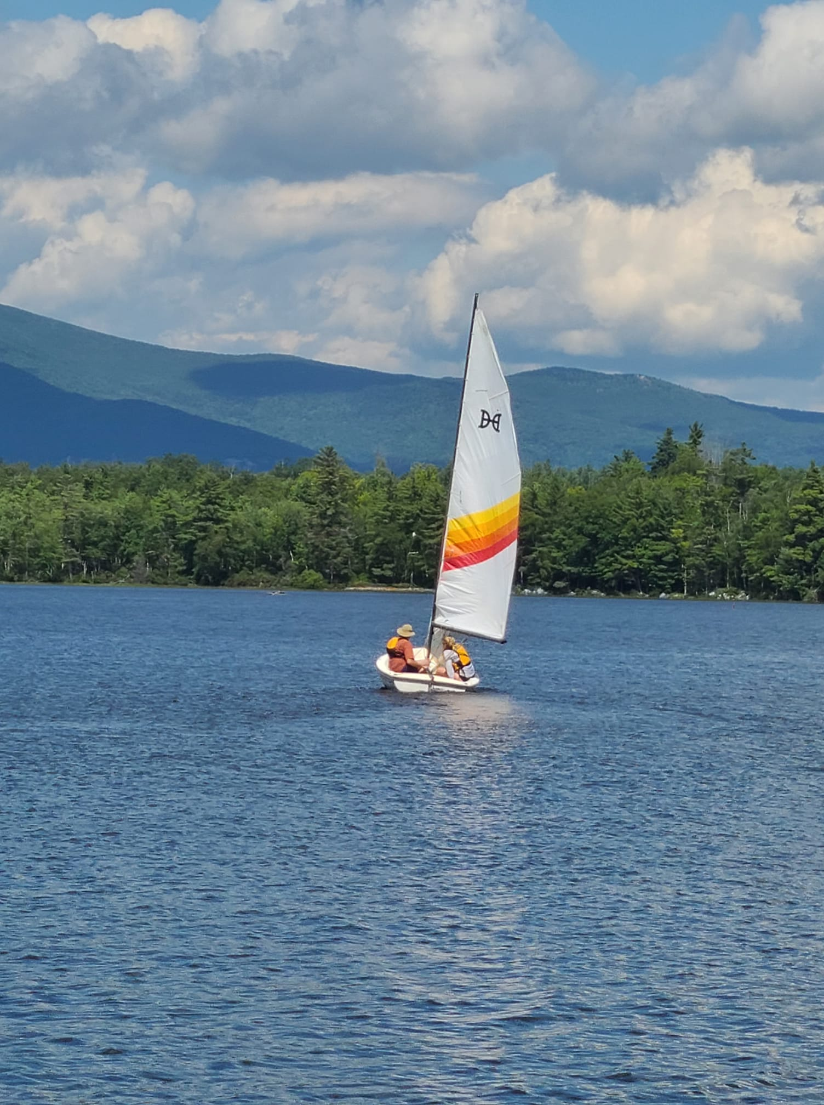
MLPA Strategic Plan
  GUIDED BY:
  Sciarappa Entry Plan interviews
  Wolfeboro Water Summit
  Lakes Congress
  Geosyntec Mirror Lake Water Management Plan (Bob Hartzel)
  Rapid Ecological Assessment
  (Rick Van de Poll)
  UNH Extension/NHDES reports
Notes:
A strategic plan to guide the work of the MLPA is underway.
Kathy Sciarappa has interviewed all MLPA board members; some key officials in Wolfeboro and Tuftonboro; and lake leaders for Lake Wentworth; Lake Winnipesaukee and NH Lakes to gather ideas for strengthening the two areas of focus: 1) clean water; 2) land conservation. Reports specific to Mirror Lake and annual conference attendance are quite helpful.

Slide 18
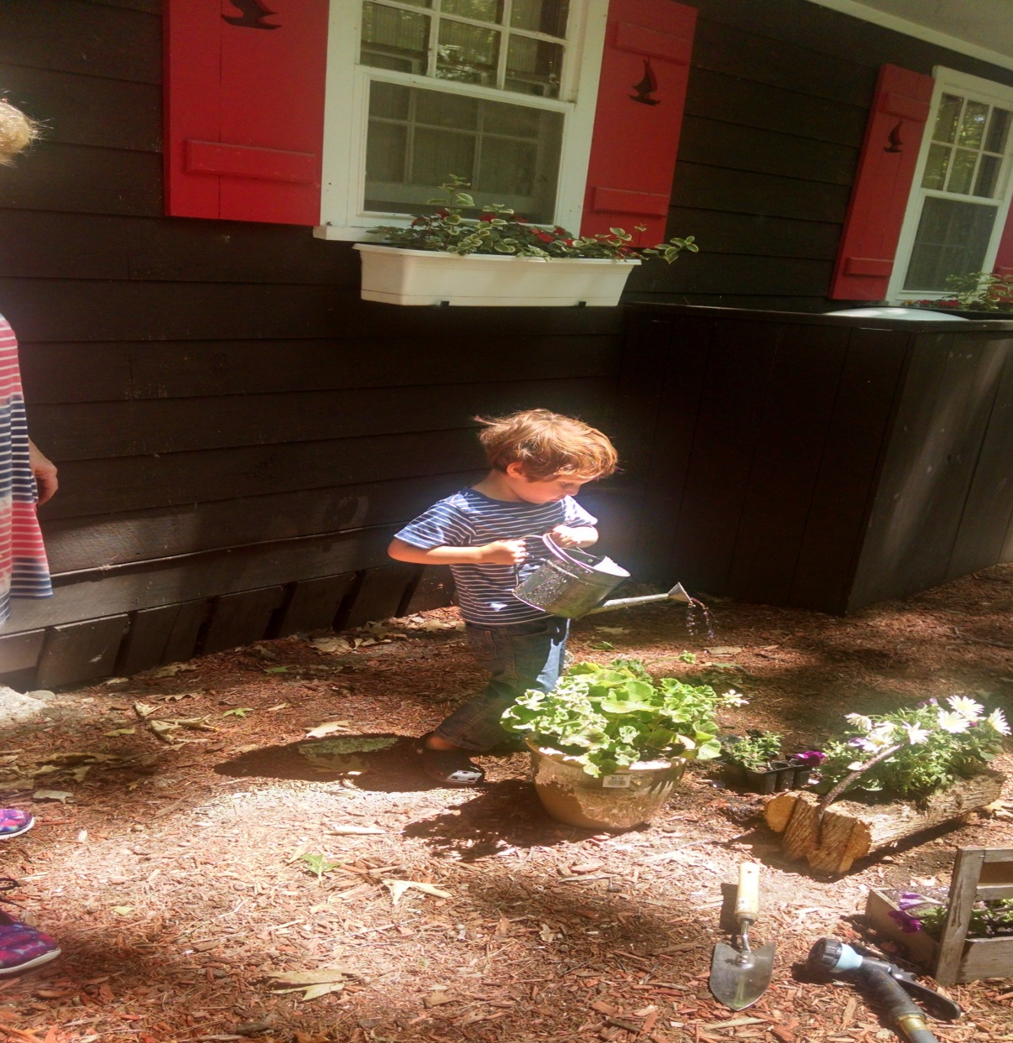
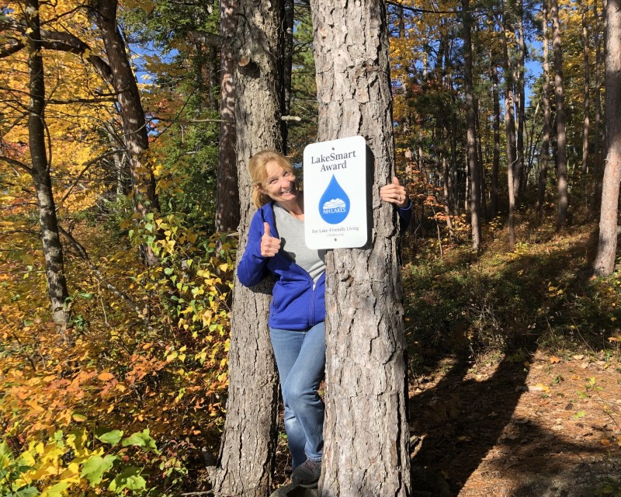
LakeSmart
Notes:
The health of Mirror Lake is dependent on property owners. But sometimes, we don’t know exactly what to do to be helpful. LakeSmart is a process to help property owners increase lake friendly practices. Everyone here today will be given a letter with details. The first step of the process is a self-assessment. Kathy Sciarappa has gone through the self assessment and visit. People can take the self-assessment without the visit. Her final report should be ready in three weeks.
She was already told that the left section of her leach field is starting to erode, something she had not noticed. She was also offered a simple solution of transplanting ferns from her woods to shore it up. Simple! The self-assessment alone is very helpful in identifying best practices in four areas: 1) Inside the home; 2) outside the home; 3) along the shoreline and on the water; and 4) in driveways and parking areas.

Slide 19
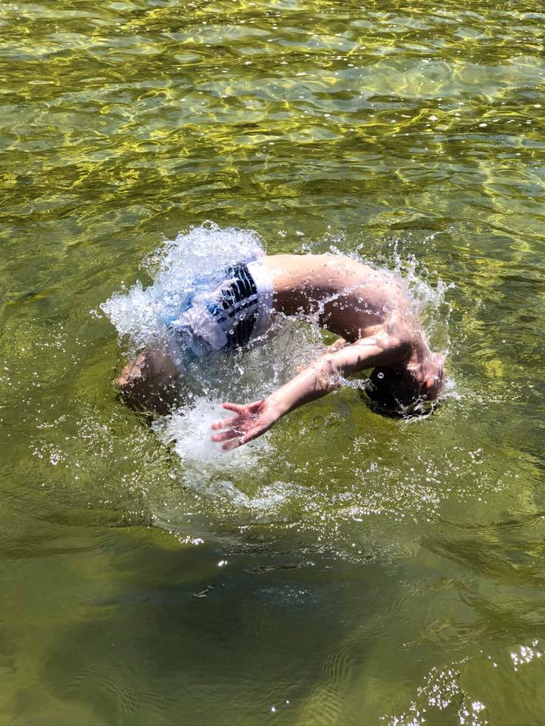
Watershed Management Plan
Notes:
The most critical piece of the strategic plan will be a new Water Management Plan which will likely direct us for the next ten years. This year we will concentrate on applying for grants to help pay for the preparation of a new plan. The original Geosyntec plan was written in 2012 and we have completed all the recommendations except one. We do not (yet) have any community septic systems.
The town of Tuftonboro has been very helpful and generous, especially with warrant articles, to help us complete the plan. Our thanks to the Selectmen and town!

Slide 20
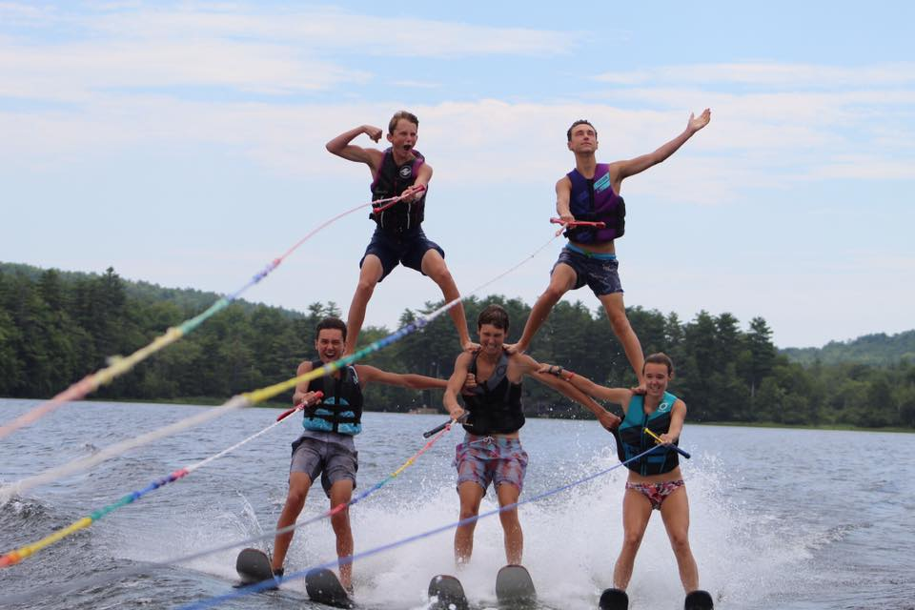
Membership Goal: 100
Current: 54 (still coming in)
Notes:
We have about 100 homes on the shoreline of lake, but MLPA is also comprised of homeowners in Tier II, Tier III and the watershed as a whole. Some members are incredibly generous and we would like to thank everyone who has joined the organization with special thanks to those who have been so generous. You’re inspirational!

Slide 21
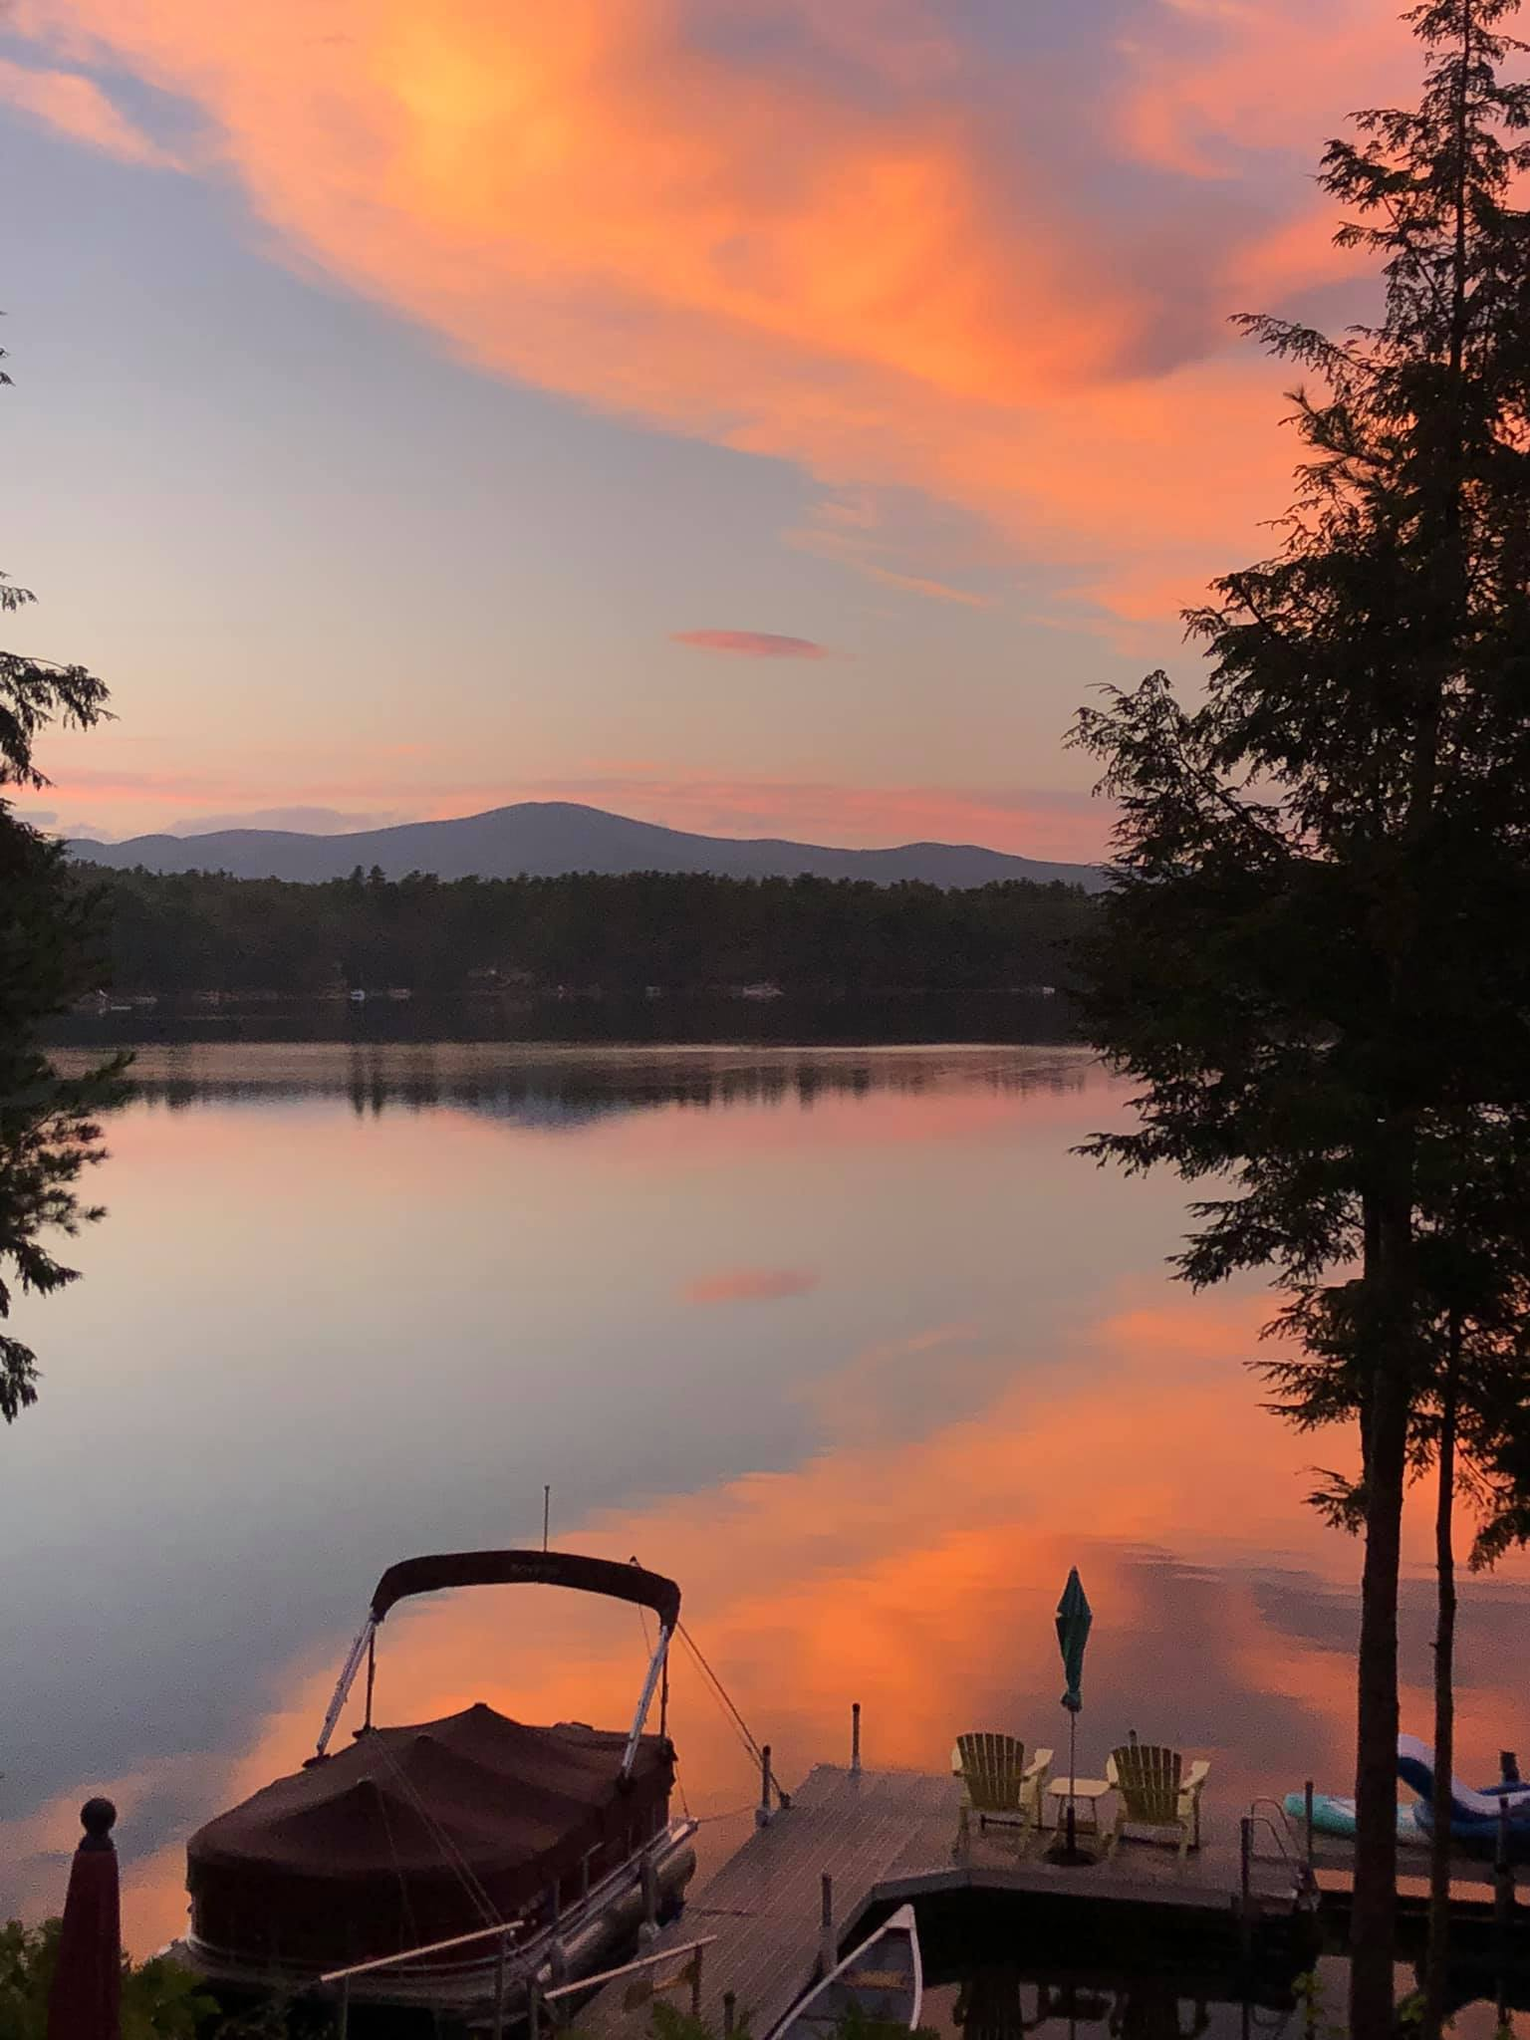
How to Help
MLPA Areas of Focus
    Clean water
    Land conservation
Support Needed
Membership
Financial Guidance
Community Engagement Event(s)
Website upgrade/communication
Notes:
Membership contributions are very helpful but active participation is the heart of any organization. The Entry Plan interviews revealed two areas of focus and four areas of need. Please consider donating some of your precious time to MLPA. There are jobs that can be done in an hour per month. Lakes Hosts and Weed Watchers are always welcome but the four areas of need are:
Membership: to keep addresses and names current
Financial guidance: to help monitor our financial future
Community Engagement: to sponsor one event such as a kayak race; a dog meet up; a cocktail party; Casino Night; a hike; a musical event etc. Or any other way to enhance community.
Website upgrade/communication: to enhance/redesign our website; create a blog relating healthy lake information; a newsletter…anything that will help keep our community informed
Contact Kathy Sciarappa kathleensciarappa@gmail.com

Slide 22
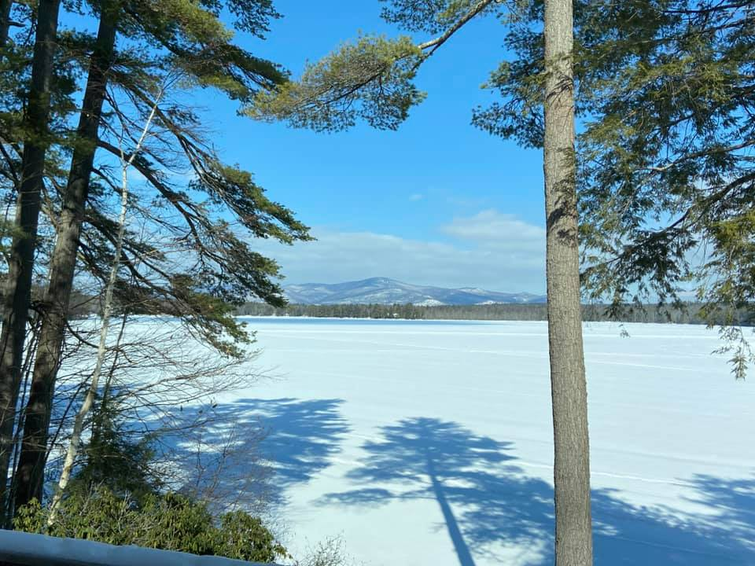
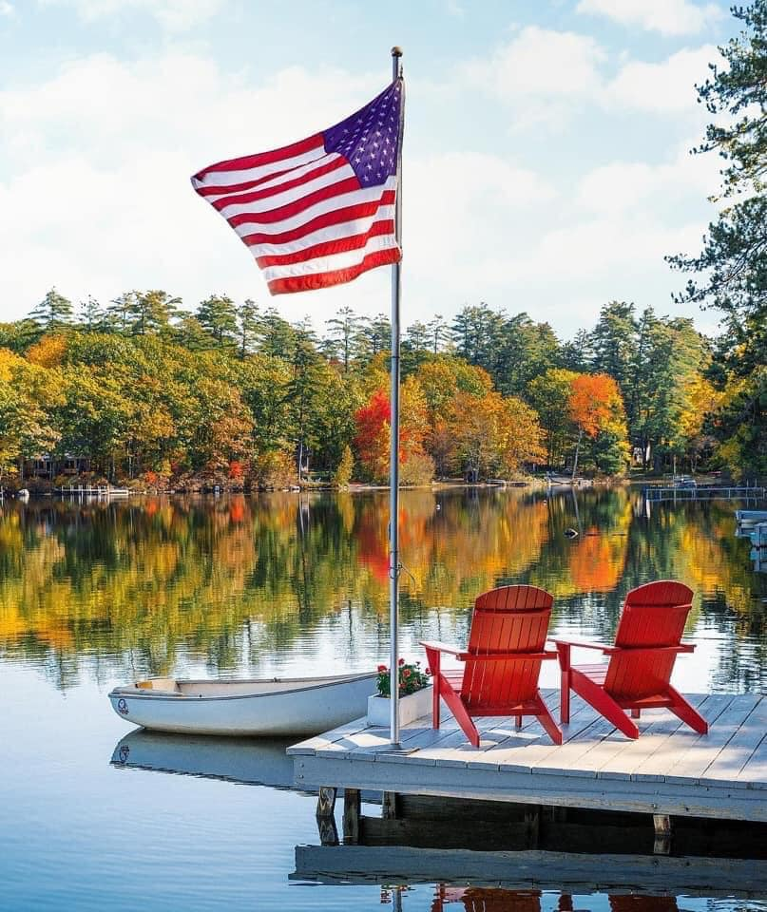
Open Discussion
New Business
Old Business

Slide 23
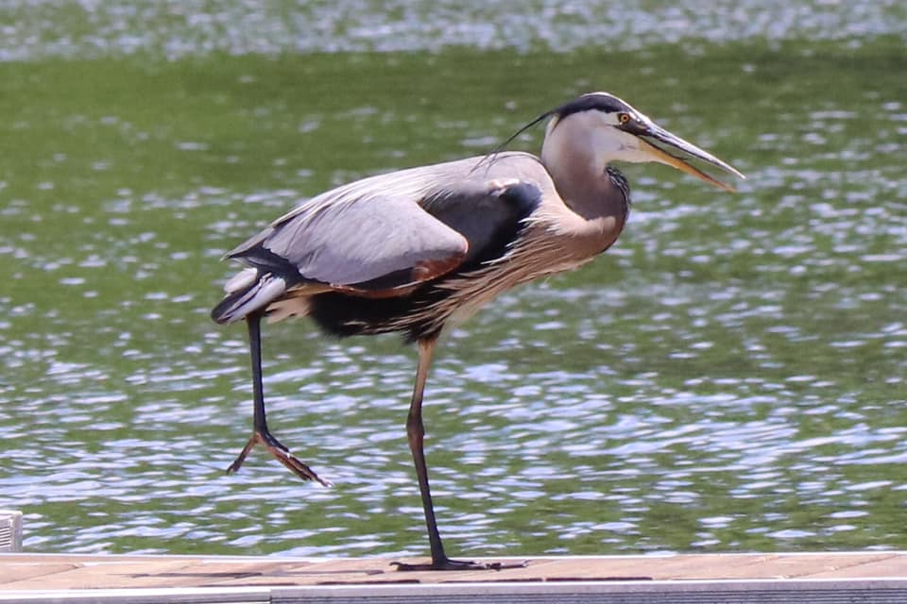
Resolutions
Notes:
You received 3 resolutions that the board worked on over the winter in the letter sent by mail.
Revised Mission Statement
Allow the board to expend in excess of $2000 as needed to protect the interests of the organization (i.e. to hire a consultant)
Creation of a Finance Committee
Motion
2nd
Discussion
Yea/nay/abstain

Slide 24
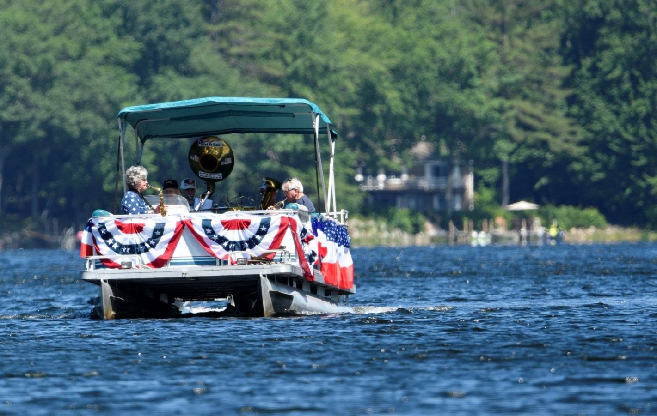
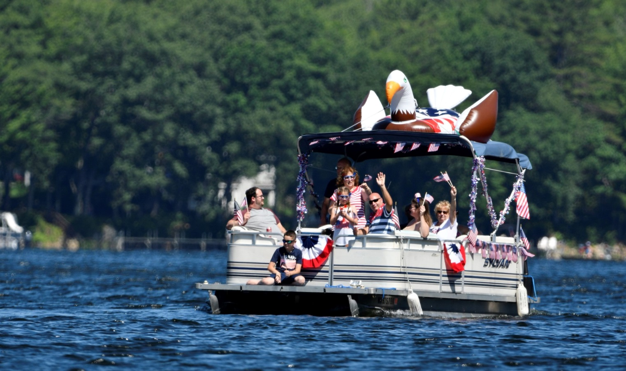
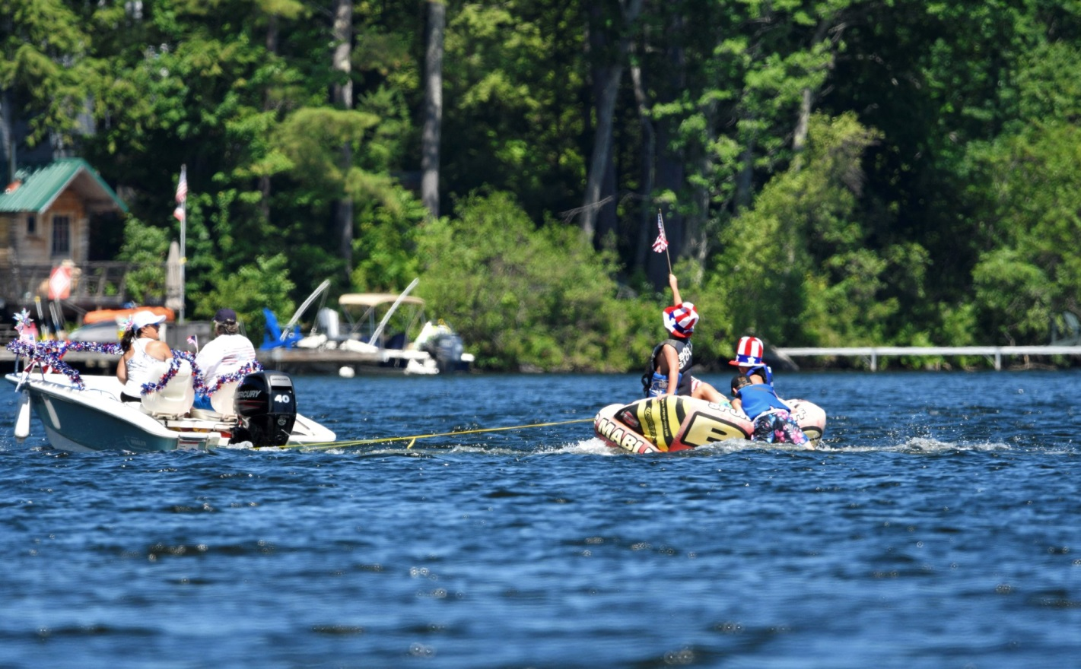
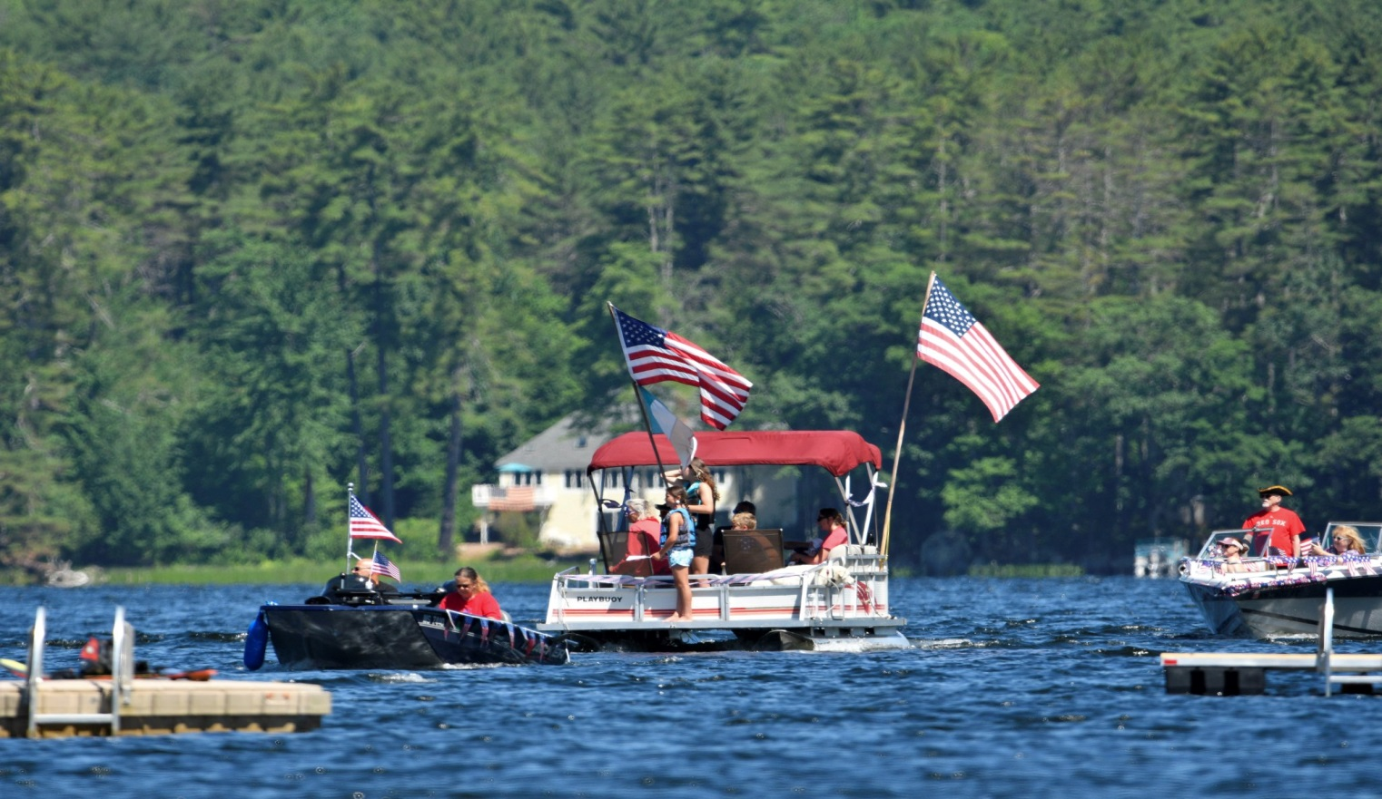
Thank you, Beth Argeros
Notes:
We had a great July 4th boat parade this year with excellent participation! Thanks to all of you who showed up either as onshore audience or parade participants. Special thanks to our superb MLPA Patriotic Band. Next year: We need a sound system!

Slide 25
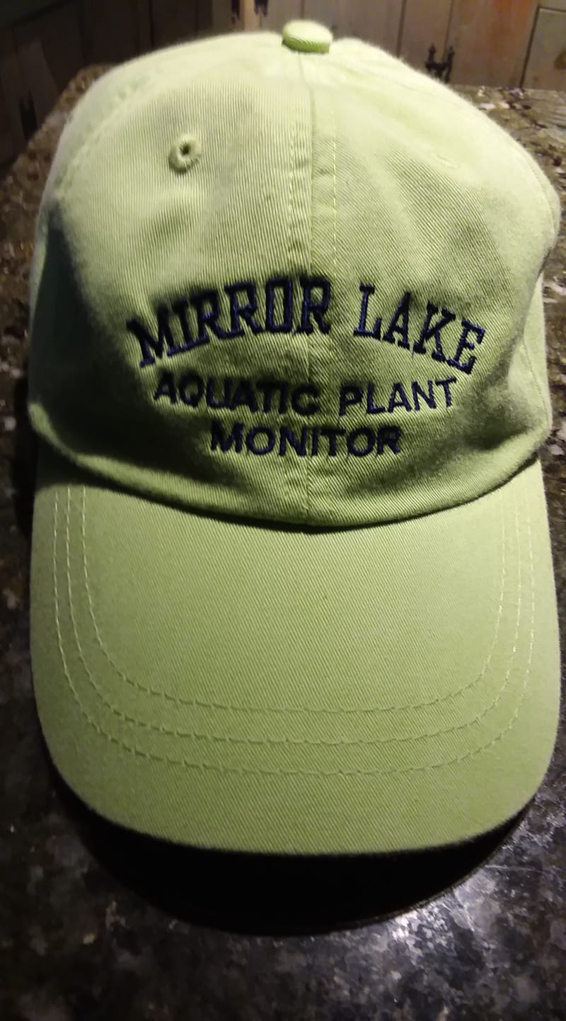
MLPA Bling
Ginny Cole
PO Box 374
Mirror Lake, NH 03853
Notes:
MLPA is making hats, shirts, sweatshirts, vests, towels and tank tops available for purchase. Emails were sent to all. If you would like to add your email to our list, a paper is being passed around

Slide 26
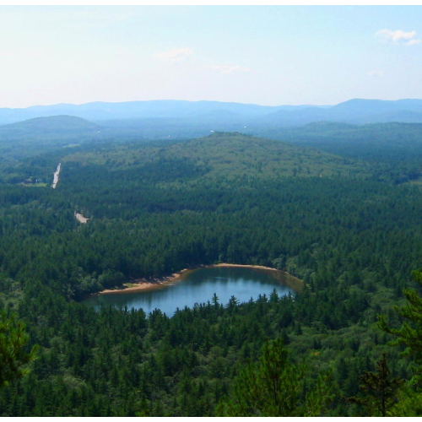
Thank You for Protecting Mirror Lake!
Notes:
Thank you, all. (Hopefully the 10am deadline was met)

