Slide 1
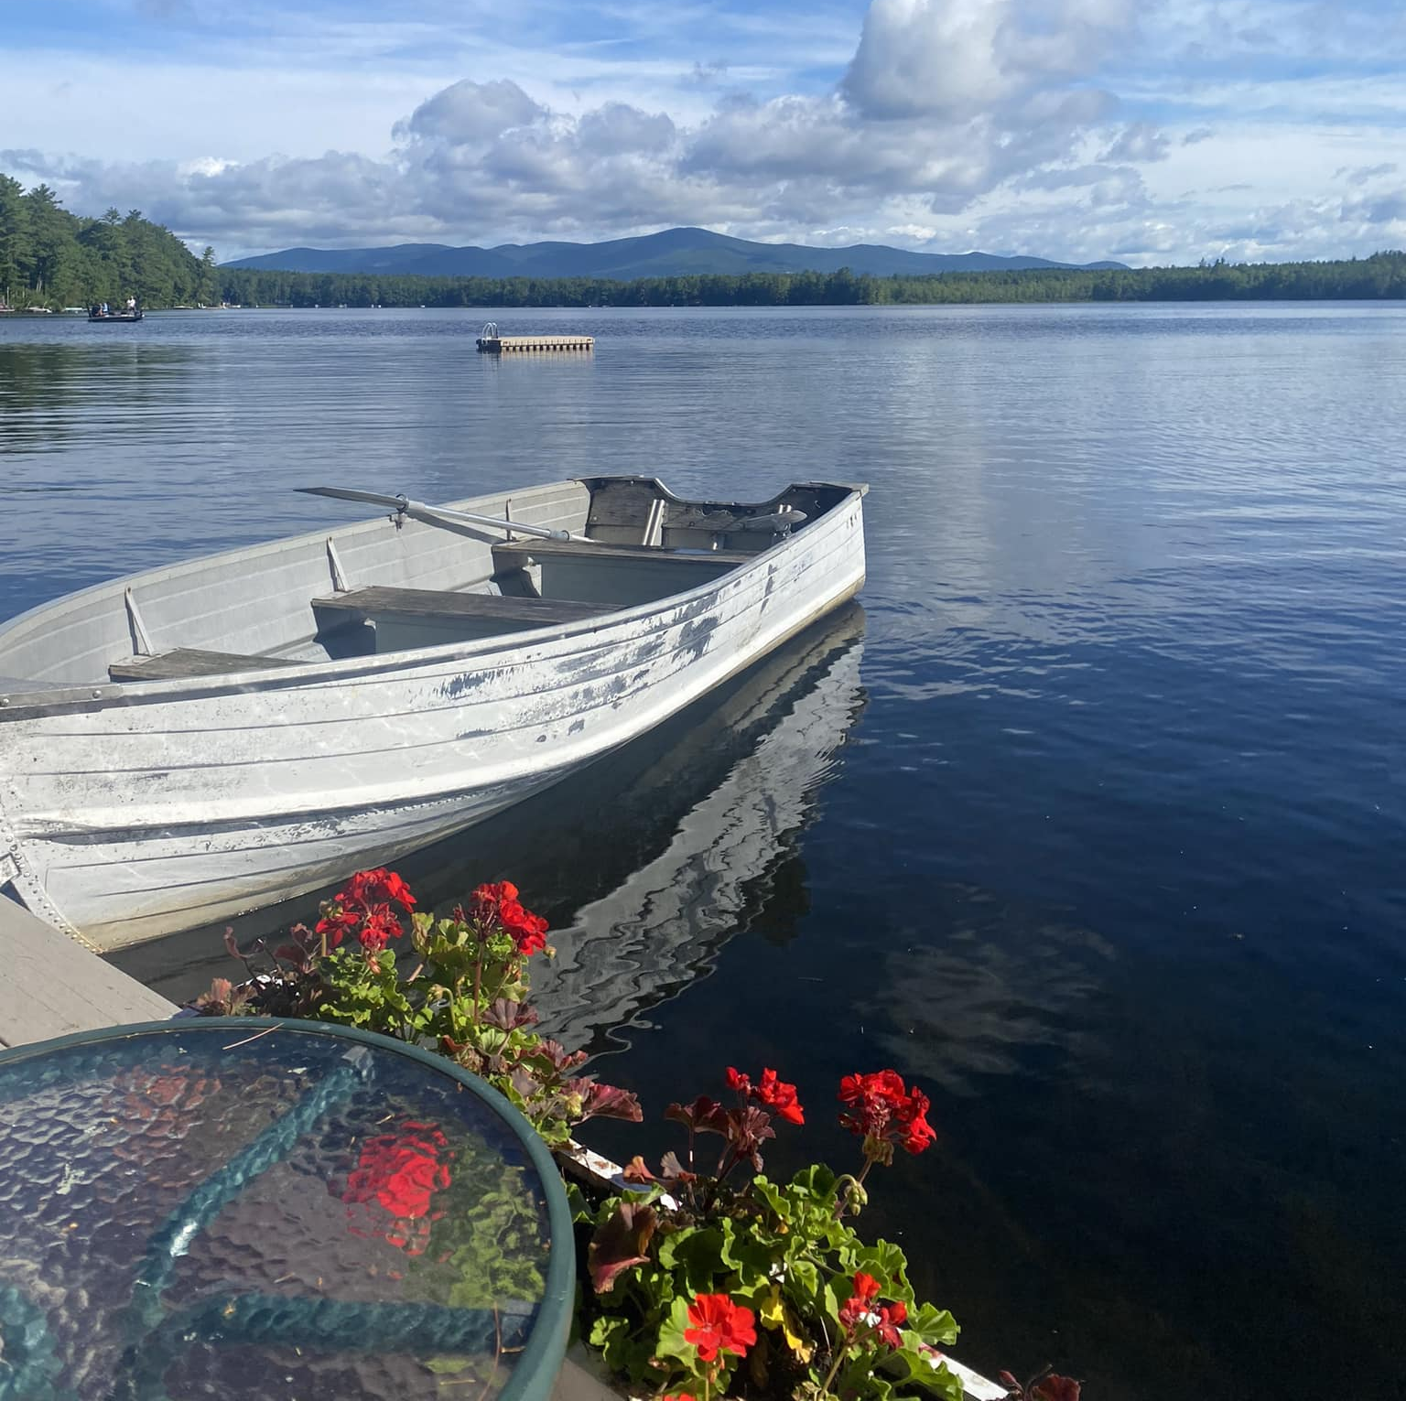
MLPA Annual Meeting 2025
WELCOME!
“Time wasted at the lake
is time well spent.”
Tuftonboro Free Library
June 28, 2025

Slide 2
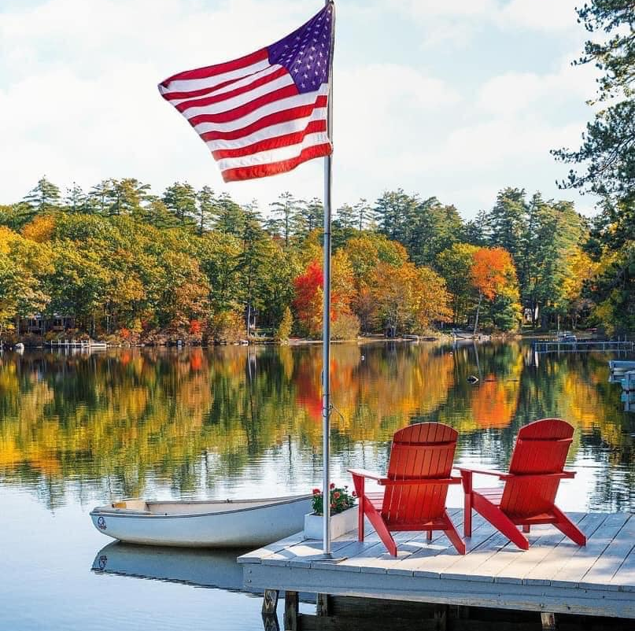
AGENDA
Opening & Business
Spirit of NH
Important New Laws
Decades Tell the Story
Protection Strategies
Fun Times

Slide 3
We Remember Claudia Bissett Nancy Byrd Robert (Bob) Friel
Thank you Mirror Lake Estates
Notes:
Mission & Vision: Next slides
Losses: Nancy Byrd; Claudia Bissett; Bob Friel
Mirror Lake Estates: Last year yielded a few new members; Kudos to those maintaining the fixes!

Slide 4
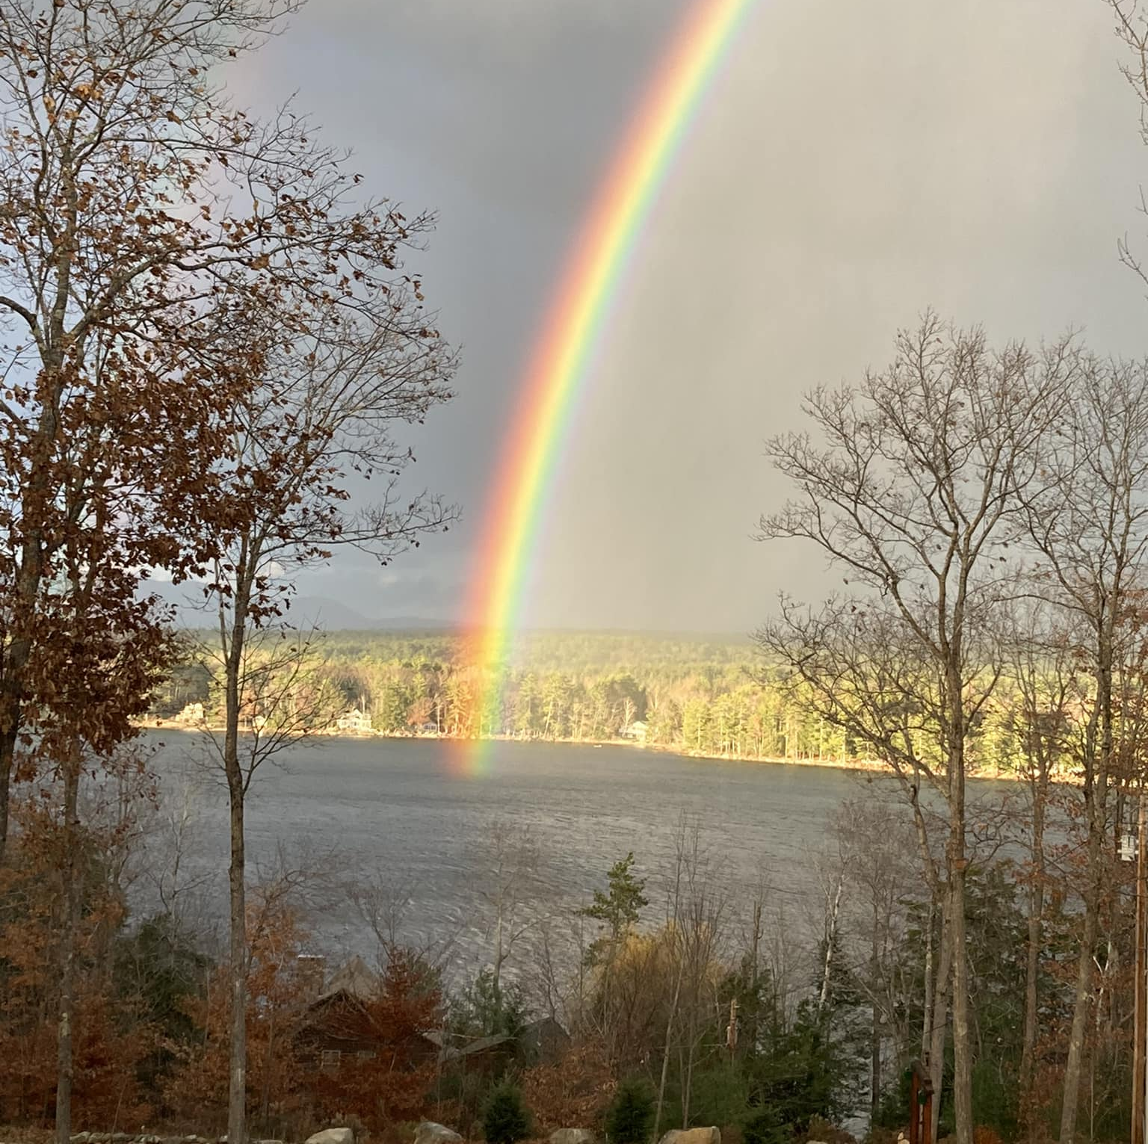
MLPA Vision
We envision future generations enjoying Mirror Lake’s scenic beauty, clean water and natural habitat for native plants and animals.

Slide 5
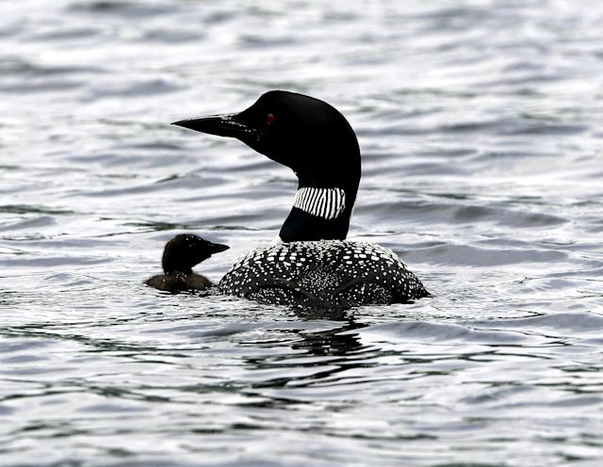
MLPA Mission Founded in 1991, the Mirror Lake Protective Association seeks to
protect the water quality and shoreline of Mirror Lake;
preserve the integrity of its natural environment within the watershed for the benefit of its inhabitants, flora, and fungi;
promote sound conservation and land use management practices;
encourage environmentally safe recreation; and
increase knowledge of the lake and its history.

Slide 6
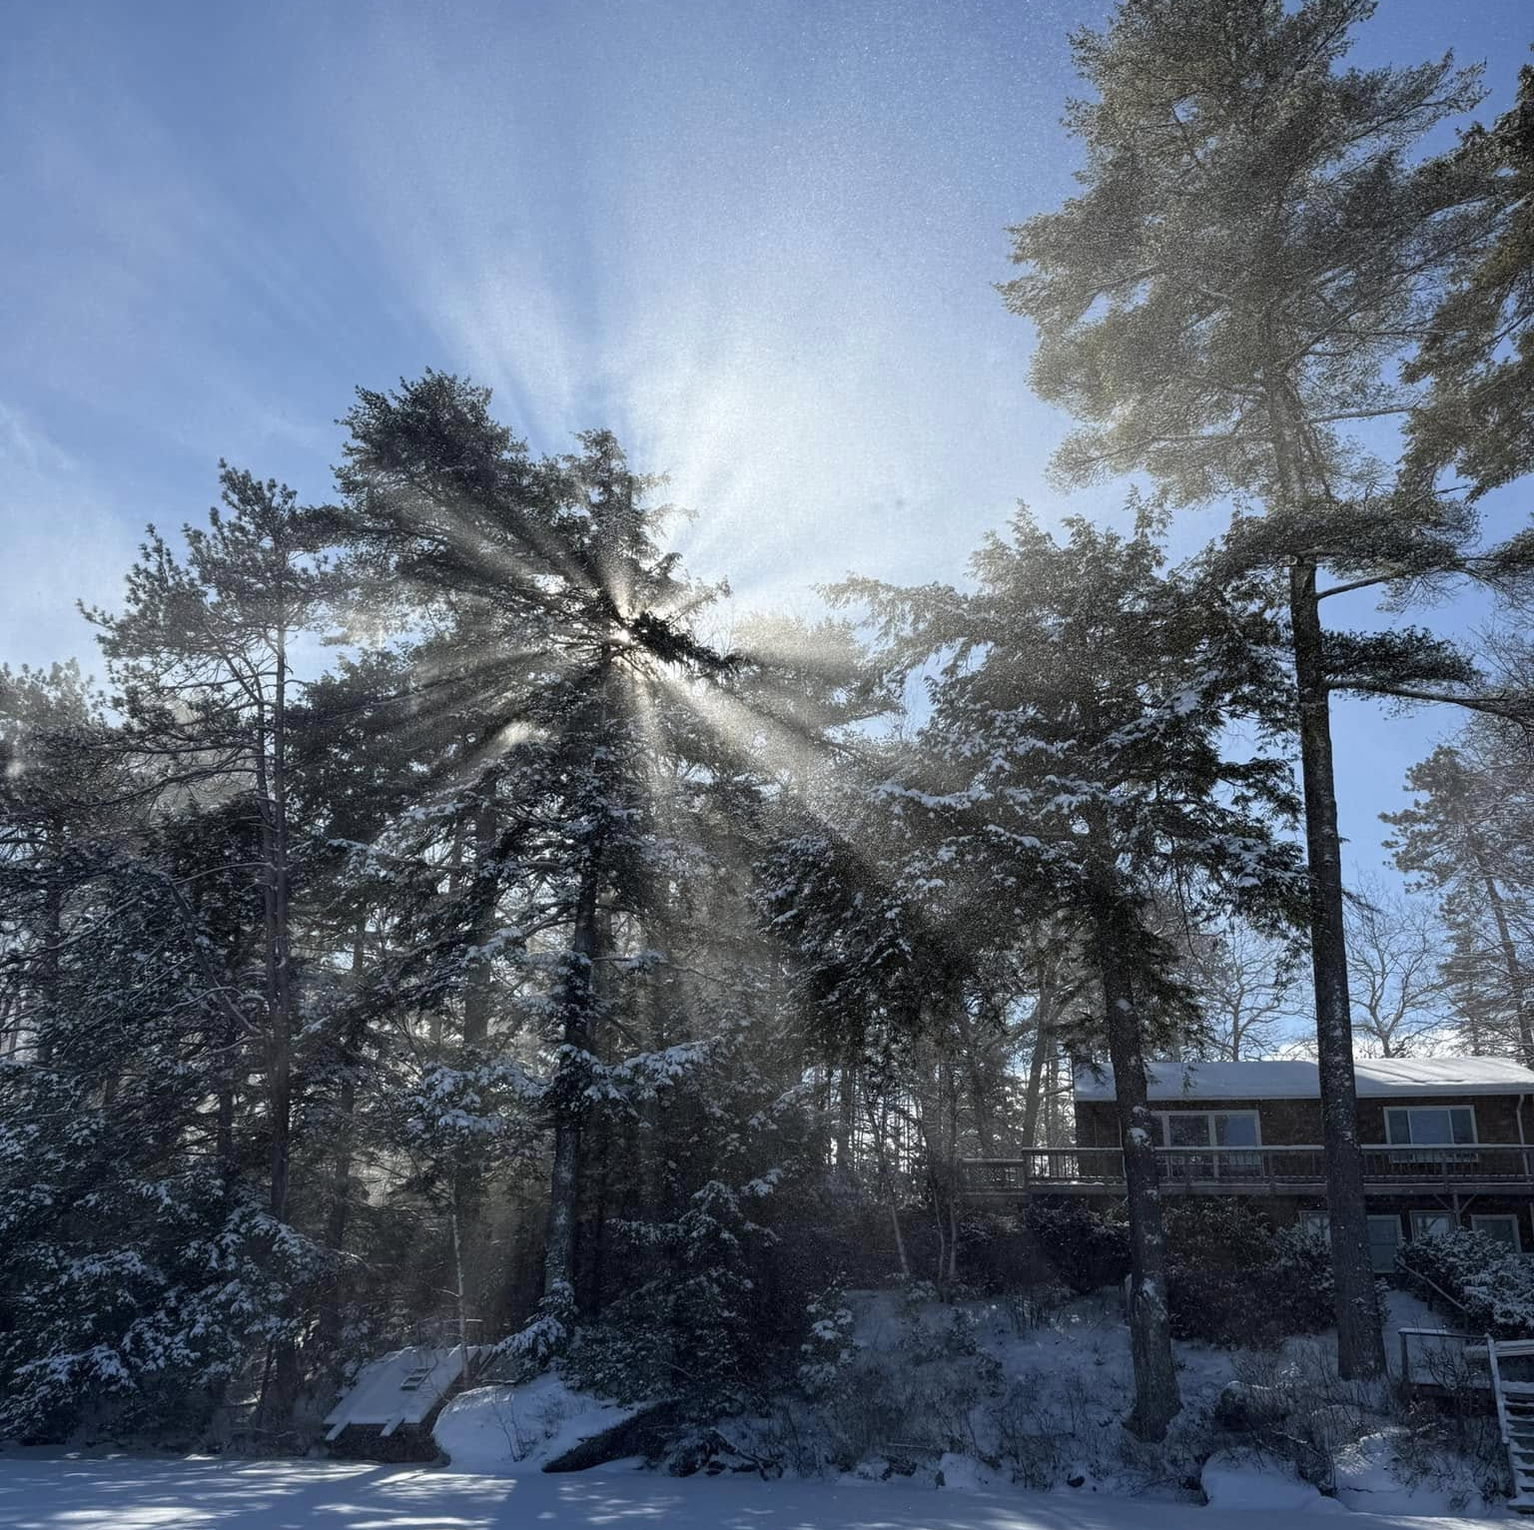
Secretary’s Report
Fran O'Donoghue

Slide 7
Mirror Lake Protective Association 8/1/2024 to 5/31/2025 Account Summary
GENERAL ACCOUNT
Beginning Balance - August 1, 2024 $41,540
INCOME
Dues and Contributions $6,499
MLPA Clothes Sales $ 0
Subtotal $6,499
EXPENSES
Donations $1,050
MLPA Liability Insurance $1,301
Website Fees $ 109
Misc.- postage, educational fees $1,367
Mirror Lake "Mingle" $ 617
NH Lakes Monitoring (Awarded $1,950 for 2025 from NH Lakes) $ 0
Core Sampling (Work done last year) $ 0
Water Testing $ 0
Subtotal $4,444
Ending Balance - May 31, 2025 $44,345
CONSERVATION ACCOUNT
Current Balance- No Activity $10,360
TOTAL ACCOUNT BALANCE AS OF MAY 31,2025 $54,705
Income from memberships and donations 2024 Jan-Nov $14,330

Slide 8
Donations
Friends of the Libby Museum $50
Lake Winnipesaukee Association $100
Lakes Region Conservation Trust $100
Loon Preservation Committee $100
Mirror Lake Community Church $100
Moose Mountain Regional Greenways $100
NH Lakes $300
Tuftonboro Fire Rescue Department $100
Proposed: Tuftonboro Free Library $100
Notes:
These are the organizations we currently donate to, and some also donate to MLPA. Proposing to add Tuftonboro Free Library as board, small committee meetings and the Annual meeting is held here. Could stop donations to Lake Winnipesaukee Association.

Slide 9
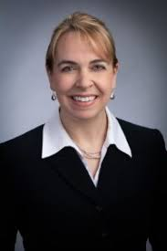
Accountants
Lorena Sinnamon
Santoro & Sinnamon, CPAs
Evan Stowell
Leone, McDonnell & Roberts
Notes:
Please join me in a salute to Evan Stowell, President and Managing Partner at Leone, McDonnell & Roberts an accounting firm in Wolfeboro. Don McDonnell resided on Mirror Lake for many years with his wife Jayne Jarvis. He was a founding member of MLPA and established the organization as a 503 (c) non profit while handling all accounting needs gratis. When he retired, moved away and then passed away, his business associate Evan Stowell continued servicing MLPA accounting needs. Last summer he let us know he could no longer take care of our account even when offered to start paying. He was simply too busy even working on weekends and holidays.
We interviewed Lorena Sinnamon and have hired Ms. Sinnamon who helpfully guided us through some tax issues, gratis.

Slide 10
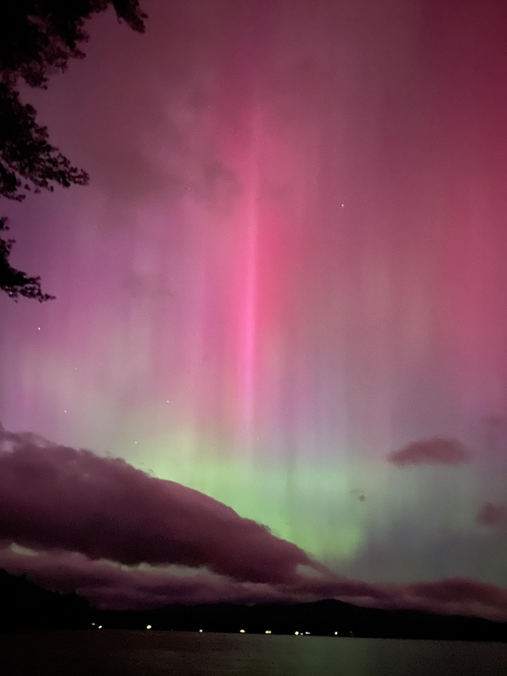
Nominations 2025
Mirror Lake
Northern Lights
2024
Mirror Lake Protective Association
Officers
President: Kathleen Sciarappa
Vice President: Val Zanchuk
Secretary: Fran O’Donoghue
Treasurer: Gary Philbin
Directors
Dusty Davies 2026
Larry Gil 2026
John Dawson 2027
Ann Torregrossa 2027
Suzanne Maus 2028
Steve Scapicchio 2028
Notes:
Good morning,
My name is Dusty Davies; I am a current board member and a former president of
MLPA.
Kathy appointed me, John Dawson, and Gene Kelly to be members of the MLPA
Nominating Committee.
MLPA’s by-laws provide that the members approve, at the annual meeting, a slate of
officers serve for a one-year term and fill two director vacancies to serve a three-year
term.
The proposed 2025-26 officers of MLPA (see slide) are:
President, Kathy Sciarappa
Vice President, Val Zanchuk
Treasurer, Gary Philbin
Secretary, Fran O’Donoghue
Before we vote on the election of the officers, I would like to thank’ and please stand a I
say your name) Kathy, Val, and Fran for agreeing to continue to serve.(applause) I
would also like to thank Robin Muench for her service as Treasurer and her long
dedication to MLPA’s conservation efforts. I worked closely with Robin in obtaining two
federal grants, one in 2010 to identify the sources of cyanobacteria in Mirror Lake, and
the second in 2012 to develop a Management Plan to implement remediation efforts
directed at the most significant sources. Her work was critical to our obtaining those
grants. Among other things Robin developed a user-friendly spread sheet to report the
thousands of volunteer hours residents contributed to the fact in finding mission. This
spread sheet format is still being used by NHDES. Many thanks for all of Robin’s hard
work.
I would like to introduce you to Gary Philbin. Unfortunately, Gary was not able to attend
today due to a family commitment, but he asked me to read the following:
Gary and Glenda Philbin have been at Mirror Lake since 2006. They have been members of
MLPA since joining the same year. Glenda has been part of the weed watching flotilla over the
years. Gary retired in 2020 after a 47-year career in retail, and has been treasurer of Mirror
Lake Estates Association [a road association] since then. Mirror Lake Estates Association efforts
include managing the annual dues, dealing with vendors on various projects and a major capital
project to re-pave much of Mirror Lake Dr. He looks forward to working with the team at
MLPA.&quot;
A side note, when we were looking for home across the lakes region in 2006, we stopped at
Bailey&#39;s Bubble after a particularly frustrating day. We happened to meet you and George, and
you told us to look at Mirror Lake and gave us your card. The rest is history!
It just goes to show you that we Presidents go to great lengths to get great neighbors on Mirror
Lake!
The committee is nominating the slate of officers presented above to serve for the 2025-26 of
MLPA term. Do we have any nominations from the floor?
Do I have a motion to approve the slate of officers proposed? A second?
Any discussion?
All in favor? oppose? abstain? Let the record show….
Nominations for the Board of Directors:
The committee is nominating Suzanne Maus and Steve Scapicchio to serve a three-year term on
the MLPA board of directors.
Before we vote on the election of the two directors highlighted above, I would like to thank Gene
Kelley (stand) for his invaluable service to MLPA, both in his capacity as a former President and
as a director. One of his significant contributions was the role he played as a member of the town
appointed committee to address the rebuilding of Lang Pond Road at the public beach. Gene’s
professional life was spent overseeing the reconstruction of vast highways and bridges including
one with which I was familiar, the Vine Street Expressway and the Ben Franking Bridge
connecting Philadelphia to NJ. Gene’s professional credentials, and general warm and kind
demeanor, guided the committee through some rough patches and contributed to keeping Lang
Pond Road a dirt road and not an elevated two-lane paved road. Thank you, Gene, and thank
you for continuing your volunteer efforts including providing your boat for MLPA water
sampling.
The committee is nominating Suzanne Maus, a new board member, to fill the position vacated by
Gene. Suzanne, would you please stand and tell us briefly about yourself?
Steve Scapicchio is the second Board member to be elected or in his case reelected as he has
agreed to continue to serve another 3-year term. We are delighted! Steve, would you please
standremind the residents of who you are and please briefly share with them your many
conservation efforts and contributions to MLPA, the Town of Tuftonboro, and the State of NH.
Thank you.
The committee is nominating Suzanne Maus and Steve Scapicchio to serve as directors or MLPA
for a three-year term. Do we have any nominations from the floor?
Do I have a motion to approve the appointment of Suzanne Maus and Steve Scapicchio?
Second?
Any discussion?
All in favor? oppose? abstain? Let the record show….

Slide 11
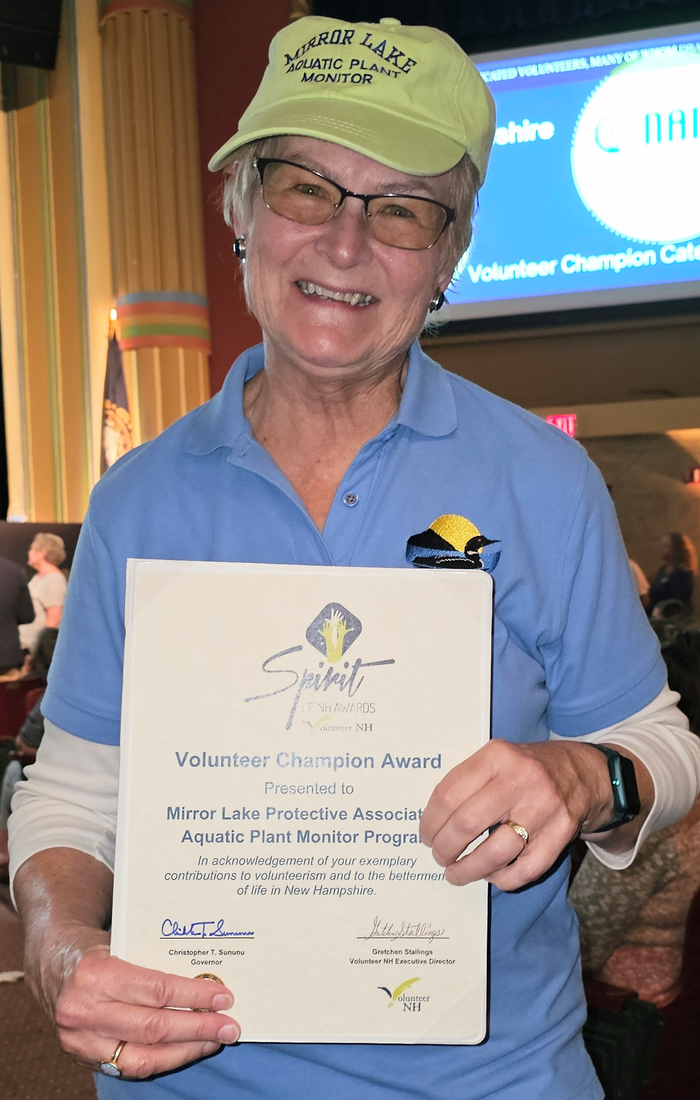
Spirit of New Hampshire Award
Weed Watchers 2024
Claudia and Tom Bissett
Jeanne Freeze
Alan Hardiman
Sharon Koning
Kip Lachner
Norma Milne
Glenda Philbin
Tiina Urv
Notes:
Spirit of NH Award: Volunteer Champion Category This category recognizes nonprofit/public service organizations and businesses for their volunteer initiatives.
Shining a spotlight on the often unsung heroes among us recognizing a group of volunteers who provide volunteer services that strengthen communities and improve the lives of New Hampshire residents.

Slide 12
NH Legislative Session 2025
Marilyn Edelhoch, MLPA
Andrea LaMoreaux, NH LAKES
Septic systems
Shoreland Water Quality Protection Act
Notes:
BECAME A LAW IN JAN 2025
Buyers of developed waterfront properties with septic systems within 250 feet of the reference line (high-water marks of lakes or ponds over 10 acres, coastal waters, or fourth-order or higher rivers) must hire a licensed septic system evaluator before the property transfer.
OUGHT TO PASS
Prohibits the intentional disposal of yard waste into the waters…penalty fine
Penalties on contractors who supervise or perform work in violation of the Shoreland Water Quality Protection Act
Prohibiting the sale of ski, boat and board waxes with polyfluorinated alkyl substances

Slide 13
Cyanobacteria Decades
1970 Phosphorus
1980 Toxins
1990 Chronic exposure
2000 Monitoring/management
2010 Climate change
2020 Public Awareness
2025 Lake Management
Notes:
1970s: Recognition of Eutrophication and Algal Blooms (link btw Phosphorus and Algae blooms)
Key Insight: Scientists identified that excess nutrients (especially phosphorus) from agriculture and wastewater were triggering eutrophication, leading to massive algal blooms.
Impact: Recognized cyanobacteria as a dominant component of blooms in nutrient-rich lakes
1980s: Toxin Production Discovered (Cyanobacteria can produce toxins)
Key Insight: Cyanobacteria were found to produce toxins (cyanotoxins), such as microcystins, that are harmful to humans, animals, and ecosystems.
Impact: Public health concern grew, particularly regarding drinking water contamination and recreational exposure
1990s: Cyanotoxins and Human Health (There are a variety of toxins)
Key Insight: More types of toxins (e.g., anatoxins, saxitoxins, cylindrospermopsin) were identified and linked to human health incidents (e.g., liver damage, neurotoxicity).
Impact: Regulatory interest increased; the WHO issued its first guideline for microcystin in drinking water. Rise in worldwide documentation
2000s: Climate Change Connections (Warmer waters; stratification; weather connections to cyano; role of runoff)
Key Insight: Studies found warming temperatures, stratification, and altered rainfall patterns promote cyanobacterial dominance.
Impact: Cyanobacteria began appearing in previously unaffected regions, and bloom duration and intensity increased.
Technology: Use of remote sensing and molecular tools (e.g., qPCR) expanded monitoring capabilities
2010s: Complex Ecology and Bloom Prediction (bloom forecasting models; warning systems)
Key Insight: Understanding grew of how interacting factors (nutrients, temperature, light, competition) drive blooms.
Impact: Researchers began developing predictive models for blooms and risk management tools.
Public Concern: Major bloom events (e.g., Toledo, Ohio 2014) prompted urgent government response
2020s: Management, Monitoring, and Microbiomes (satellite data and monitoring tools)
Key Insight: Focus shifted toward lake microbiomes, gene-level toxin detection, and real-time monitoring (buoys, satellites, machine learning).
Impact: Emphasis on adaptive management and nutrient reduction policies to prevent blooms.
Innovation: Work on biological controls (like viruses and bacteria that prey on cyanob

Slide 14
55 Years of Study
Monitor!
Property Value
Detect Invasives Early--
Respond Rapidly
4. Funding
5. Manage Watershed Input
(Keep nutrients out of lake)
Notes:
Conclusions of 55 years:
1. Monitoring is of utmost importance. We have data stretching back to the 1950s and very active water testers today. We maintain close ties to UNH Extension (Bob Craycraft and NHDES)
2. Nationwide and locally there is a strong correlation between healthy lakes and strong property value. Conversely, lakes with issues have experienced up to 30% drop in value.
3. Early detection is the primary goal of Weed Watchers and Lake Hosts. Our responses have always been rapid. Fortunately, we mostly have false alarms.
4. Lake Congress predictions are that funding is drying up and unlikely to return to previous levels. Lucky to already have our $100,000
5. Crucial for us to manage stormwater runoff. Will talk about specific strategies landowners can employ.

Slide 15
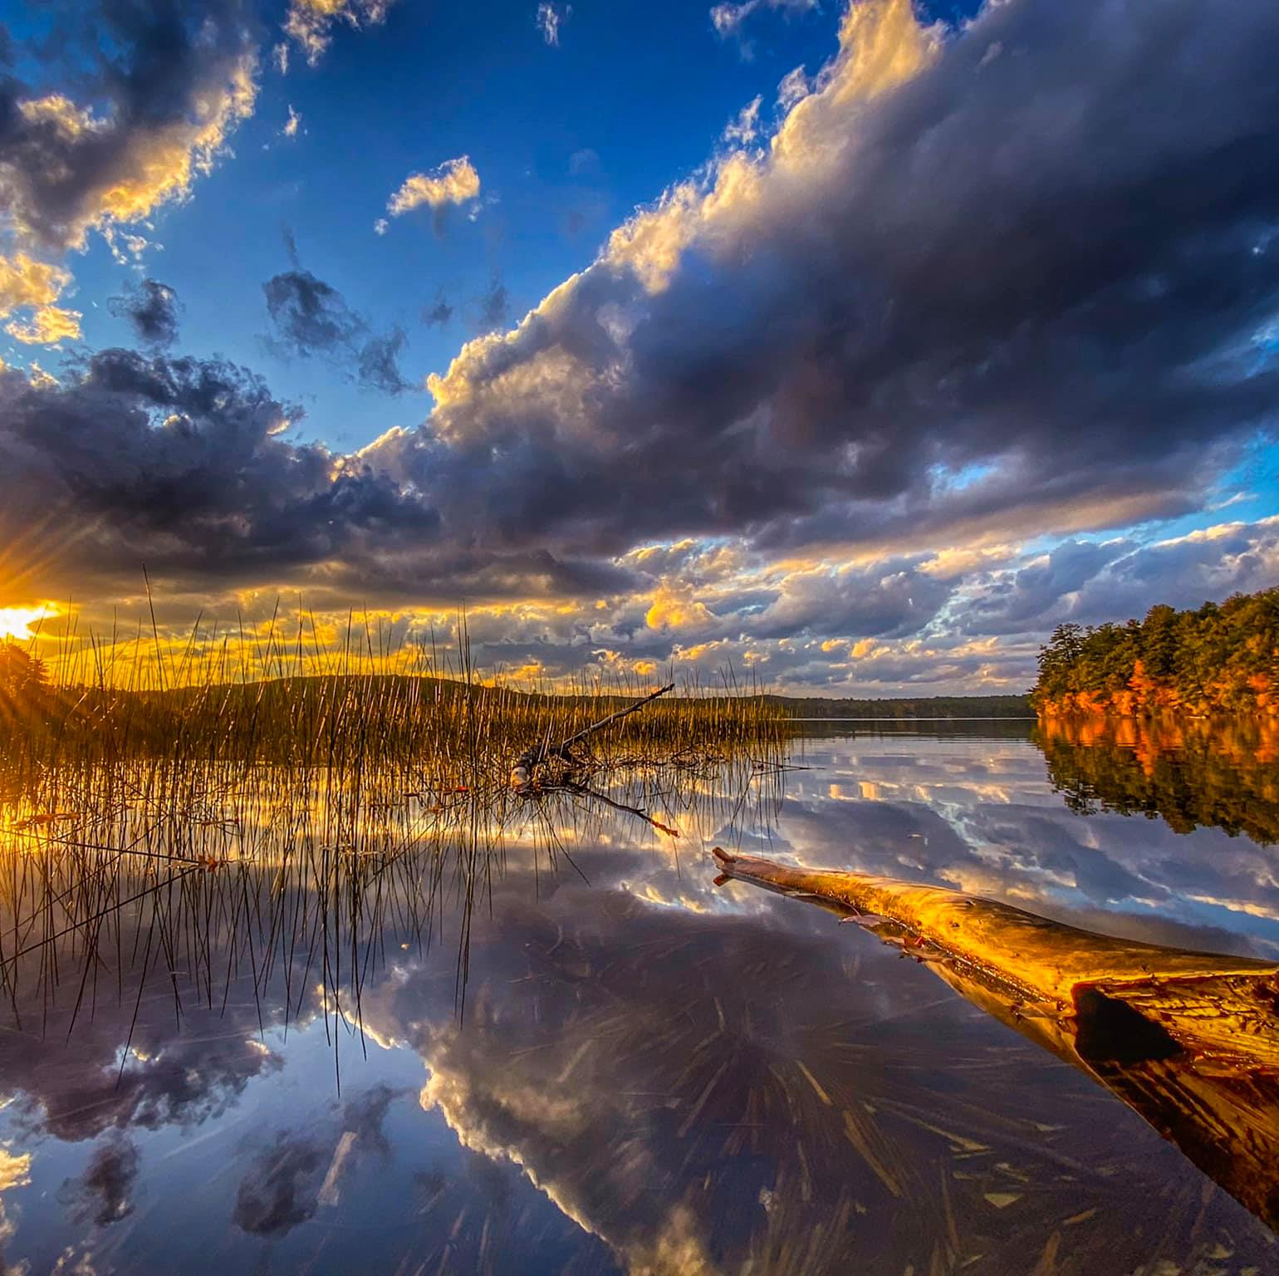
NHCWSRF NHCleanWaterStateRevolvingFund Mirror Lake Tasks $100,000 NH Governor’s Council
1. Management & Meetings
2. Shoreline survey
3. Watershed Survey & Engineering
Design
4. Water Quality Testing and Analysis
5. Action Plan & In-Lake Restoration

Slide 16
Mirror Lake Phosphorus
Watershed runoff (50-70%)
Atmospheric (5-24%)
Deep Hole 17%
Septic systems 7%
“Internal” and “external” loading
Notes:
In lakes, external loading refers to the influx of nutrients and other materials from sources outside the lake, like rivers, streams, and atmospheric deposition. Internal loading describes the release of nutrients from the lake's sediments back into the water column, often triggered by factors like oxygen depletion or sediment disturbance. Understanding both is crucial for managing lake health, as they can significantly impact water quality and ecosystem dynamics.

Slide 17
Land Conservation
Phosphorus
from
one developed acre
is
10x-20x greater
than
a natural forested acre
Notes:
Don Kretchmer, Certified Lake Manager: The phosphorus loading from a developed acre of land (residential, roads, commercial etc) would be roughly 10-20 times the phosphorus loading from a natural forested acre of land. Improving practices on developed land can reduce the numbers for developed land although they will likely never approach natural forest numbers.

Slide 18
Lake Smart Ambassadors
Notes:
All the board members agreed to be LakeSmart Ambassadors
Survey is being revamped

Slide 19
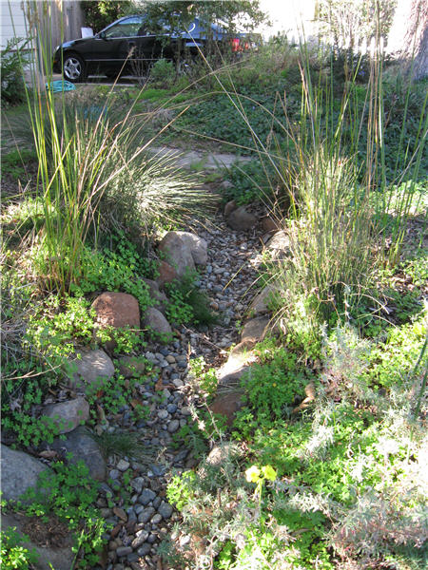
Popular Projects
Swales
Rock Beds
Notes:
Divert the water Slogan “Slow the Flow”

Slide 20
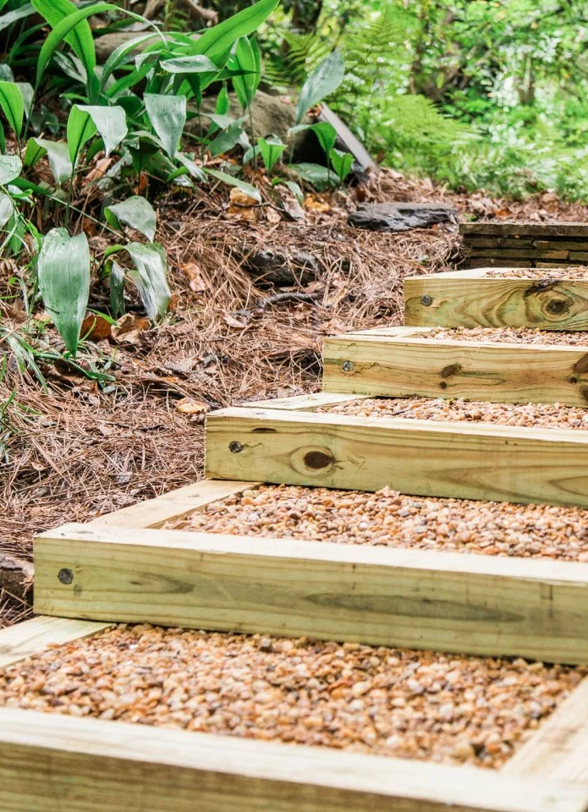
Popular Projects
Walkways
Paths
Notes:
Gravel!

Slide 21
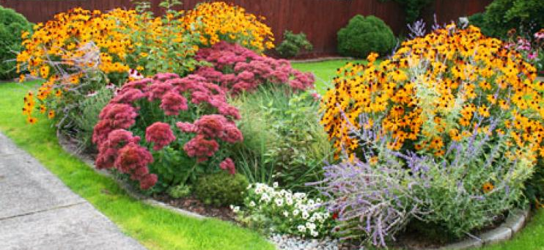
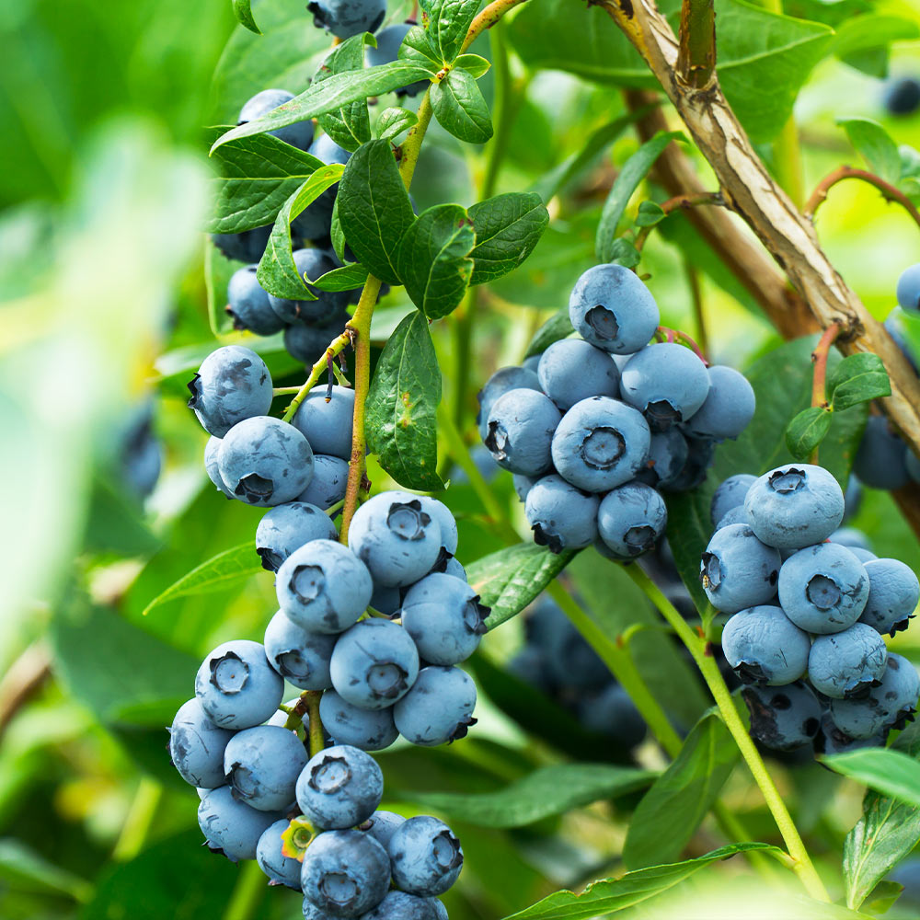
Popular Projects
Rain Gardens
Shoreline Plantings

Slide 22
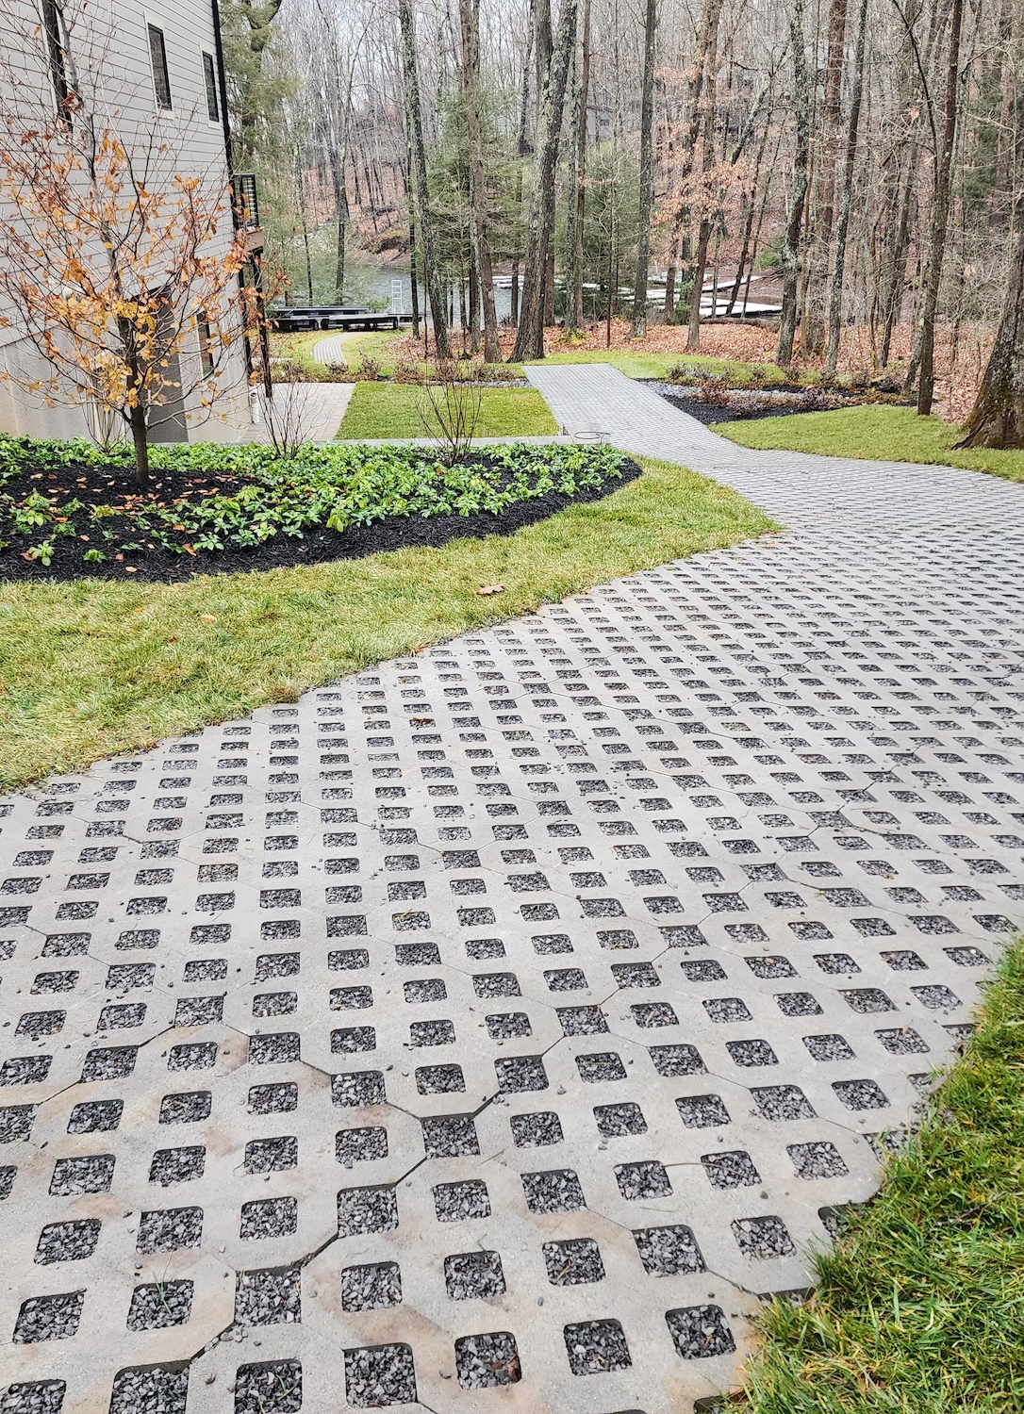
Popular Projects
Pervious
(flow through)
materials
Trenches

Slide 23
Assess Before Entering the Water
LOOK
CHECK
REPORT
Healthy Swimming Mapper

Slide 24
The Stick Test
Appears as paint on a stick…cyanobacteria
Samples brought to Concord lab
“When in doubt, stay out”

Slide 25
Our Loons
1975: 34 loon pairs
NH Bans Lead Sinkers (1st)
Lead poisoning
2024: 326 loon pairs
192 chicks
133 survived season
Notes:
1975: 34 loon pairs Territorial loon pairs are those that defend their area in a lake and have the capacity to produce chicks
Mirror Lake is just barely large enough for one loon pair. We didn’t always have a territorial loon pair.
NH Bans Lead Sinkers (1st) NH was the first state to ban lead sinkers which are (were) the leading cause of death for loons. Once ingested, 2-4 weeks for death from lead poisoning
2024: 326 loon pairs
192 chicks
133 survived season

Slide 26
Turnover
Understanding How
to
Keep the Lake
Healthy

Slide 27
Welcome New Neighbors

Slide 28
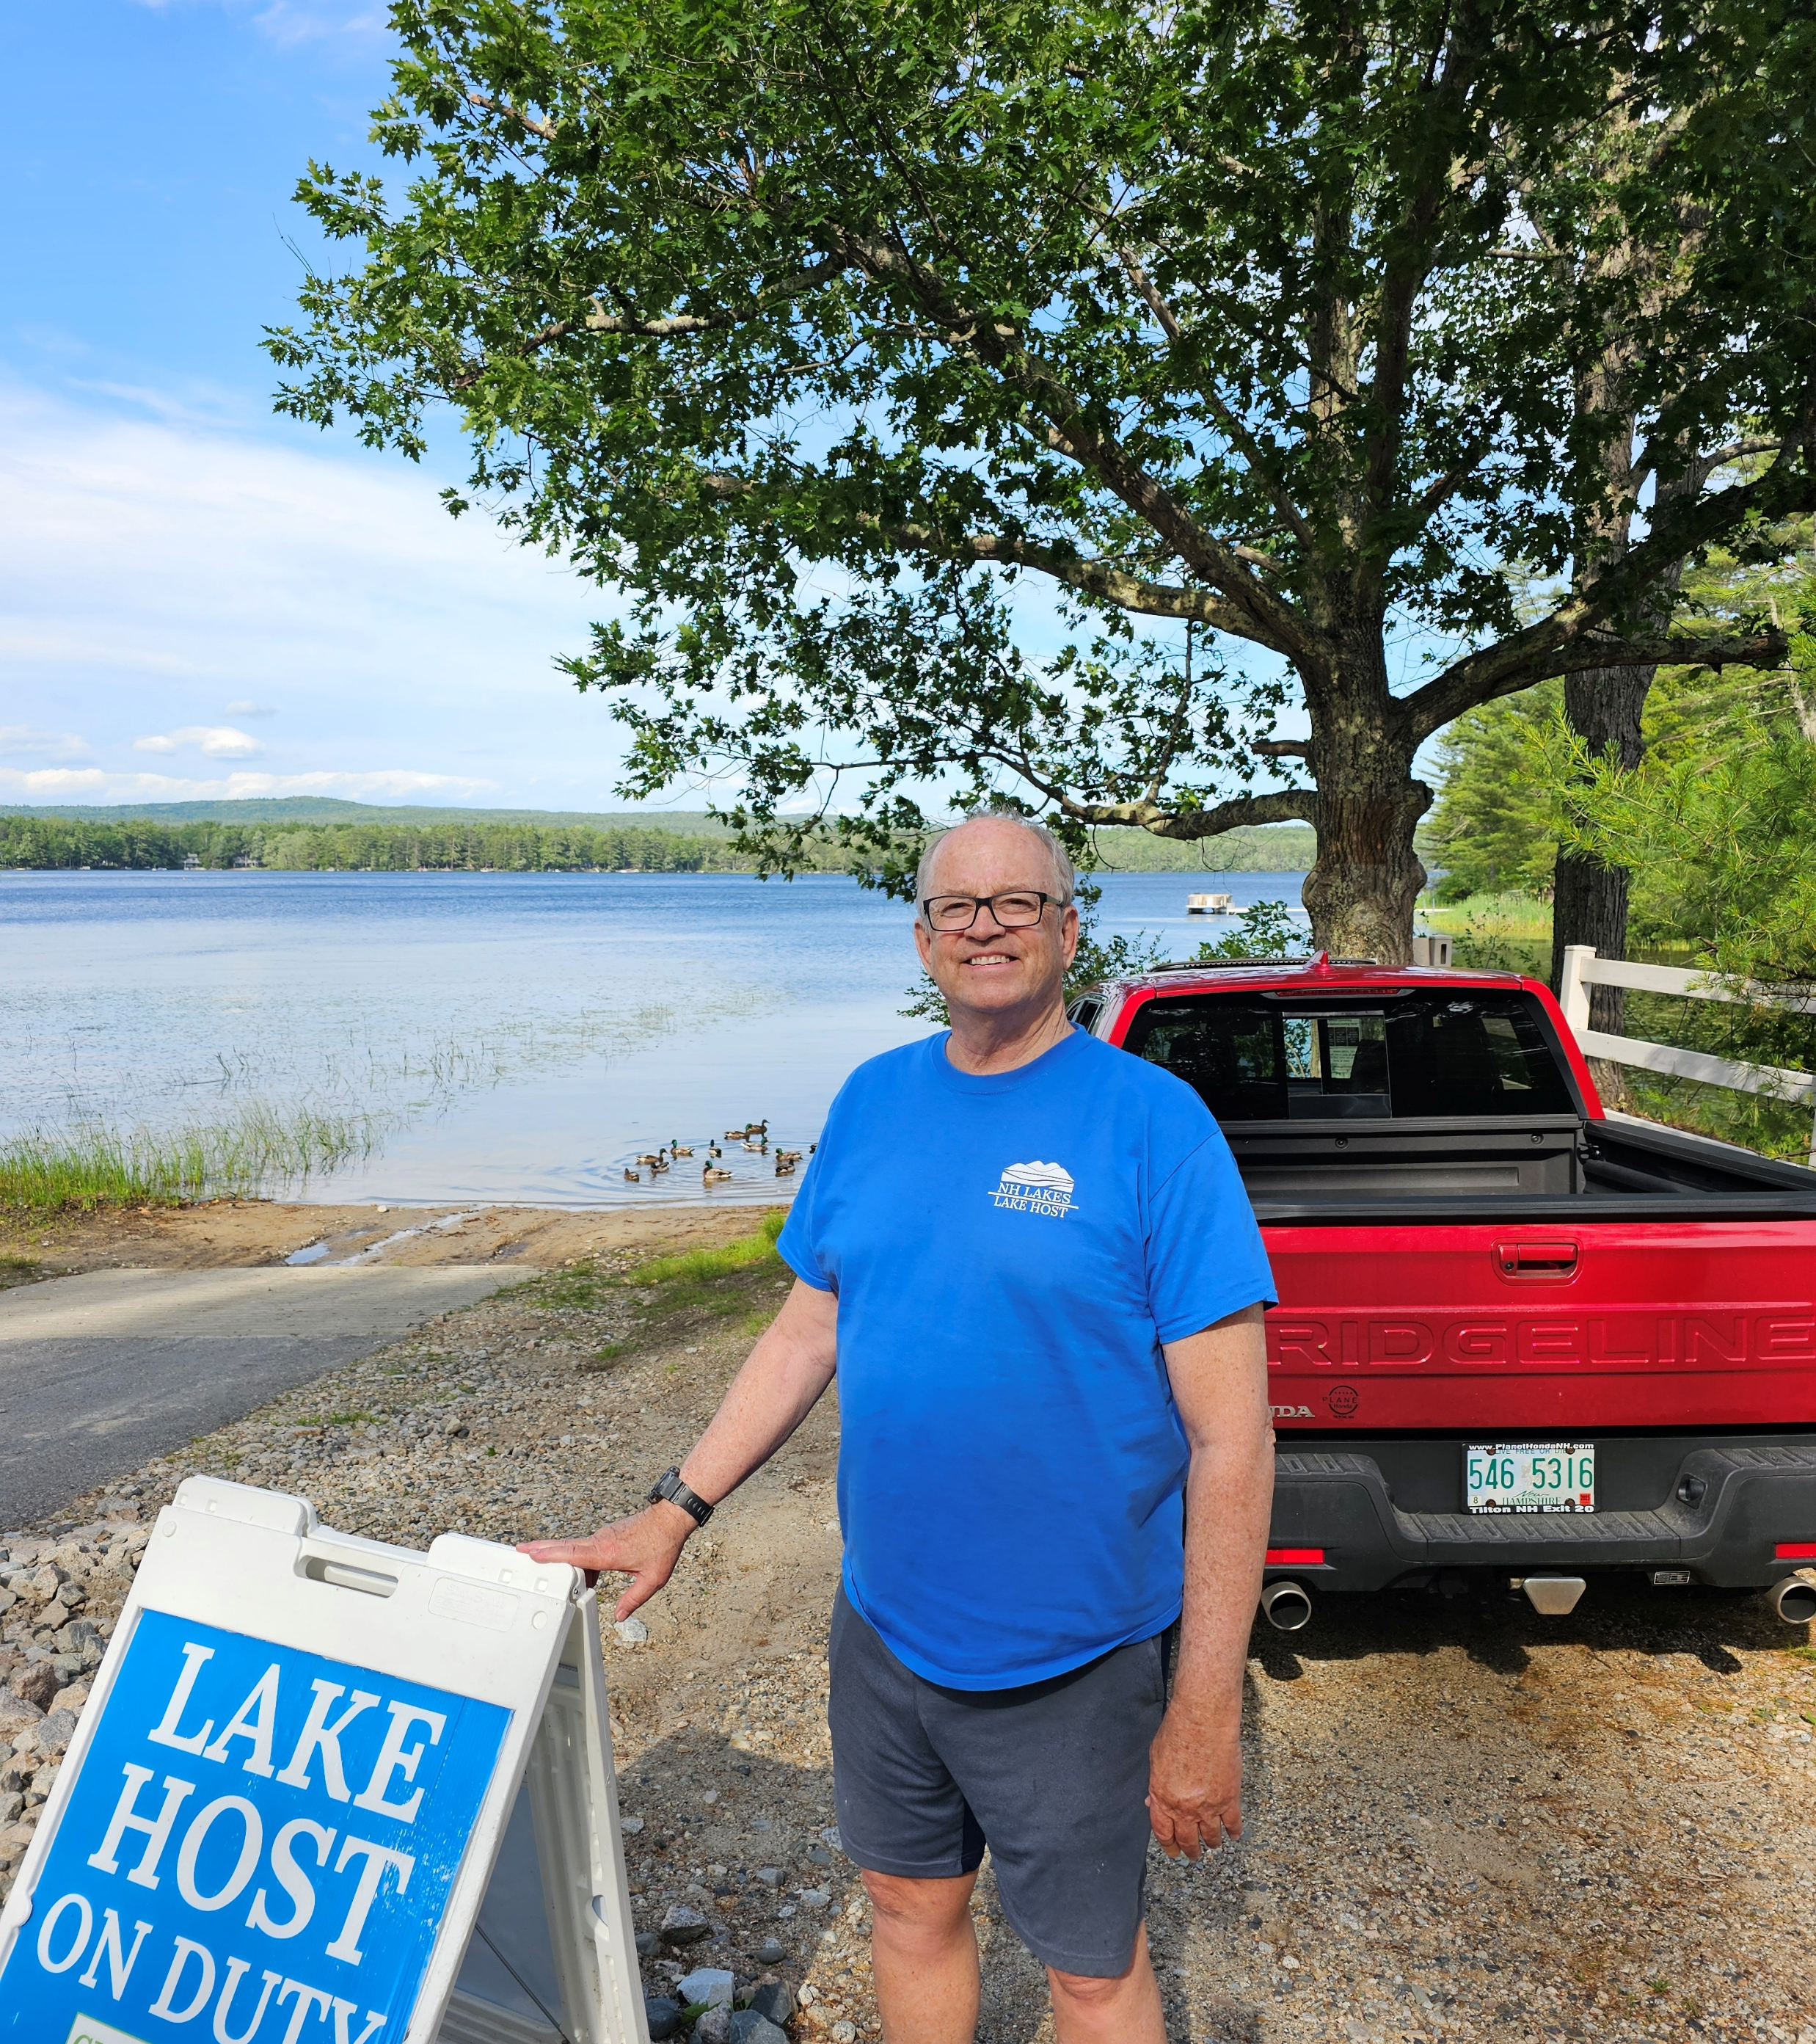
Lake Hosts
Phil Cassidy (paid Lake Host)
Denise Ferriman (paid Lake Host)
Janet Plourde (paid Lake Host)
Larry Gil Chair (volunteer)
Alan Hardiman (volunteer)

Slide 29
Aquatic Plant Monitoring “Weed Watchers”
Tom Bissett
Alan Hardiman
Kip Lachner
Norma Milne, Chair
Glenda Philbin
Tiina Urv
Sharon Koning

Slide 30
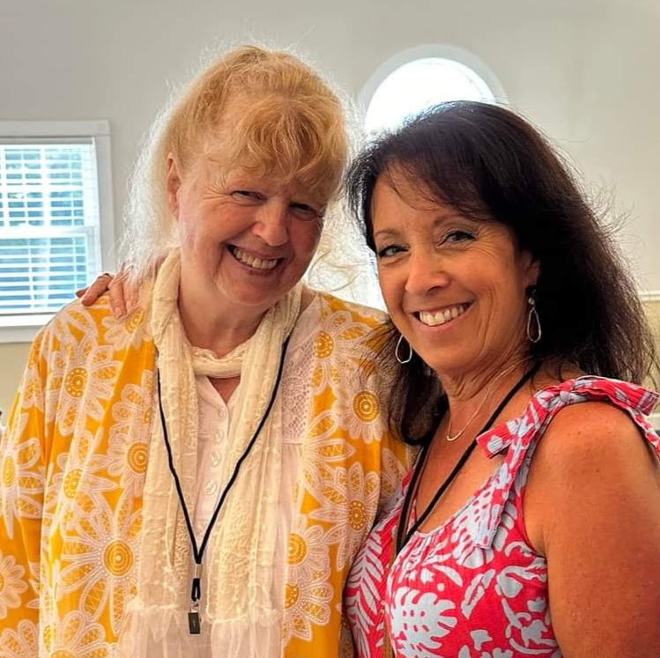
Beth Argeros Fran O’Donghue

Slide 31
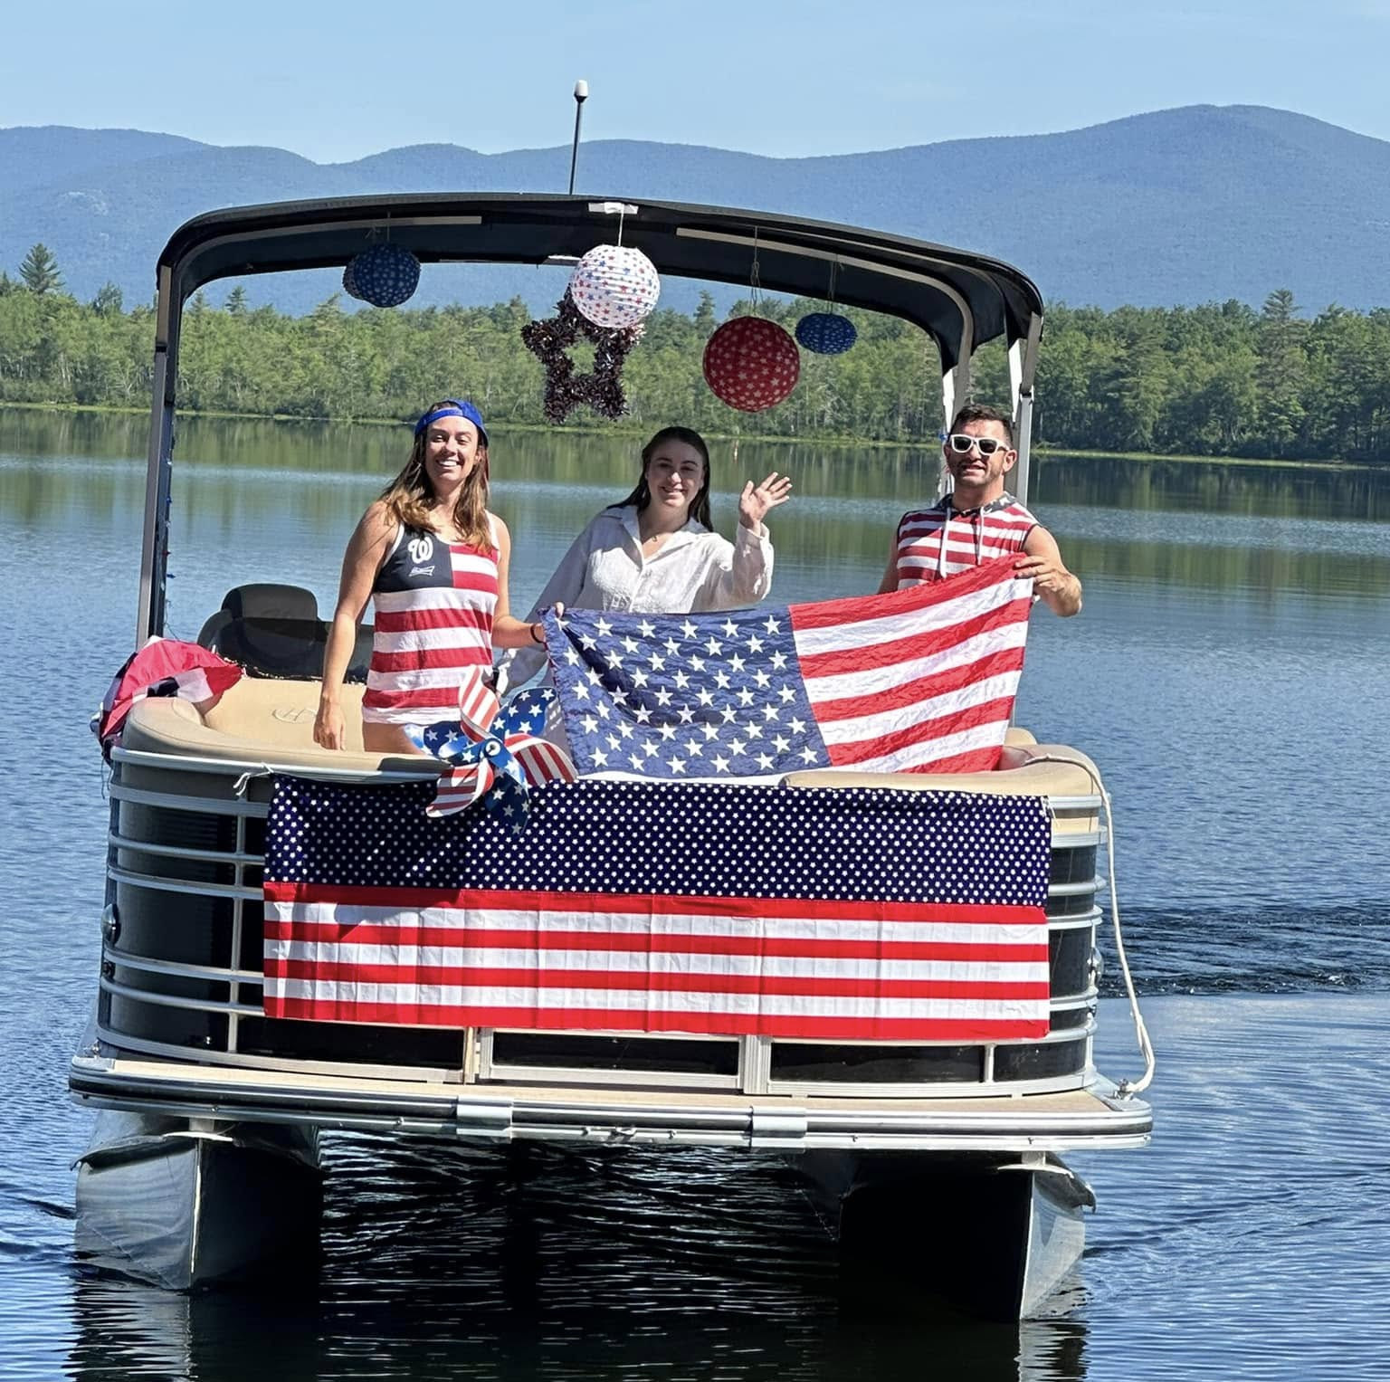
Fun Times!
Boat Parade
Thursday July 3, 10:00am
Boat Socials
Sunday July 20, 4:00pm
Thursday Aug 7, 4:00pm
Mirror Lake Mingle
Tuesday Aug 19, 4:00pm
Yard Sale
Saturday Aug 30, 9am-2pm

Slide 32
MLPA Website https://www.mirrorlakenh.org/

