Slide 1
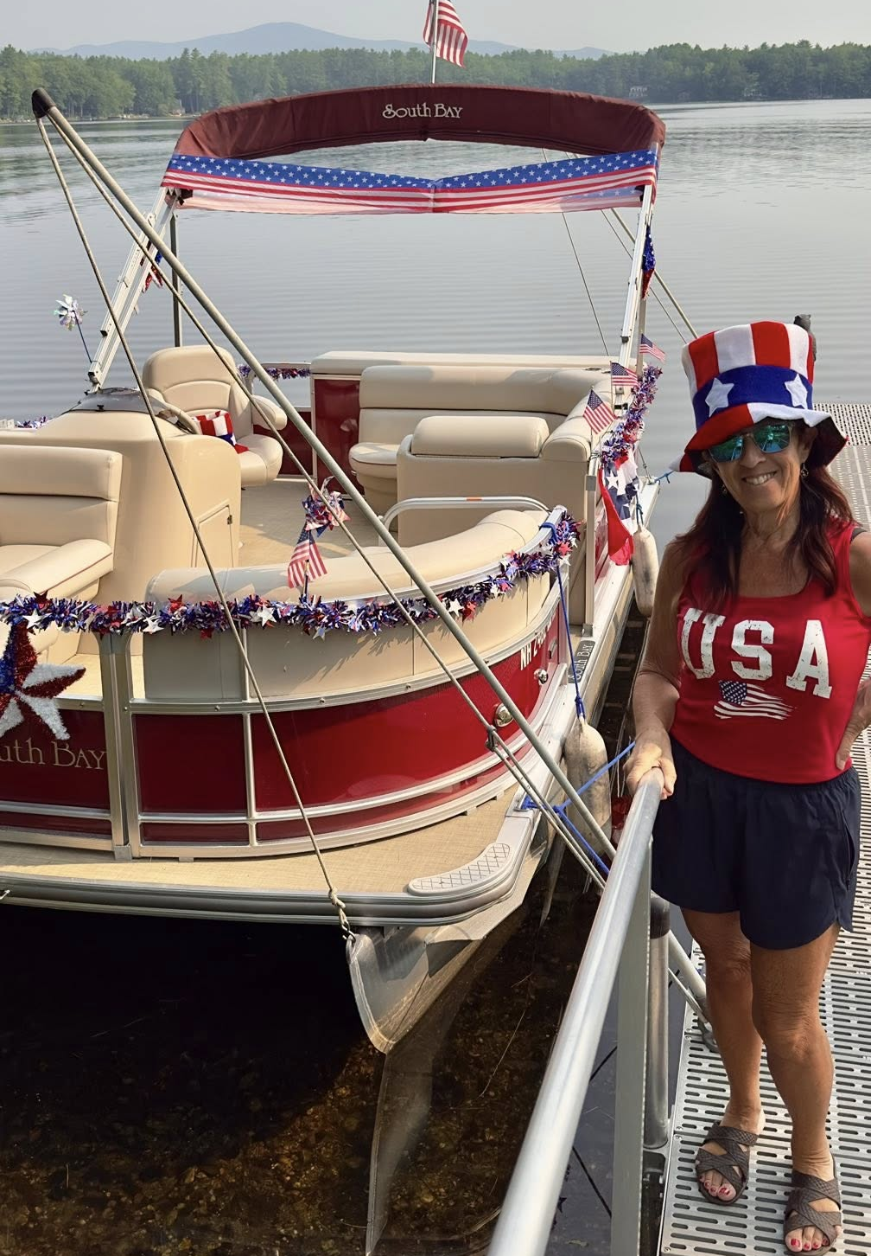
MLPA Annual Meeting
2026
WELCOME!
Memories
made
at the lake
last a lifetime!
June 27, 2026

Slide 2
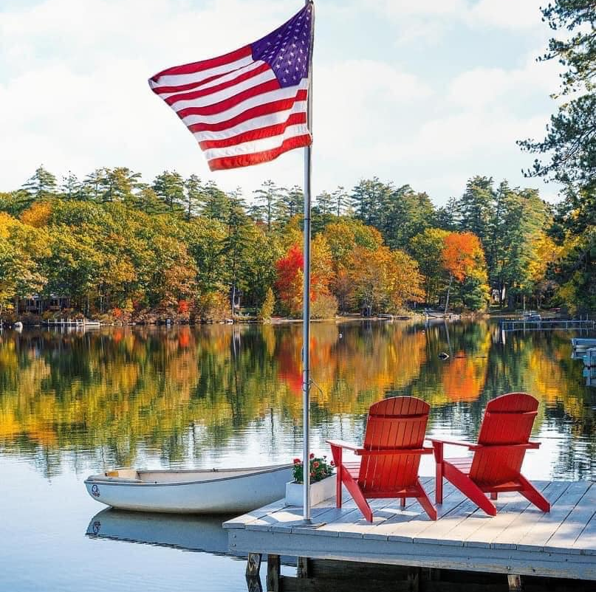
AGENDA
Opening & Business
  Awards, budget, nominations
Legislation & Good News
Challenges & Responses
Fighting Mosquitoes
Watershed Management
Safe Swimming
Path Forward
Old Fashioned Picnic

Slide 3
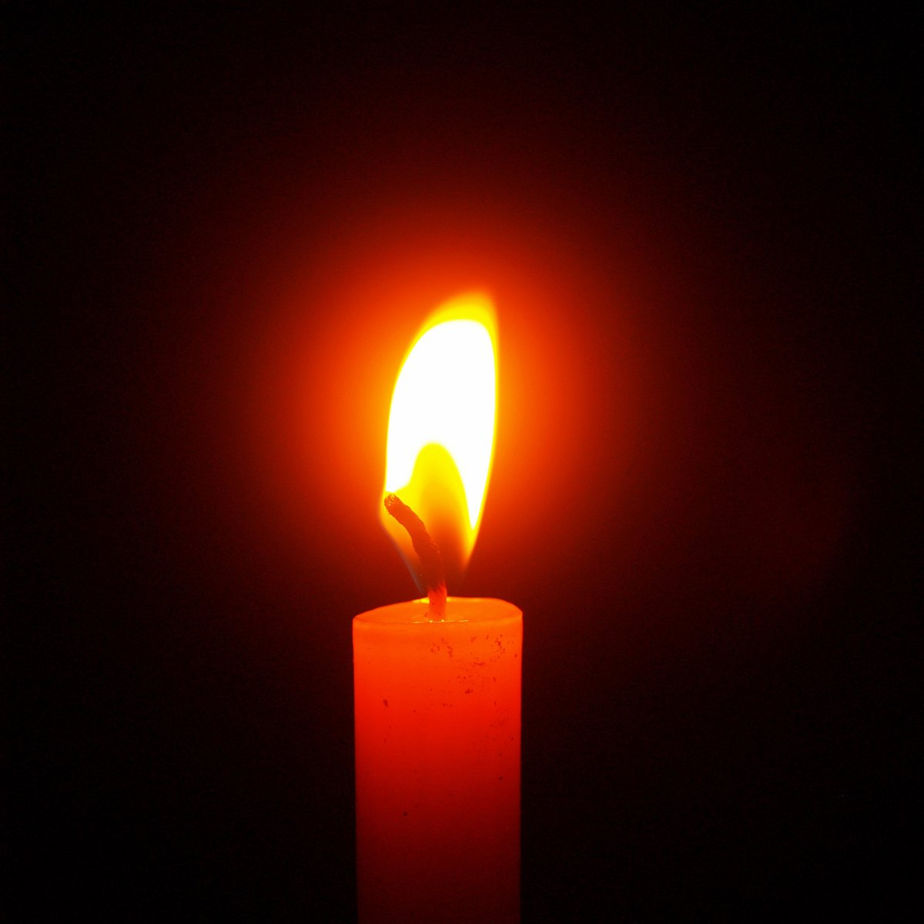
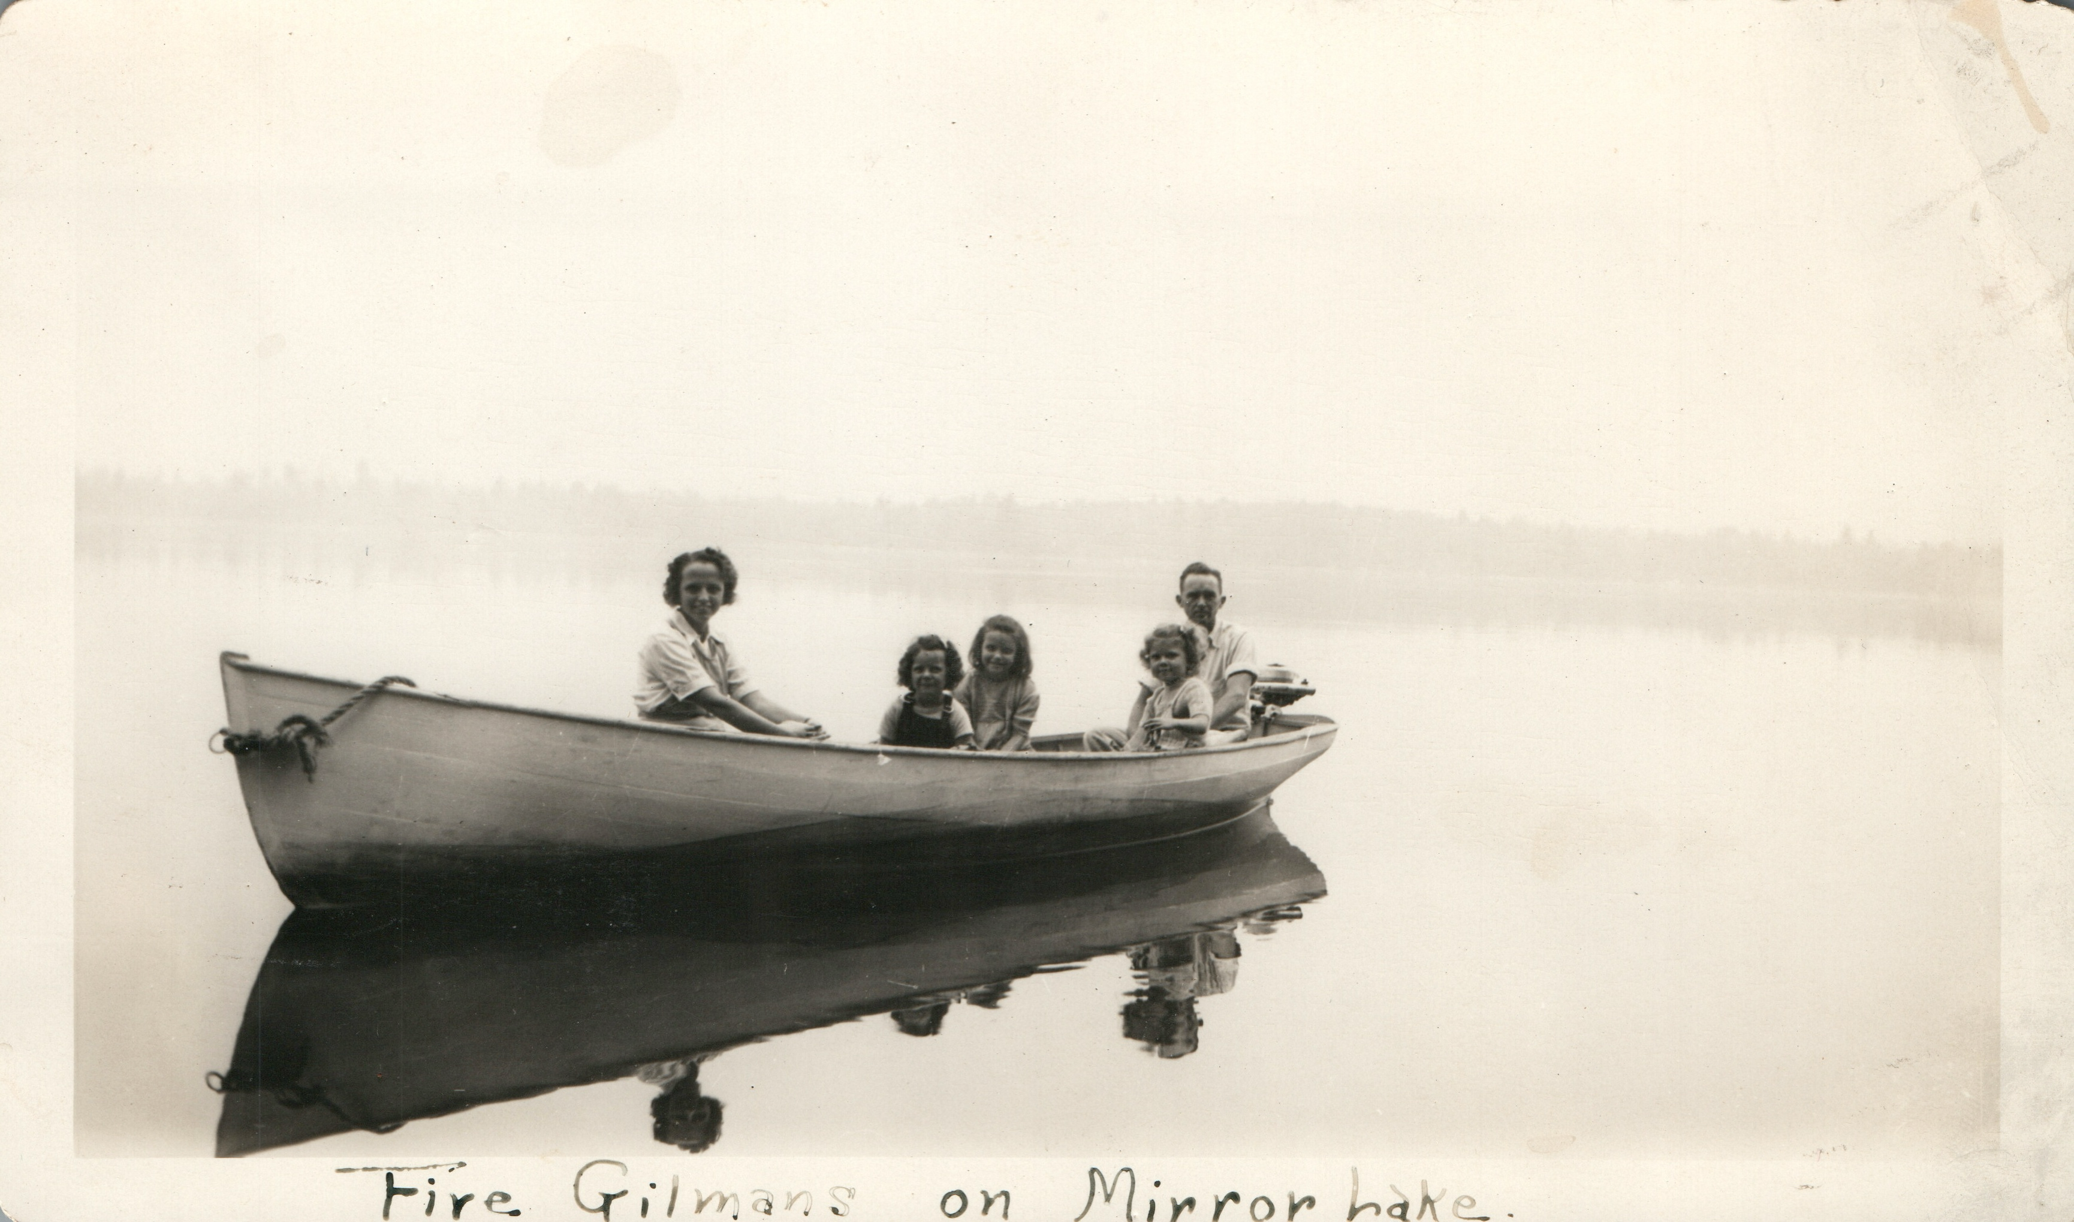
We Remember
Ann Gilman Freeze
Otto “Bud” Nemec
Notes:
Mission & Vision: Next slides
Losses: Nancy Byrd; Claudia Bissett; Bob Friel
Mirror Lake Estates: Last year yielded a few new members; Kudos to those maintaining the fixes!

Slide 4
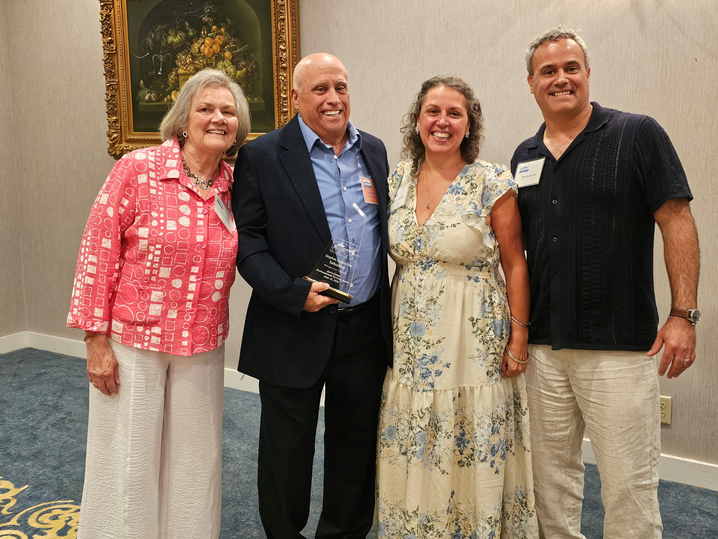
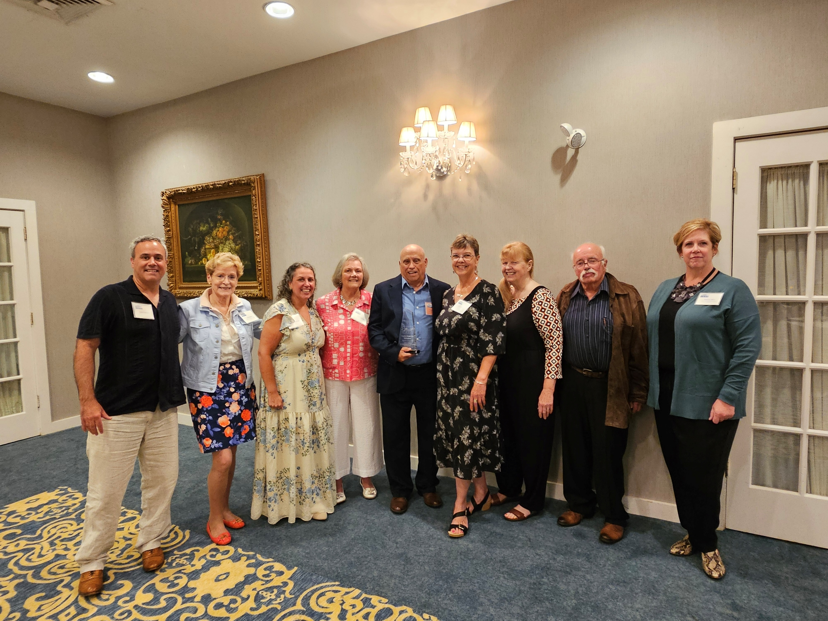
Lakes Region Planning Commission
Ayers Cotton Award: STEVE SCAPICCHIO
Notes:
“Beacon of the community”
“Enriches the environment”
“Faithfully and persistently works to improve environmental quality of the Lakes Region”
Steve and Joan plus their children
Audrey Frazier, Tuftonboro Town Administrator
KS
Larry Gil
Dusty Davies
Suzanne Maus

Slide 5

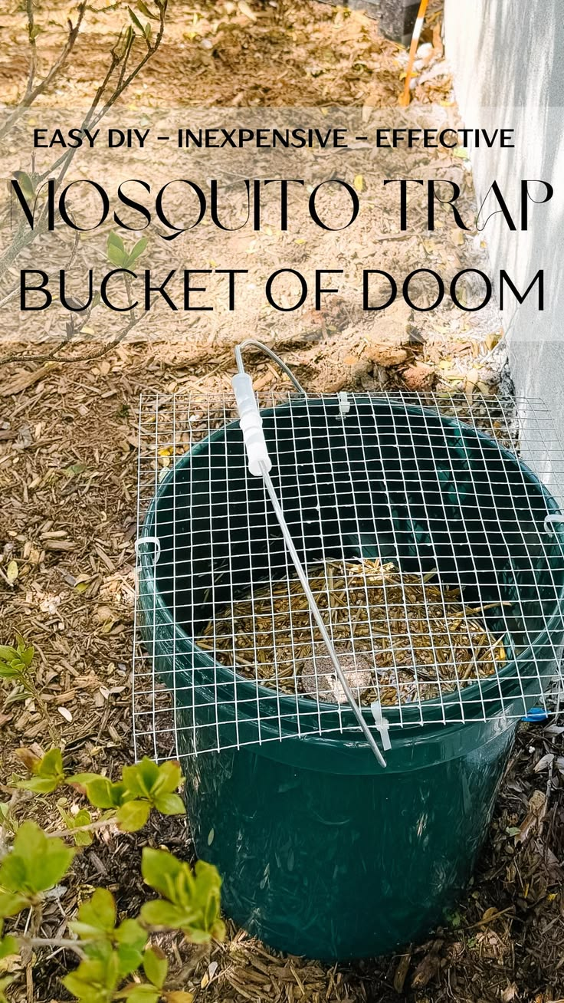
How Can You Help Today?
Permission to Walk on Property
Mosquito Bucket Raffle

Slide 6
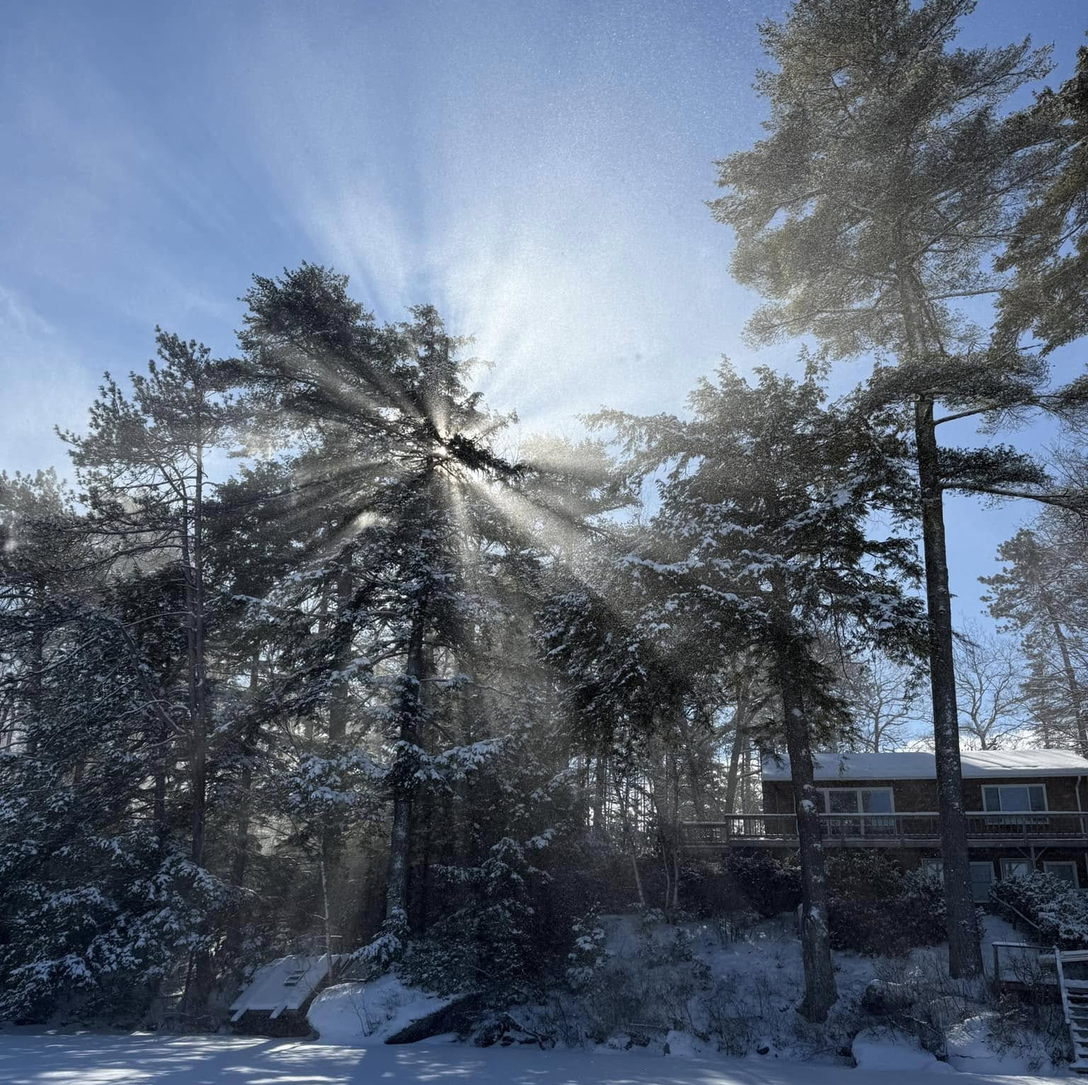
Secretary’s Report
Fran O'Donoghue

Slide 7

2026 MLPA Financial Report
Gary Philbin, Treasurer
Contributions YTD
Check Deposits $8150
Credit Cards $1155
PayPal $1178
Venmo $ 202
Total Deposits $10,685
Cash Balance
July 1, 2025 $56,508
May 29, 2026 $53,342
Expenses
NH Lakes Host (2x) $8478 Hospitality $1460
Insurance $1356
Donations $1050
Water Testing $ 400
Misc, Postage,etc $ 339
Supplies $ 268
Other Misc $ 522
Total Expenses: $13,863

Slide 8

MLPA Proposed Budget ‘26-27
Dues Goal $12,000 (We are halfway there today)
Expenses
NH Lakes Payroll Contribution 4500
Insurance 1400
Lake Testing 1200
Hospitality 1100
Donations 1100
Website Fees 450
Postage, etc 350
Supplies 250
NH Lakes Congress 250
Other 250
TOTAL $11,600

Slide 9

Cash Balance
Cash Balance July 1, 2025 $56,508
Cash Balance May 29, 2026 $53,342

Slide 10

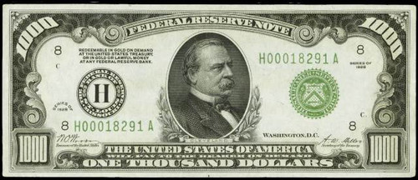
Tax Break for Donations
Standard Deduction
Notes:
Yes, you can deduct charitable contributions even when taking the standard deduction. Thanks to the One Big Beautiful Bill Act, you can claim an "above-the-line" deduction of up to $1,000\) (single filers) or $2,000\) (married filing jointly) without having to itemize. [1, 2, 3]
Direct Gifts Only: This deduction applies to gifts made directly to qualified 501(c)(3) charities, but does not apply to contributions made to Donor-Advised Funds (DAFs). [1, 2]Itemizers vs. Non-Itemizers: If your total charitable donations and other deductions exceed the standard deduction (\(\$16,100\) for single filers; \(\$32,200\) for married couples filing jointly), you will likely benefit more by itemizing on Schedule A. [1, 2]Here’s the information on the charitable deductions:
From ChatGPT:
Yes, you are referring to a new charitable deduction for non-itemizers.
Starting with tax year 2026, taxpayers who take the standard deduction can also deduct certain charitable contributions. The IRS states that if you do not itemize, you may deduct up to $1,000 of qualifying charitable contributions if filing single, or $2,000 if married filing jointly.
In plain English:
Before 2026, if you took the standard deduction, your charitable gifts generally provided no federal tax deduction.
Beginning in 2026, you can take the standard deduction and still deduct up to $1,000 ($2,000 for a married couple filing jointly) of qualifying charitable gifts.
A few important limitations:
The contribution must generally be cash (including checks, credit cards, and similar cash-equivalent gifts).
The gift must be made to a qualified charitable organization recognized by the IRS.
Gifts to individuals are not deductible.
Contributions to donor-advised funds generally do not qualify for this particular deduction.
For example:
If you file as a single taxpayer, take the standard deduction, and donate $800 to your church and $200 to a local food bank during 2026, you may be able to deduct the entire $1,000.
If you donate $1,500, the deduction is generally capped at $1,000 if filing single.
As to what form you will use: the IRS has not named this deduction. It is a charitable deduction that will be claimed on your 2026 federal income tax return (filed in 2027), and the IRS will provide the appropriate reporting line or schedule.

Slide 11

Donations
Lake Wentworth Water Summit $100
Lake Winnipesaukee Association $100
Lakes Region Conservation Trust $100
Loon Preservation Committee $100
Mirror Lake Community Church $100
Moose Mountain Regional Greenways$100
NH Lakes $300
Tuftonboro Fire Rescue Department $100
Tuftonboro Free Library $100
Notes:
These are the organizations we currently donate to, and some also donate to MLPA. Proposing to add Tuftonboro Free Library as board, small committee meetings and the Annual meeting is held here. Could stop donations to Lake Winnipesaukee Association.

Slide 12
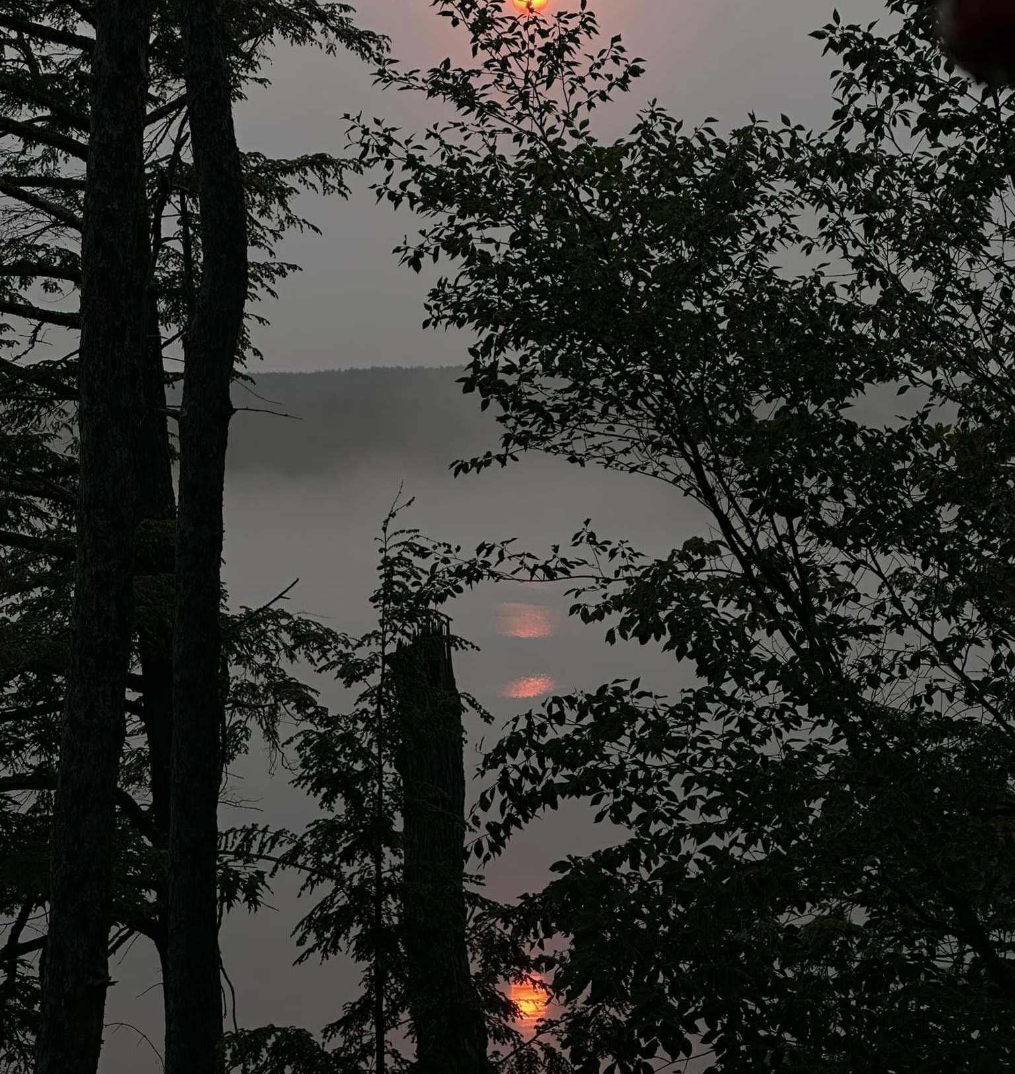
Nominations 2026
Mirror Lake Protective Association
Officers
President: Kathleen Sciarappa
Vice President: Val Zanchuk
Secretary: Fran O’Donoghue
Treasurer: Gary Philbin
Directors
Dusty Davies 2029
Larry Gil 2029
John Dawson 2027
Ann Torregrossa 2027
Suzanne Maus 2028
Steve Scapicchio 2028
Notes:
Good morning,
My name is Dusty Davies; I am a current board member and a former president of
MLPA.
Kathy appointed me, John Dawson, and Gene Kelly to be members of the MLPA
Nominating Committee.
MLPA’s by-laws provide that the members approve, at the annual meeting, a slate of
officers serve for a one-year term and fill two director vacancies to serve a three-year
term.
The proposed 2025-26 officers of MLPA (see slide) are:
President, Kathy Sciarappa
Vice President, Val Zanchuk
Treasurer, Gary Philbin
Secretary, Fran O’Donoghue
Before we vote on the election of the officers, I would like to thank’ and please stand a I
say your name) Kathy, Val, and Fran for agreeing to continue to serve.(applause) I
would also like to thank Robin Muench for her service as Treasurer and her long
dedication to MLPA’s conservation efforts. I worked closely with Robin in obtaining two
federal grants, one in 2010 to identify the sources of cyanobacteria in Mirror Lake, and
the second in 2012 to develop a Management Plan to implement remediation efforts
directed at the most significant sources. Her work was critical to our obtaining those
grants. Among other things Robin developed a user-friendly spread sheet to report the
thousands of volunteer hours residents contributed to the fact in finding mission. This
spread sheet format is still being used by NHDES. Many thanks for all of Robin’s hard
work.
I would like to introduce you to Gary Philbin. Unfortunately, Gary was not able to attend
today due to a family commitment, but he asked me to read the following:
Gary and Glenda Philbin have been at Mirror Lake since 2006. They have been members of
MLPA since joining the same year. Glenda has been part of the weed watching flotilla over the
years. Gary retired in 2020 after a 47-year career in retail, and has been treasurer of Mirror
Lake Estates Association [a road association] since then. Mirror Lake Estates Association efforts
include managing the annual dues, dealing with vendors on various projects and a major capital
project to re-pave much of Mirror Lake Dr. He looks forward to working with the team at
MLPA.&quot;
A side note, when we were looking for home across the lakes region in 2006, we stopped at
Bailey&#39;s Bubble after a particularly frustrating day. We happened to meet you and George, and
you told us to look at Mirror Lake and gave us your card. The rest is history!
It just goes to show you that we Presidents go to great lengths to get great neighbors on Mirror
Lake!
The committee is nominating the slate of officers presented above to serve for the 2025-26 of
MLPA term. Do we have any nominations from the floor?
Do I have a motion to approve the slate of officers proposed? A second?
Any discussion?
All in favor? oppose? abstain? Let the record show….
Nominations for the Board of Directors:
The committee is nominating Suzanne Maus and Steve Scapicchio to serve a three-year term on
the MLPA board of directors.
Before we vote on the election of the two directors highlighted above, I would like to thank Gene
Kelley (stand) for his invaluable service to MLPA, both in his capacity as a former President and
as a director. One of his significant contributions was the role he played as a member of the town
appointed committee to address the rebuilding of Lang Pond Road at the public beach. Gene’s
professional life was spent overseeing the reconstruction of vast highways and bridges including
one with which I was familiar, the Vine Street Expressway and the Ben Franking Bridge
connecting Philadelphia to NJ. Gene’s professional credentials, and general warm and kind
demeanor, guided the committee through some rough patches and contributed to keeping Lang
Pond Road a dirt road and not an elevated two-lane paved road. Thank you, Gene, and thank
you for continuing your volunteer efforts including providing your boat for MLPA water
sampling.
The committee is nominating Suzanne Maus, a new board member, to fill the position vacated by
Gene. Suzanne, would you please stand and tell us briefly about yourself?
Steve Scapicchio is the second Board member to be elected or in his case reelected as he has
agreed to continue to serve another 3-year term. We are delighted! Steve, would you please
standremind the residents of who you are and please briefly share with them your many
conservation efforts and contributions to MLPA, the Town of Tuftonboro, and the State of NH.
Thank you.
The committee is nominating Suzanne Maus and Steve Scapicchio to serve as directors or MLPA
for a three-year term. Do we have any nominations from the floor?
Do I have a motion to approve the appointment of Suzanne Maus and Steve Scapicchio?
Second?
Any discussion?
All in favor? oppose? abstain? Let the record show….

Slide 13
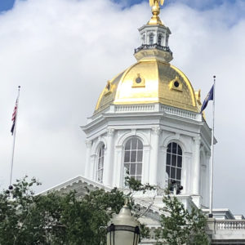
Lake Legislation 2026
Marilyn Edelhoch, MLPA
Andrea LaMoreaux, NH LAKES
Fees/misdemeanor yard waste in lake
Deeper study of cyanobacteria
Limits on dock agitators
Cyanobacteria mitigation funding
Notes:
• House Bill 416 (Jan 2026) prohibits the intentional disposal of yard waste into the surface waters of the state. (1st offense fines; 2nd misdemeanor)
House Bill 1148 expands the state's study of cyanobacteria and algae blooms, helping inform future policies and strategies to protect lake ecosystems, recreation, and drinking water supplies.
• Senate Bill 594 limits the use of ice-prevention devices, including agitators and bubblers, to situations where they are needed to protect legally existing permanent shoreline structures along our lakes during the winter. The law also strengthens public safety by increasing the visibility requirements for thin-ice warning signs from 150 feet to 200 feet. These commonsense changes help reduce unnecessary disturbance to lake ecosystems while improving safety for winter recreationists.
• Senate Bill 598 establishes a task force to identify sustainable long-term funding sources for the Cyanobacteria Mitigation Loan and Grant Fund—an important step toward addressing one of the most significant and growing threats to lake health in New Hampshire.

Slide 14
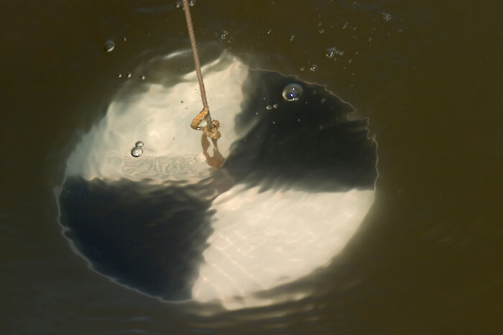

Mirror Lake Water Clarity
Secchi Disc
5.3 m=17.466 ft
Notes:
Conclusions of 55 years: 5.3 meters =17 ft 4.661 inches UNH Extension Station 3 Deep Point
1. Monitoring is of utmost importance. We have data stretching back to the 1950s and very active water testers today. We maintain close ties to UNH Extension (Bob Craycraft and NHDES)
2. Nationwide and locally there is a strong correlation between healthy lakes and strong property value. Conversely, lakes with issues have experienced up to 30% drop in value.
3. Early detection is the primary goal of Weed Watchers and Lake Hosts. Our responses have always been rapid. Fortunately, we mostly have false alarms.
4. Lake Congress predictions are that funding is drying up and unlikely to return to previous levels. Lucky to already have our $100,000
5. Crucial for us to manage stormwater runoff. Will talk about specific strategies landowners can employ.

Slide 15
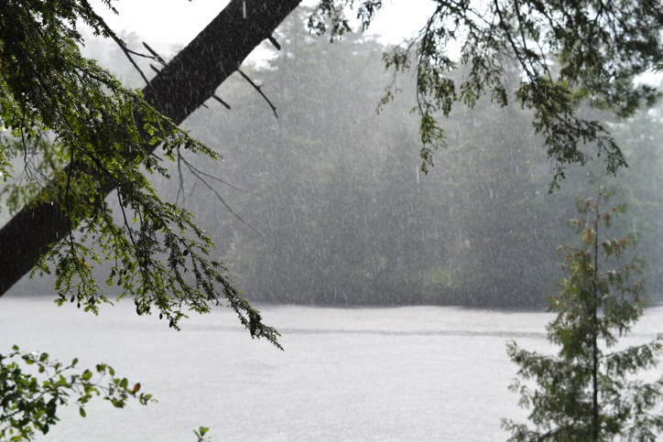
Diminished Acid Rain

Slide 16
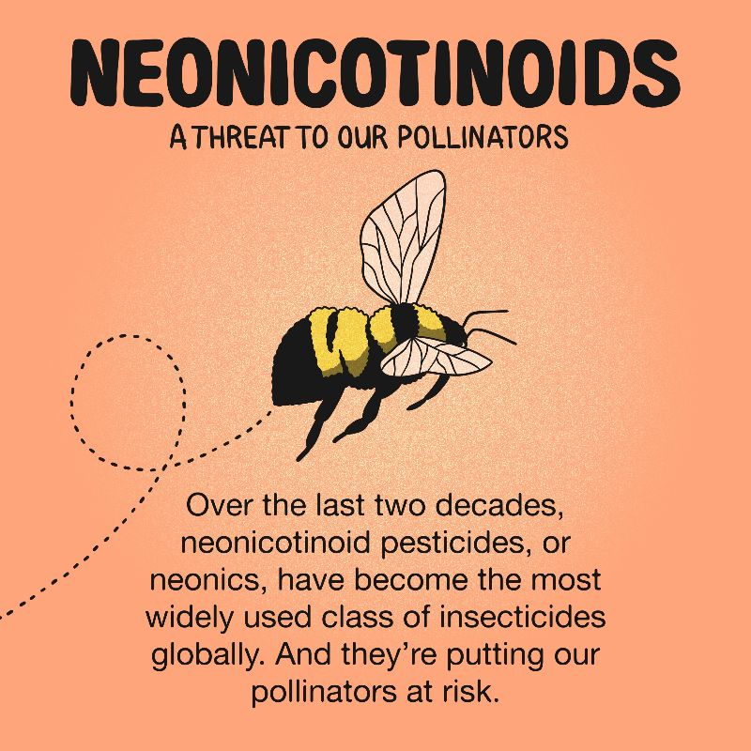
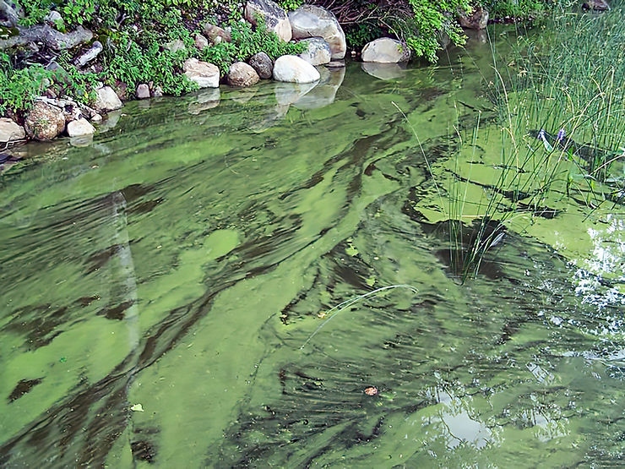
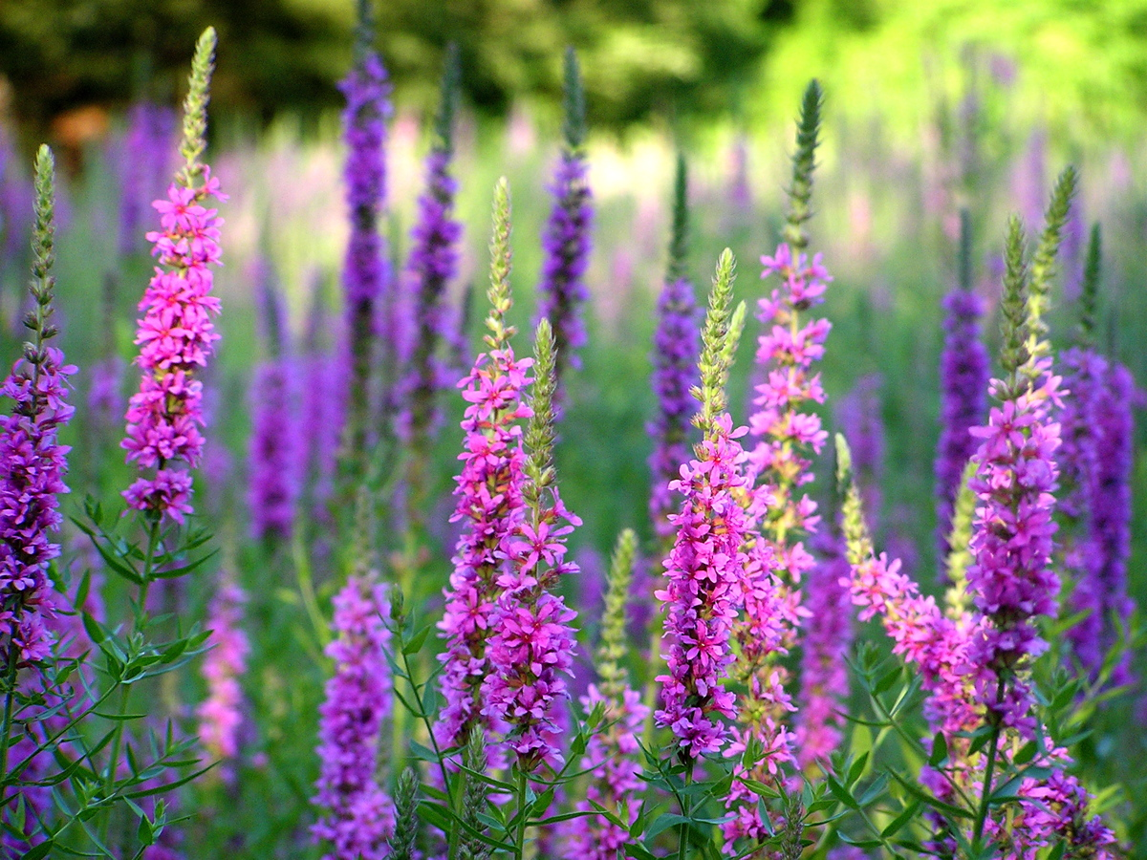
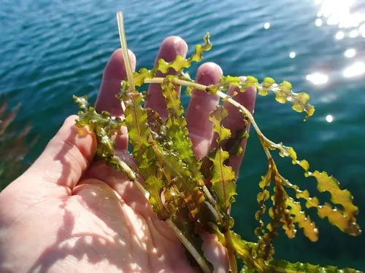
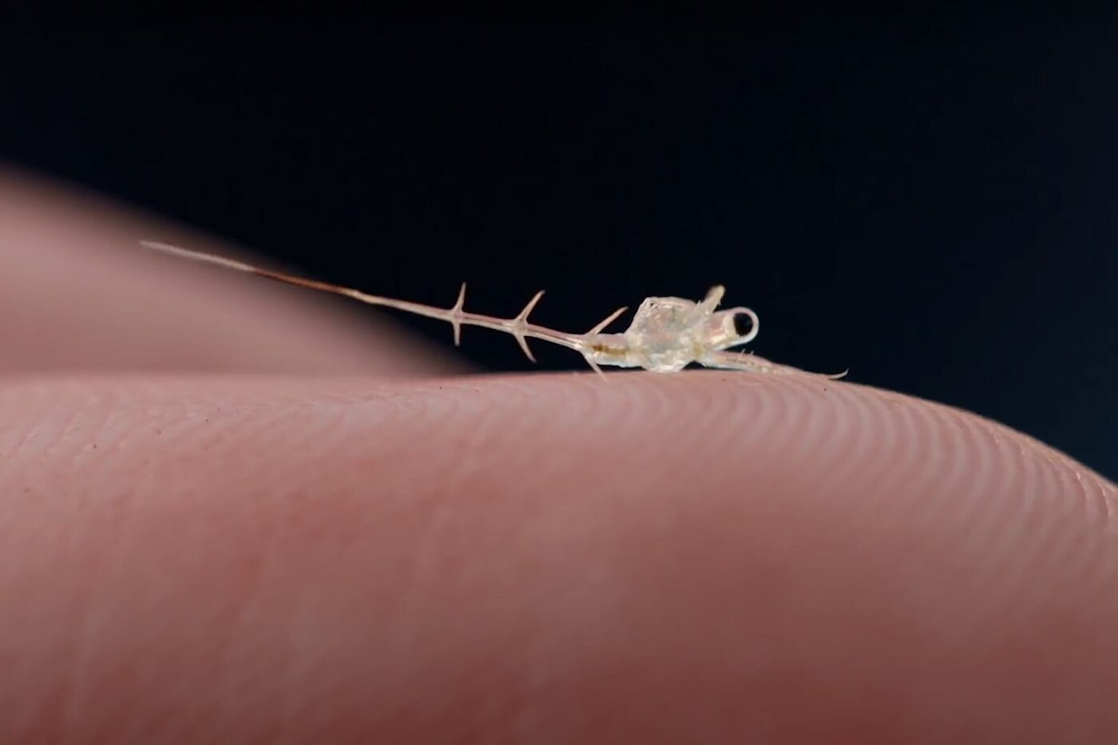
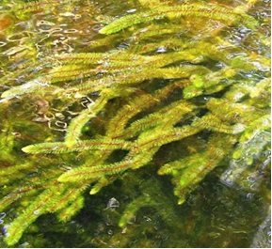
Mirror Lake Threats
Cyanobacteria
Purple Loosestrife
Spiny water flea
Milfoil
Curley leaf pondweed
Notes:
According to Amy Smagula Director Limnology Center, Chief Aquatic Biologist:
Spiny water fleas are best suited to clear, deep lakes of 20-40ft depths throughout. Mirror Lake is not as likely to be attractive. However, they are also highly adaptable creatures and watches for spiny fleas should continue.

Slide 17
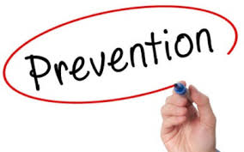


Slide 18
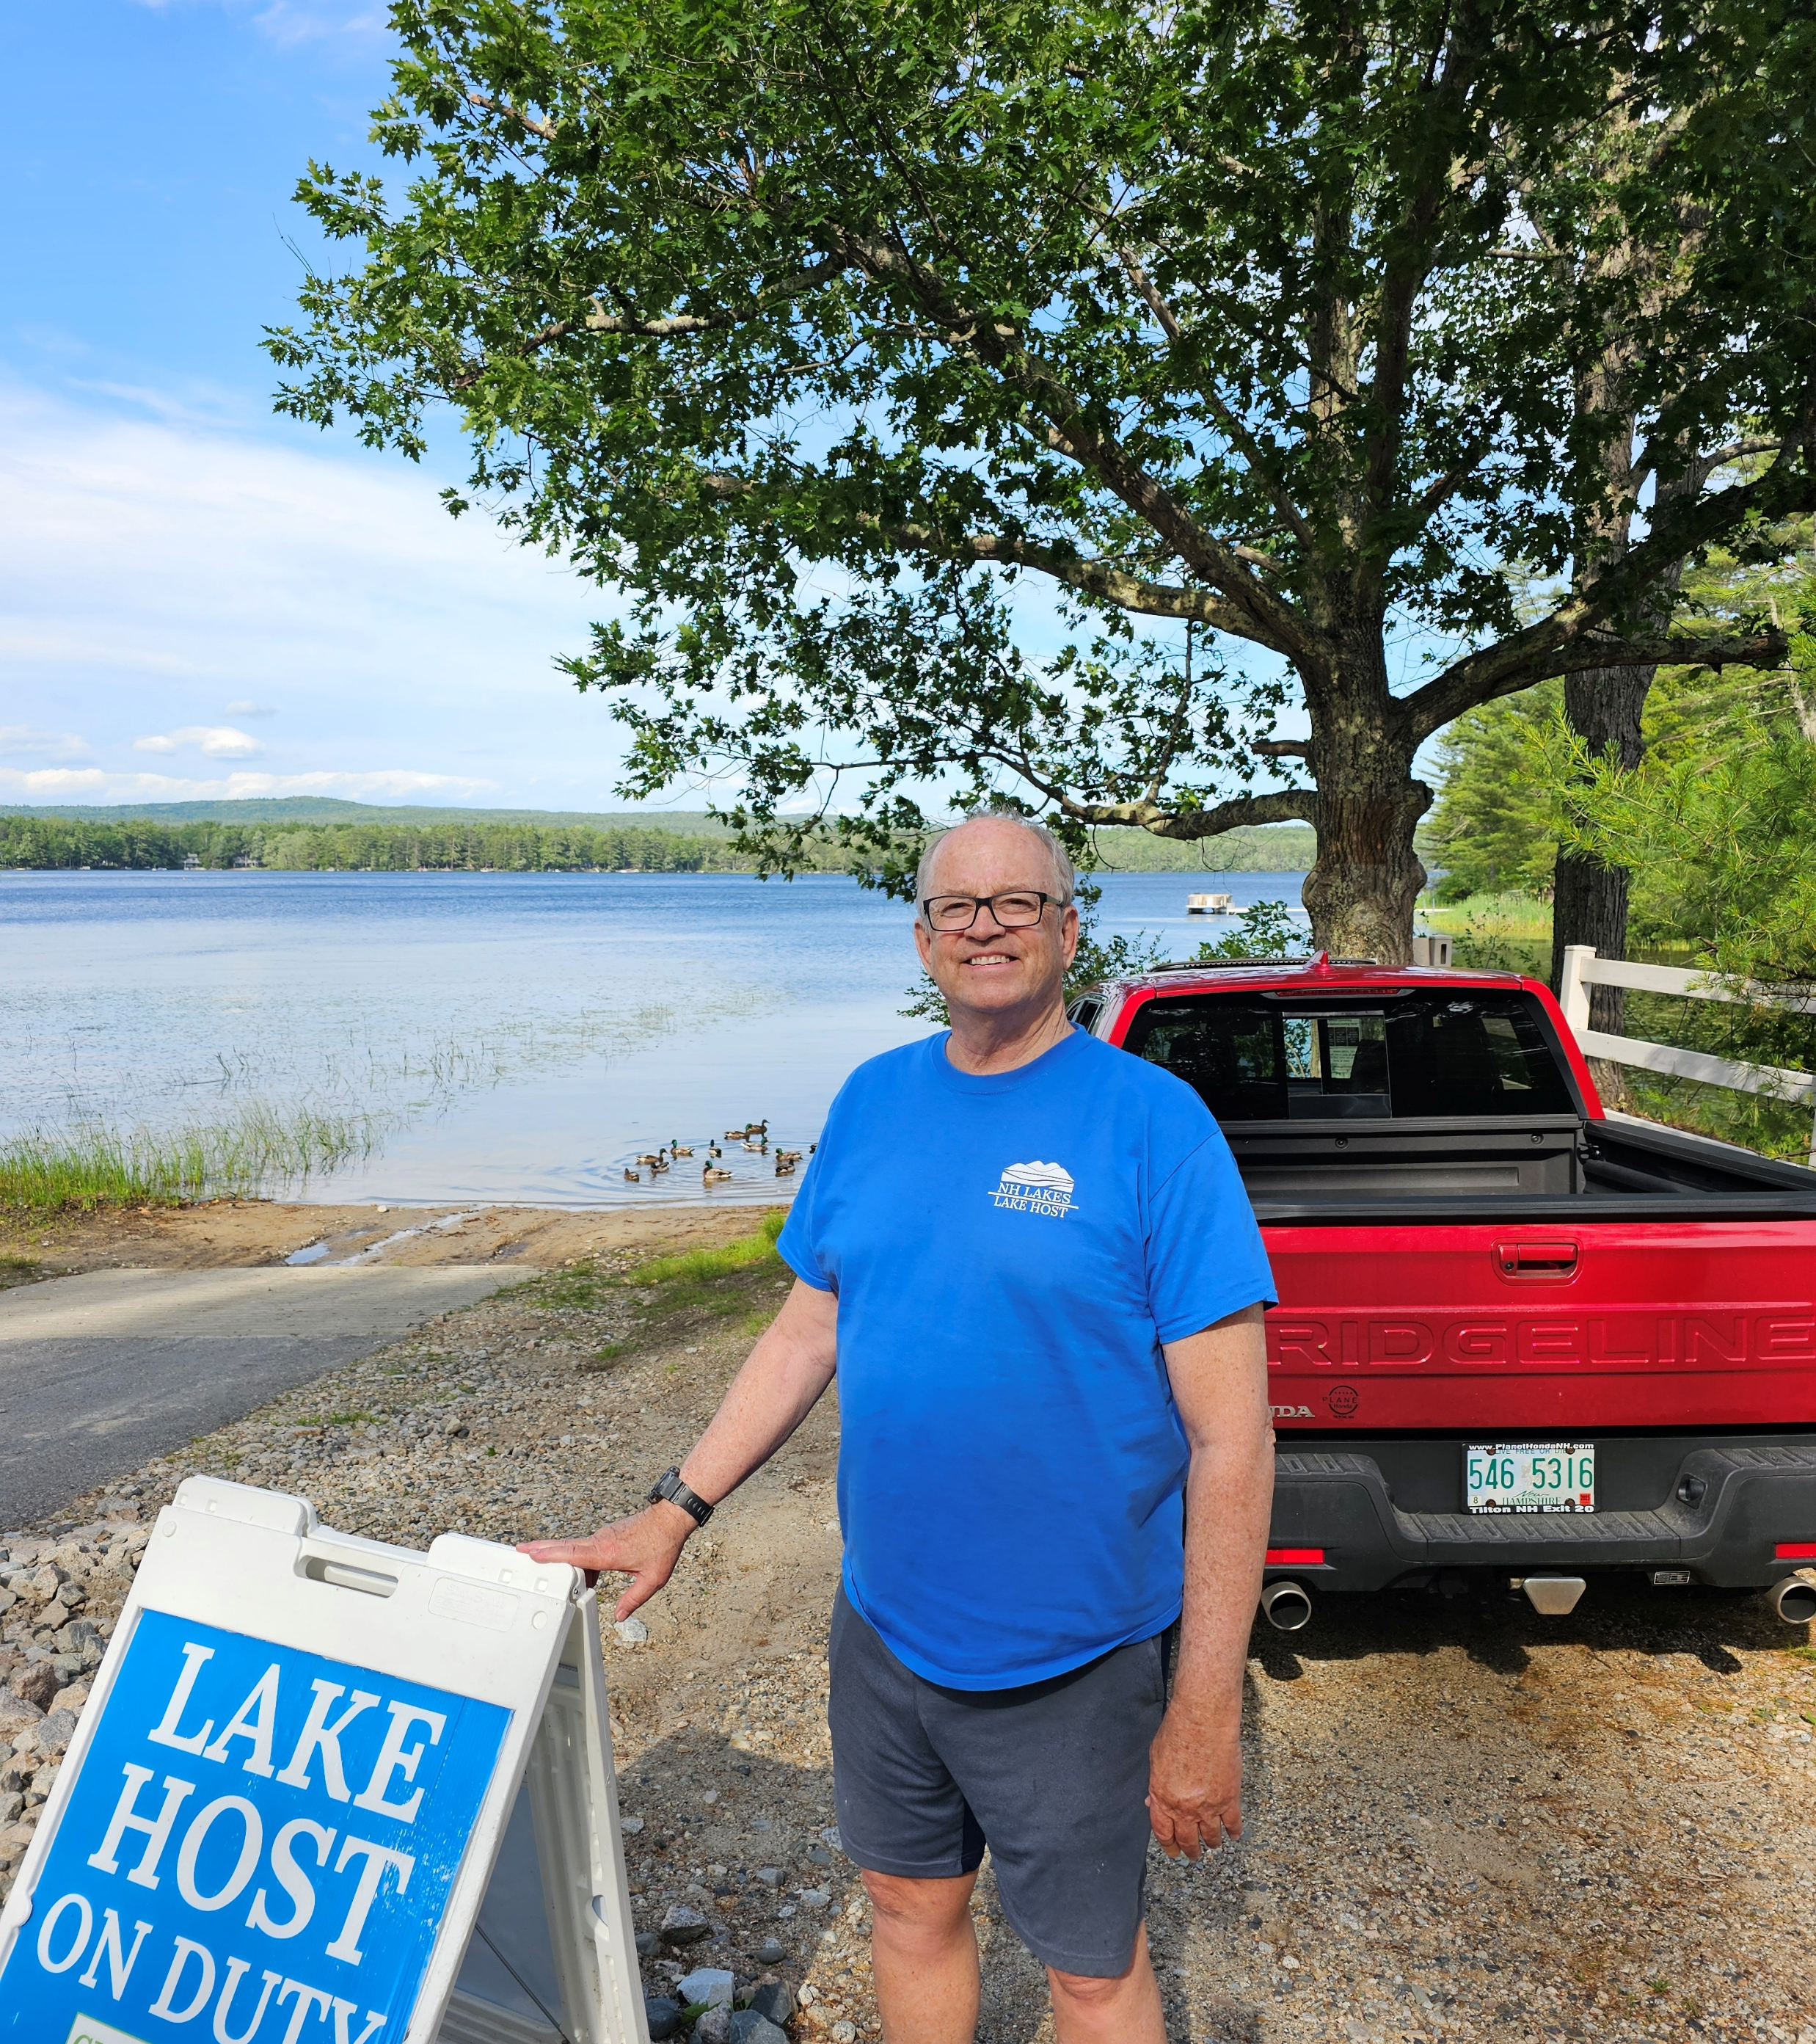
Lake Hosts
Phil Cassidy (paid Lake Host)
Denise Ferriman (paid Lake Host)
Janet Dephoure (paid Lake Host)
Larry Gil Chair (volunteer)
Alan Hardiman (volunteer)

Slide 19
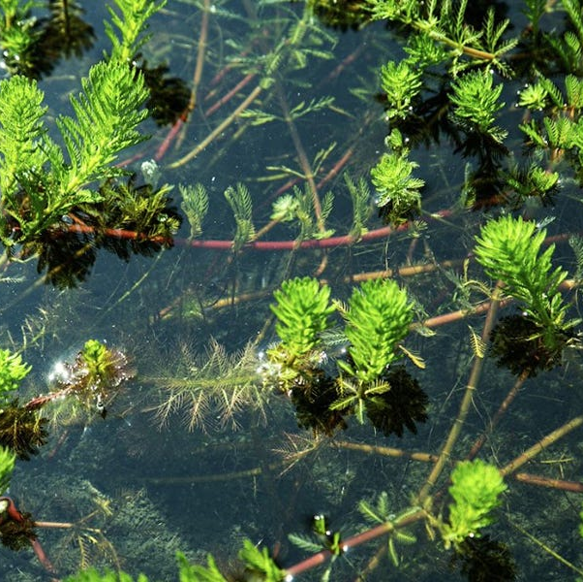
Aquatic Plant Monitoring
“Weed Watchers”
Tom Bissett
Alan Hardiman
Kip Lachner
Norma Milne, Chair
Glenda Philbin
Tiina Urv
Sharon Koning

Slide 20
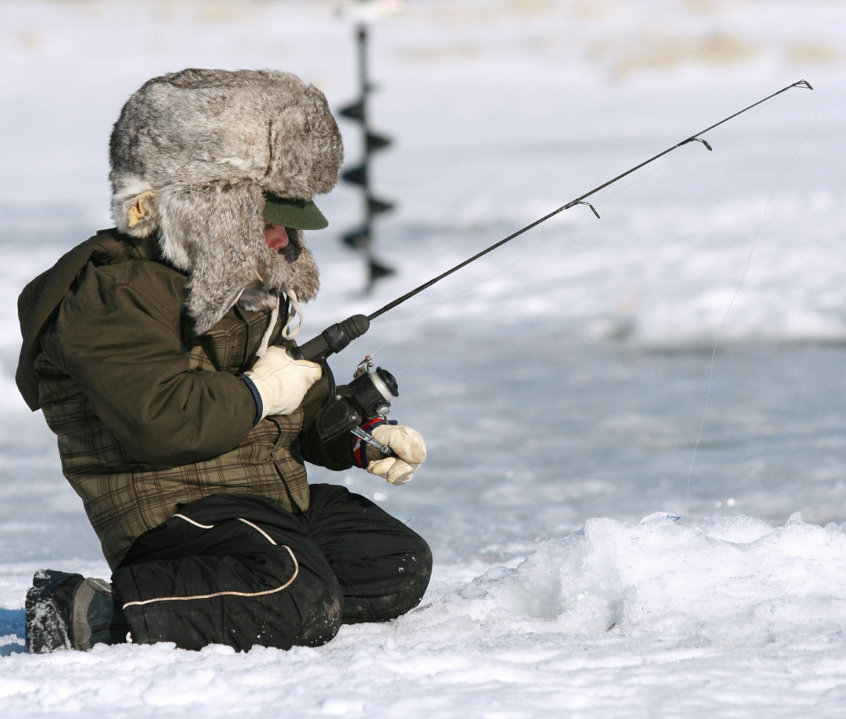
New Hampshire Climate Change
2024 warmest NH on record
Lakes warming (vs air & ocean)
Ice cover (3 months vs 4)
2023 1.5 months ice cover
Weather events (4” & 5” )
Droughts
Organic matter after storms
“P” 3x-9x greater after storms
Mosquitos increasing

Slide 21
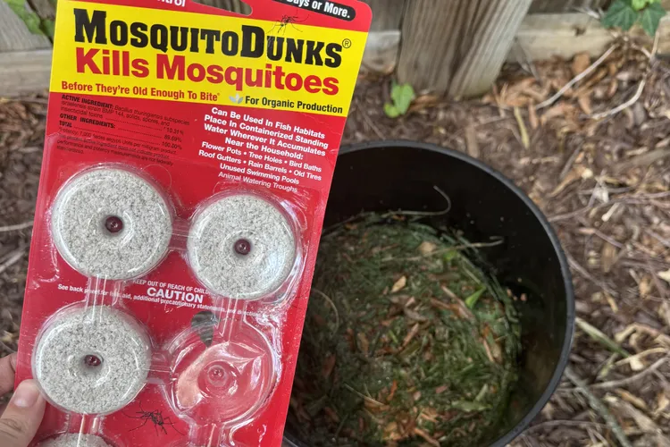
Neonicotinoids

Slide 22

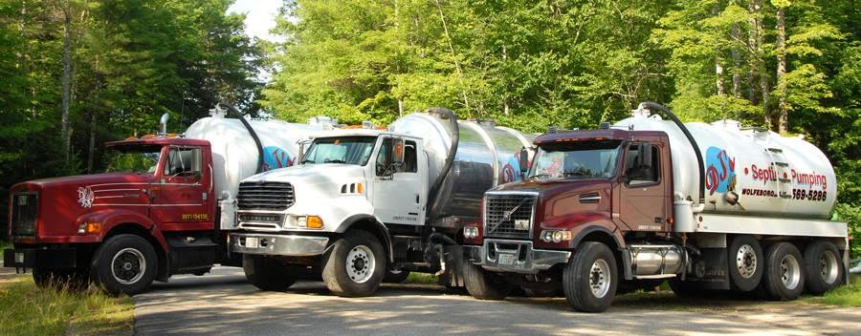
DJ Septic 10%

Slide 23
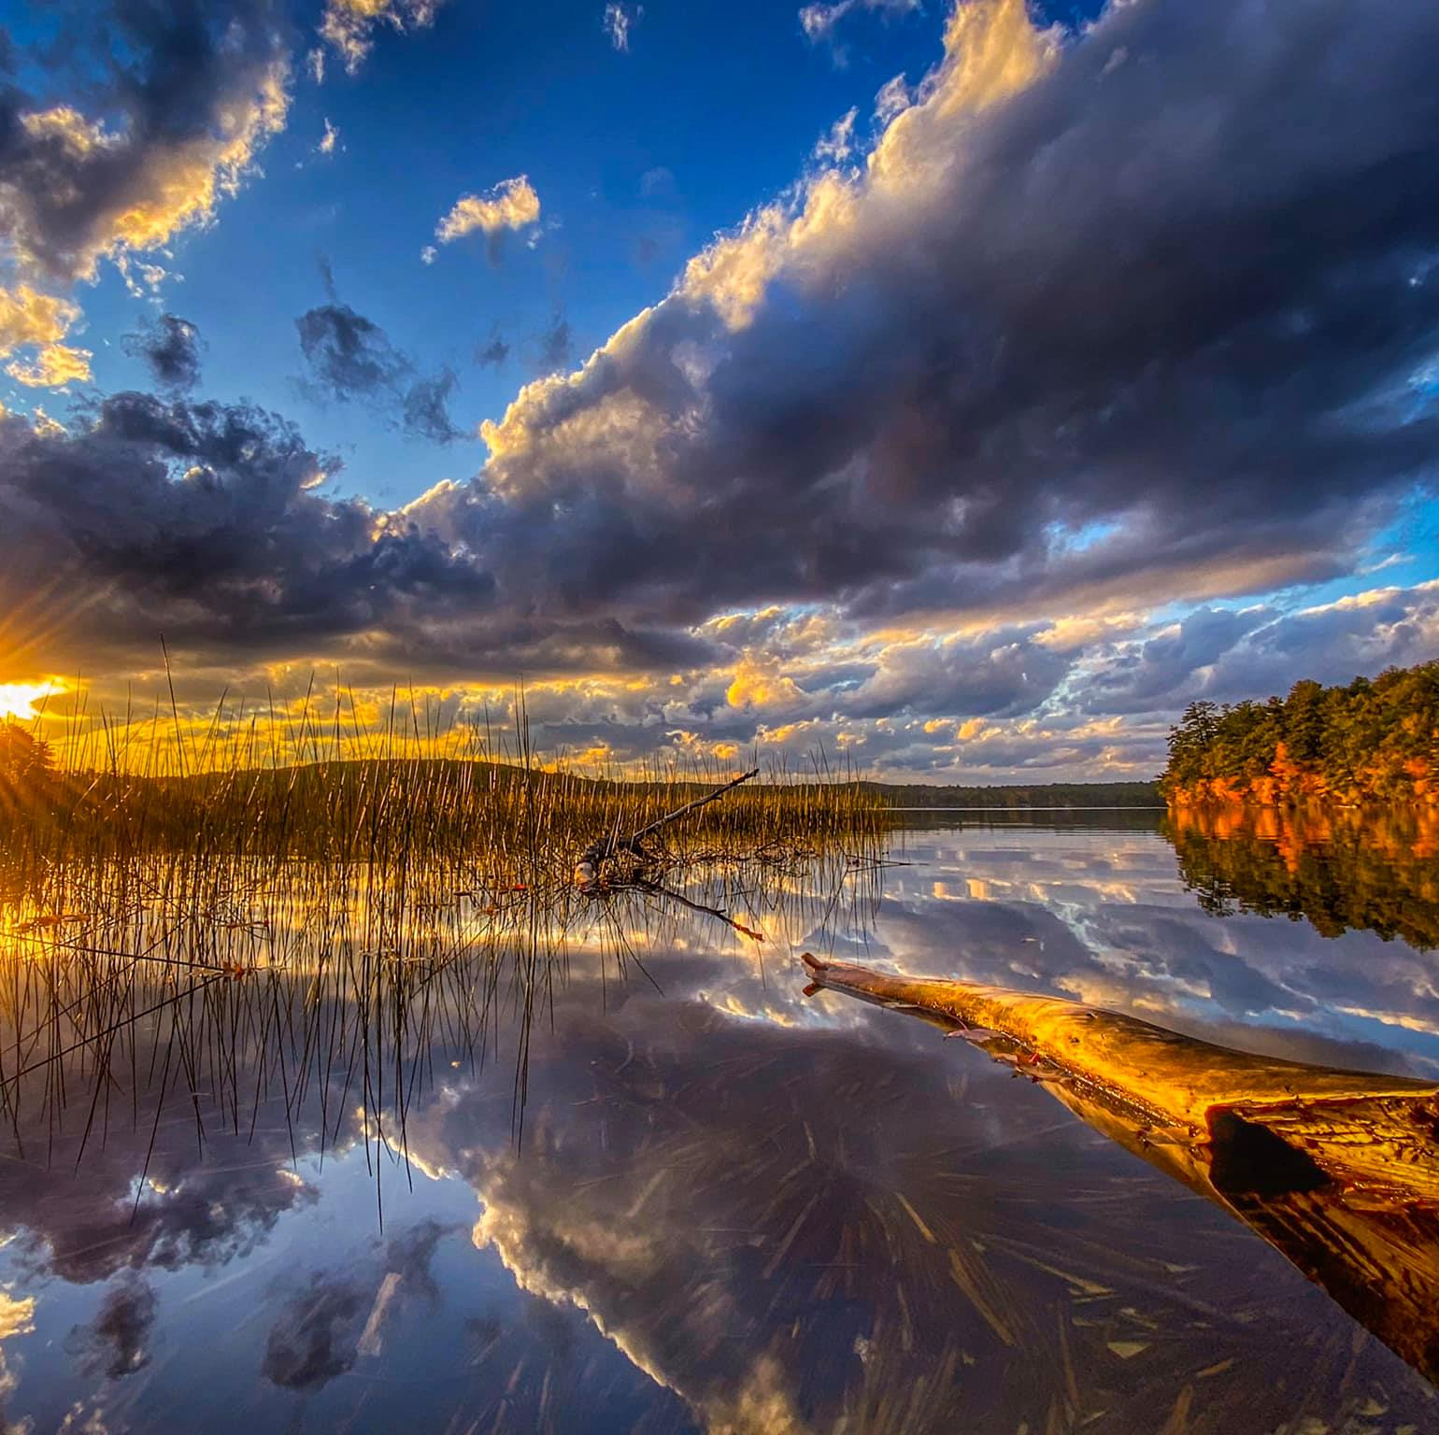
NHCWSRF NHCleanWaterStateRevolvingFund
Mirror Lake Tasks
$100,000
NH Governor’s Council
1. Management & Meetings
2. Shoreline survey
3. Watershed Survey & Engineering
Design
4. Water Quality Testing and Analysis
5. Action Plan & In-Lake Restoration

Slide 24
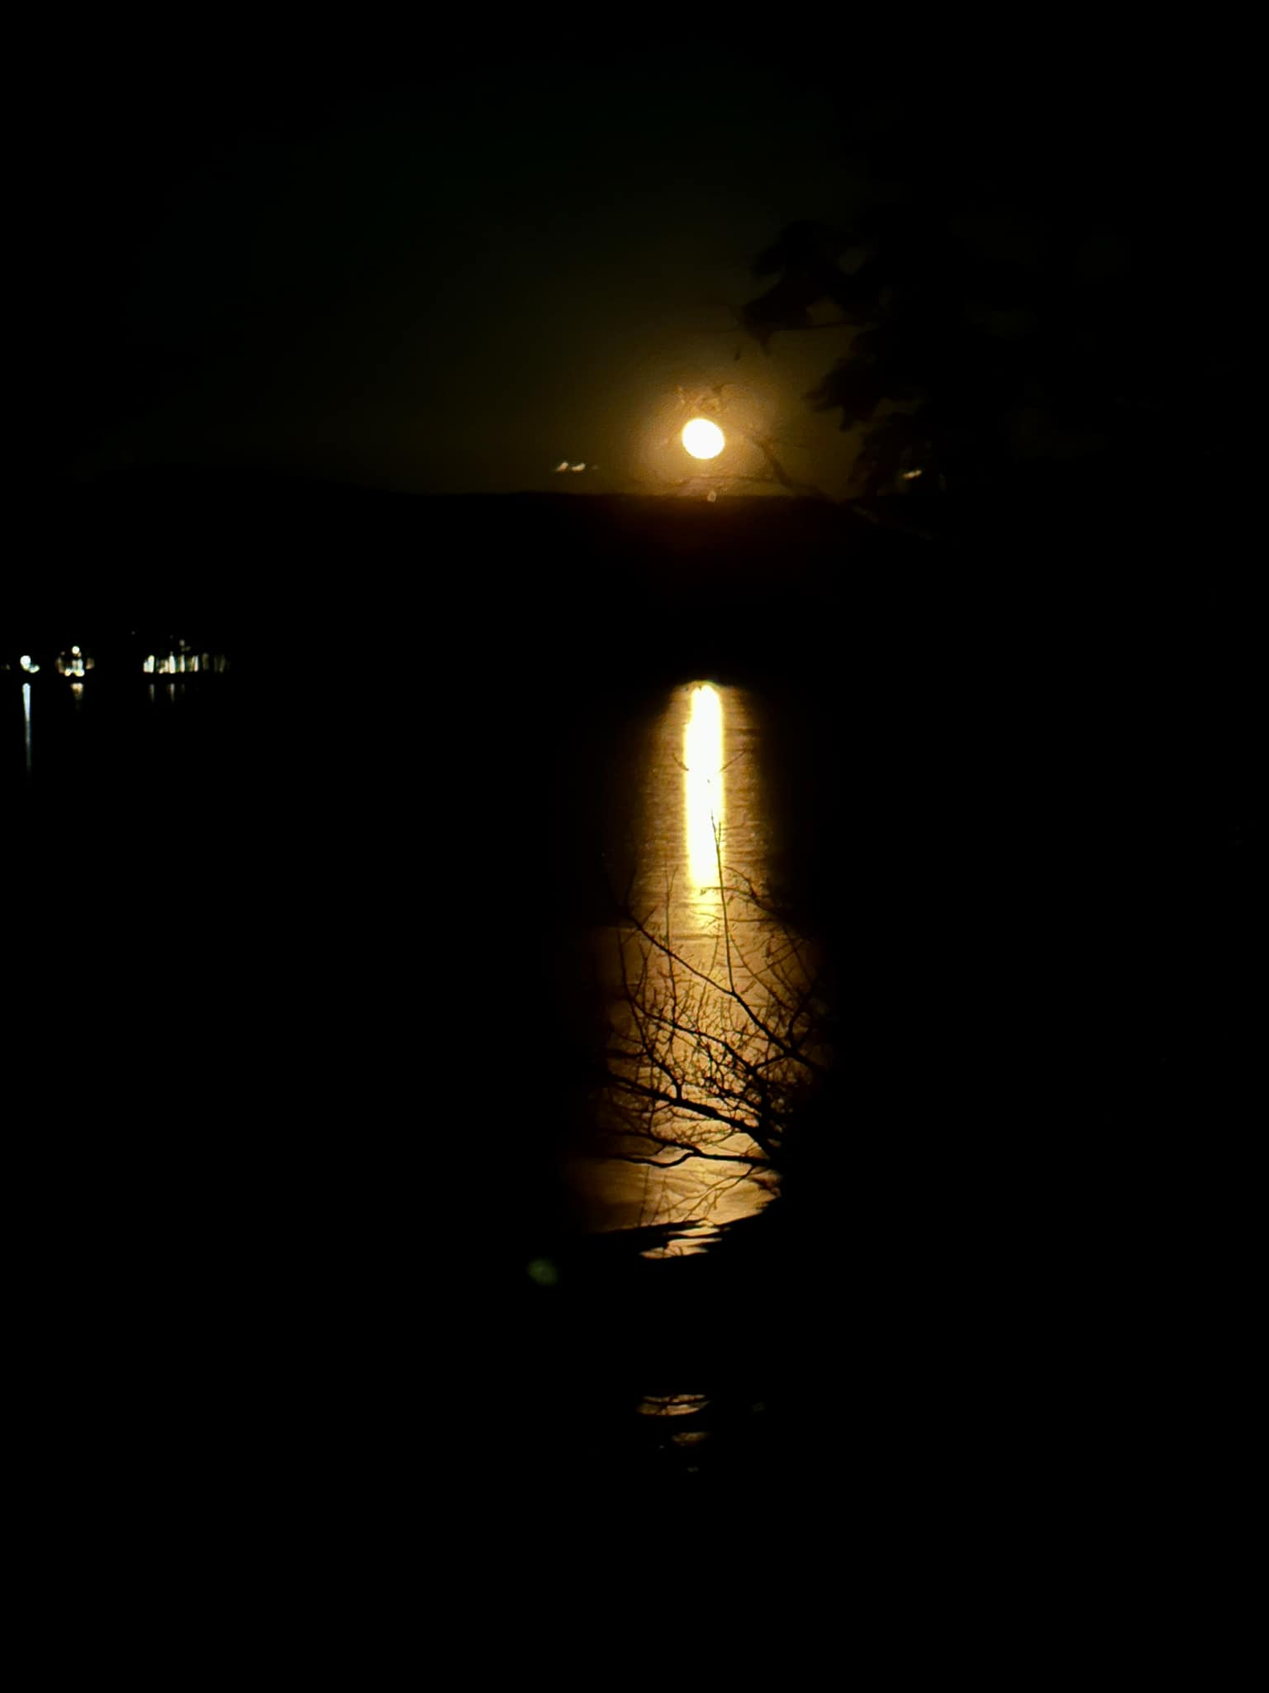
Mirror Lake Phosphorus
Watershed runoff 50-70%
Atmospheric 5-24%
Mirror Lake Deep Hole 17%
Septic systems 7%
“Internal” and “external” loading
Notes:
In lakes, external loading refers to the influx of nutrients and other materials from sources outside the lake, like rivers, streams, and atmospheric deposition. Internal loading describes the release of nutrients from the lake's sediments back into the water column, often triggered by factors like oxygen depletion or sediment disturbance. Understanding both is crucial for managing lake health, as they can significantly impact water quality and ecosystem dynamics.

Slide 25

Phosphorus Loading = Cyanobacteria Blooms
Phosphorus
from
one developed acre
is
10x-20x greater
than
a natural forested acre
Notes:
Phosphorus loading, the primary driver of cyanobacteria toxic blooms, from a developed acre of land is 10-20 times the phosphorus loading from a natural forested acre of land

Slide 26
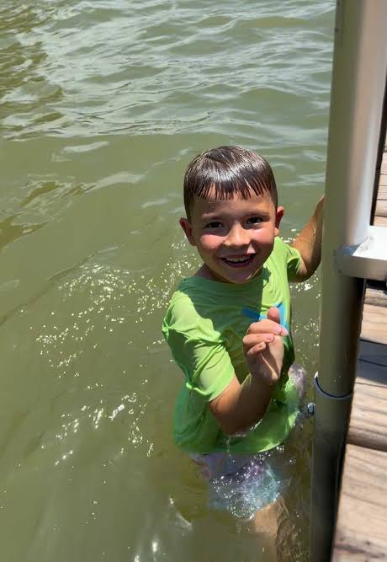
Safe to Swim?
NH Department of
Environmental Services
Healthy Swimming Mapper

Slide 27
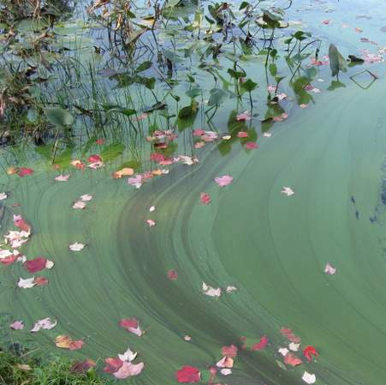
Assess Before Entering the Water
      LOOK
      CHECK
      REPORT
Healthy Swimming Mapper

Slide 28
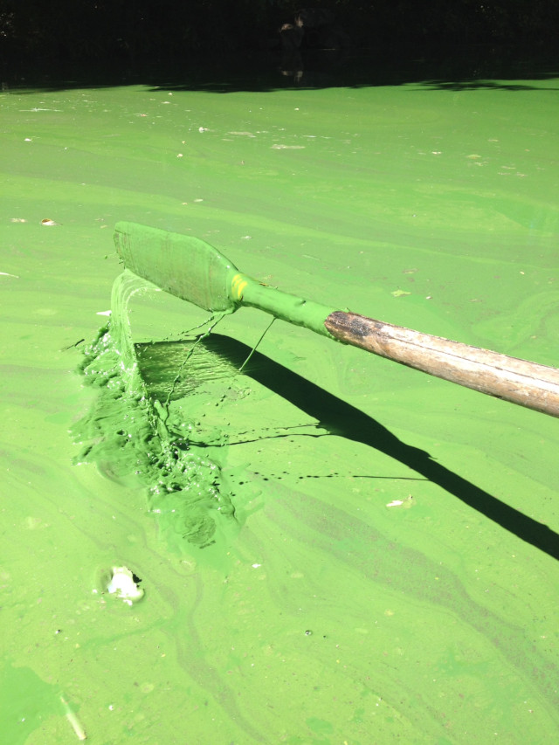
The Stick Test
Appears as paint on a stick…cyanobacteria
Samples brought to Concord lab
“When in doubt, stay out”

Slide 29
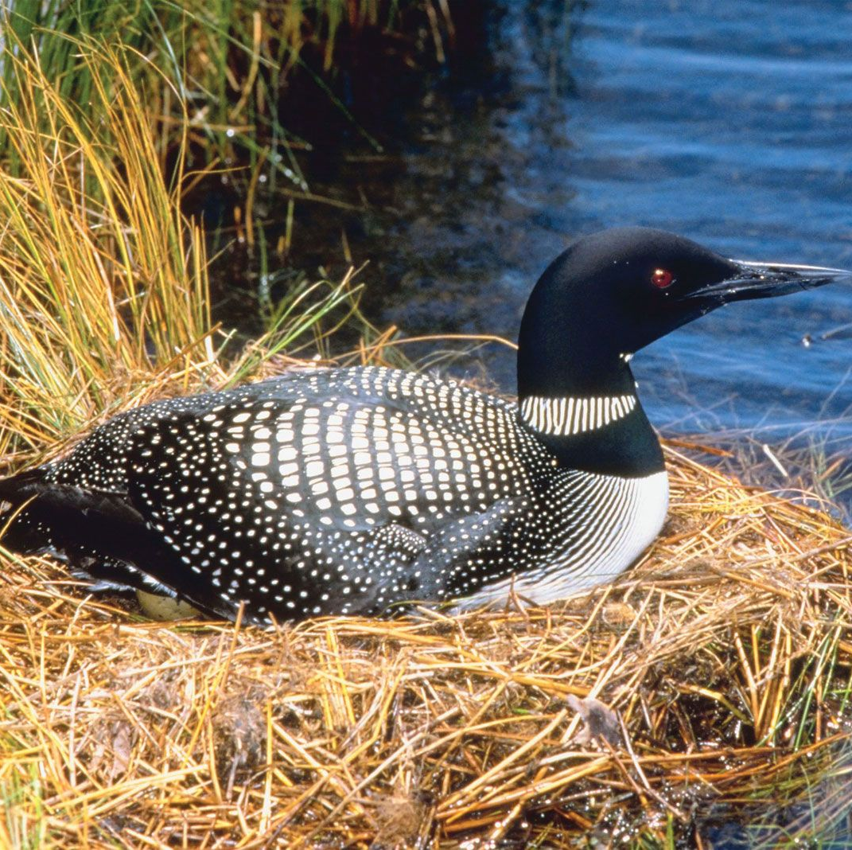
Our Loons
Notes:
1975: 34 loon pairs Territorial loon pairs are those that defend their area in a lake and have the capacity to produce chicks
Mirror Lake is just barely large enough for one loon pair. We didn’t always have a territorial loon pair.
NH Bans Lead Sinkers (1st) NH was the first state to ban lead sinkers which are (were) the leading cause of death for loons. Once ingested, 2-4 weeks for death from lead poisoning
2024: 326 loon pairs
192 chicks
133 survived season

Slide 30

Path Forward
  Control water runoff
  Use native plants with deep roots instead of lawns
  Avoid fertilizers
  Maintain septic (pump & inspect)
  Avoid wake boats
  No dock agitators
  Reduce winter salt
  Go “Wild”
Notes:
Eliminate dock agitators
They increase sun exposure; exposure to wind; add to nutrient mix
The watershed is KEY to improving water quality to the lake
Use native plants with deeper roots instead of lawns
Avoid fertilizers
Maintain septic (both pump and inspect)
Avoid use of wake boats (they mix nutrients 30 feet or lower)
No dock agitators
DES VLAP monitoring & NHDES
Plankton sampling-phytoplankton and zooplankton counted by Ken Wagner

Slide 31


Welcome New Neighbors

Slide 32

Get Your Mirror Lake Shirt!
$25 or 2 for $40!

Slide 33
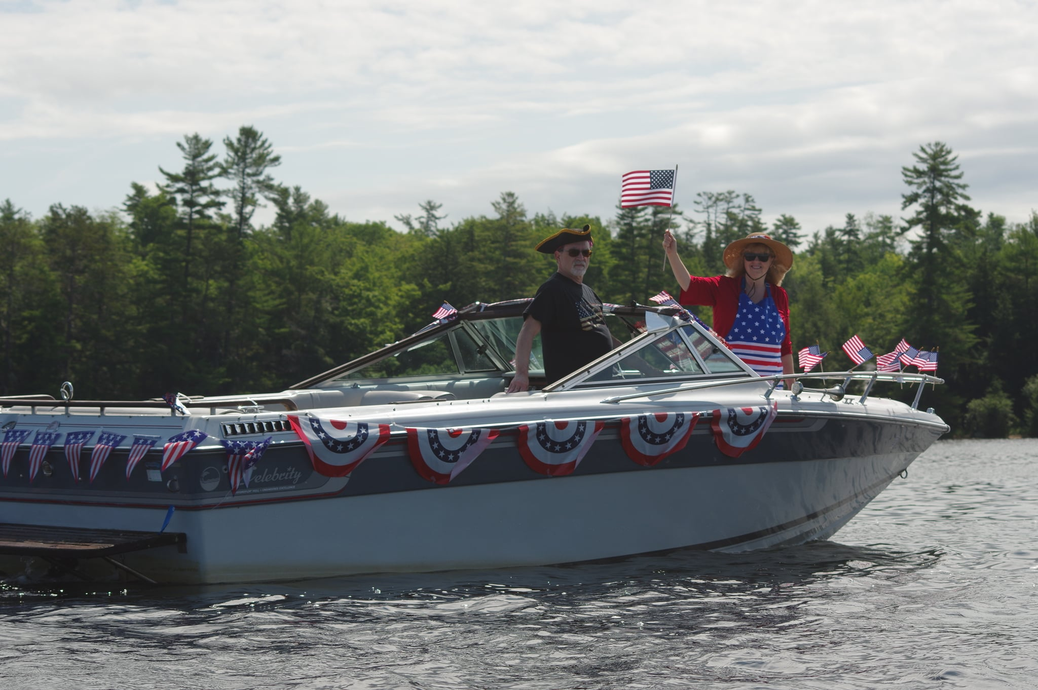
Social Events
Boat Parade July 3 10:00am
July 5 Rain Date
****************************
VOLUNTEERS NEEDED
Old Fashioned Mirror Lake Mingle
Aug 22 4-7:00pm
Aug 23 Rain Date
Families and Younger Members
BBQ, Games & Music

Slide 34
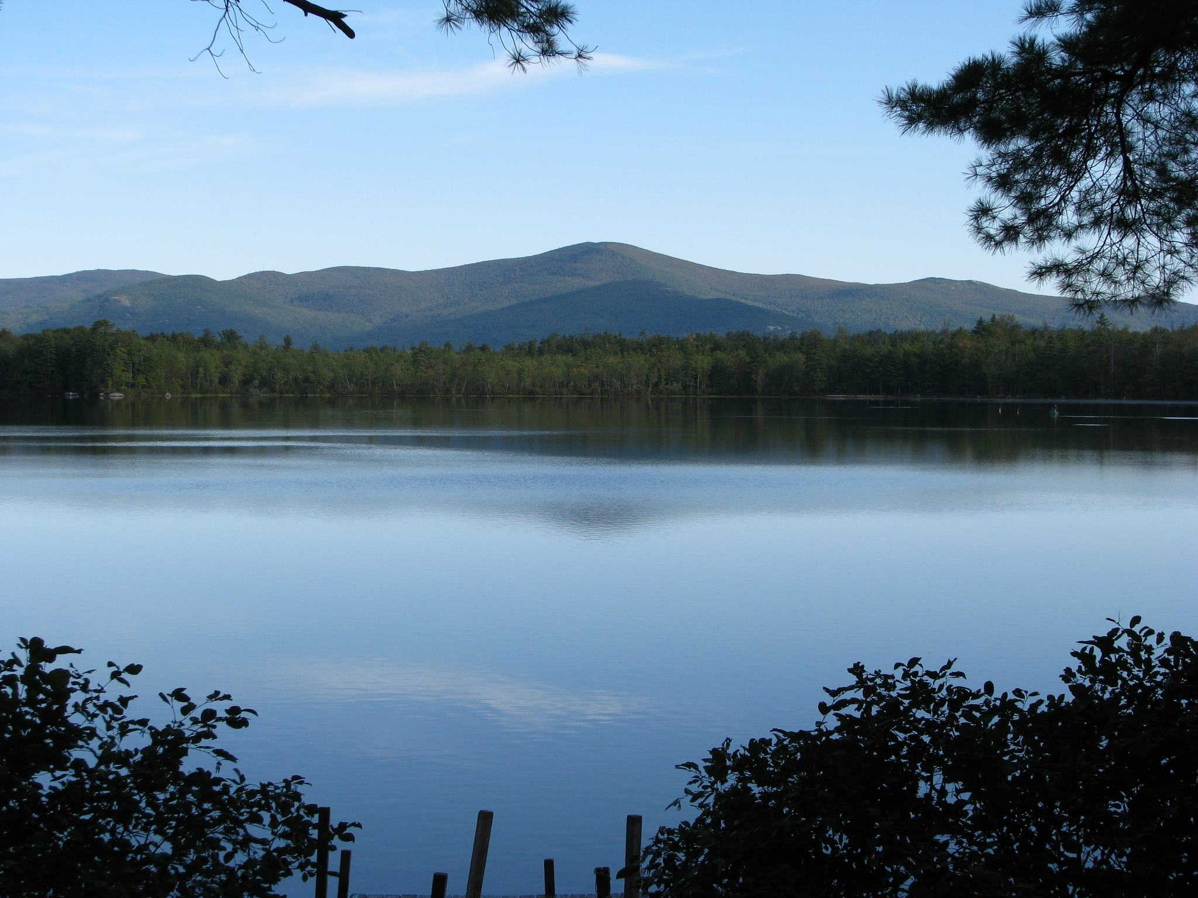
MLPA Website https://www.mirrorlakenh.org/

